Slide 1
Standardization of Western and Central North Pacific Swordfish (Xiphias gladius) Catch Per Unit Effort in the Hawai’i Longline Fishery from 1995–2021
ISC Billfish Working Group Data Preparatory Meeting for Western and Central North Pacific Swordfish, Yokohama, Japan, 28 November 2022
Erin Bohaboy and Michelle Sculley
NOAA Fisheries, Honolulu, Hawai'i

Slide 2
Data
Hawai'i Longline (Logbook)
June 1995 – December 2021
Catch, effort, operational details, environmental information
CPUE is count per 1000 hooks
Target species / sector indicated by hooks per float (HPF)
1995–2000, 11–14 HPF
573 sets (87.1% zeros)
Shallow-Set 1995–2000
Swordfish-targeting
≤10 HPF
24,233 sets (14.7% zeros)
Closed Feb 2001
Shallow-Set 2005–2021
Fishery re-opened May 2004
Swordfish-targeting
≤14 HPF
18,728 sets (1.1% zeros)
Deep-Set 1995–2021
Tuna-targeting
YOY swordfish as bycatch
≥15 HPF
380,885 sets (84.2% zeros)
Notes:
Hawai'i longline fishery historically targeted tuna, vessels began targeting swordfish and mixed species in 1990s
longlining for swordfish closed February 2001 due to high sea turtle (loggerhead and leatherback) bycatch
Longlining for swordfish reopened in May 2004 with clear definitions of deep- vs. shallow-sets
Shallow-sets required 100% observer coverage
stated target species for each set: tuna, billfish, mixed.
majority of 95-2000 sets with 11-14 hooks stated target was Tunas, but we want to avoid having a break in the deep-set time-series

Slide 3
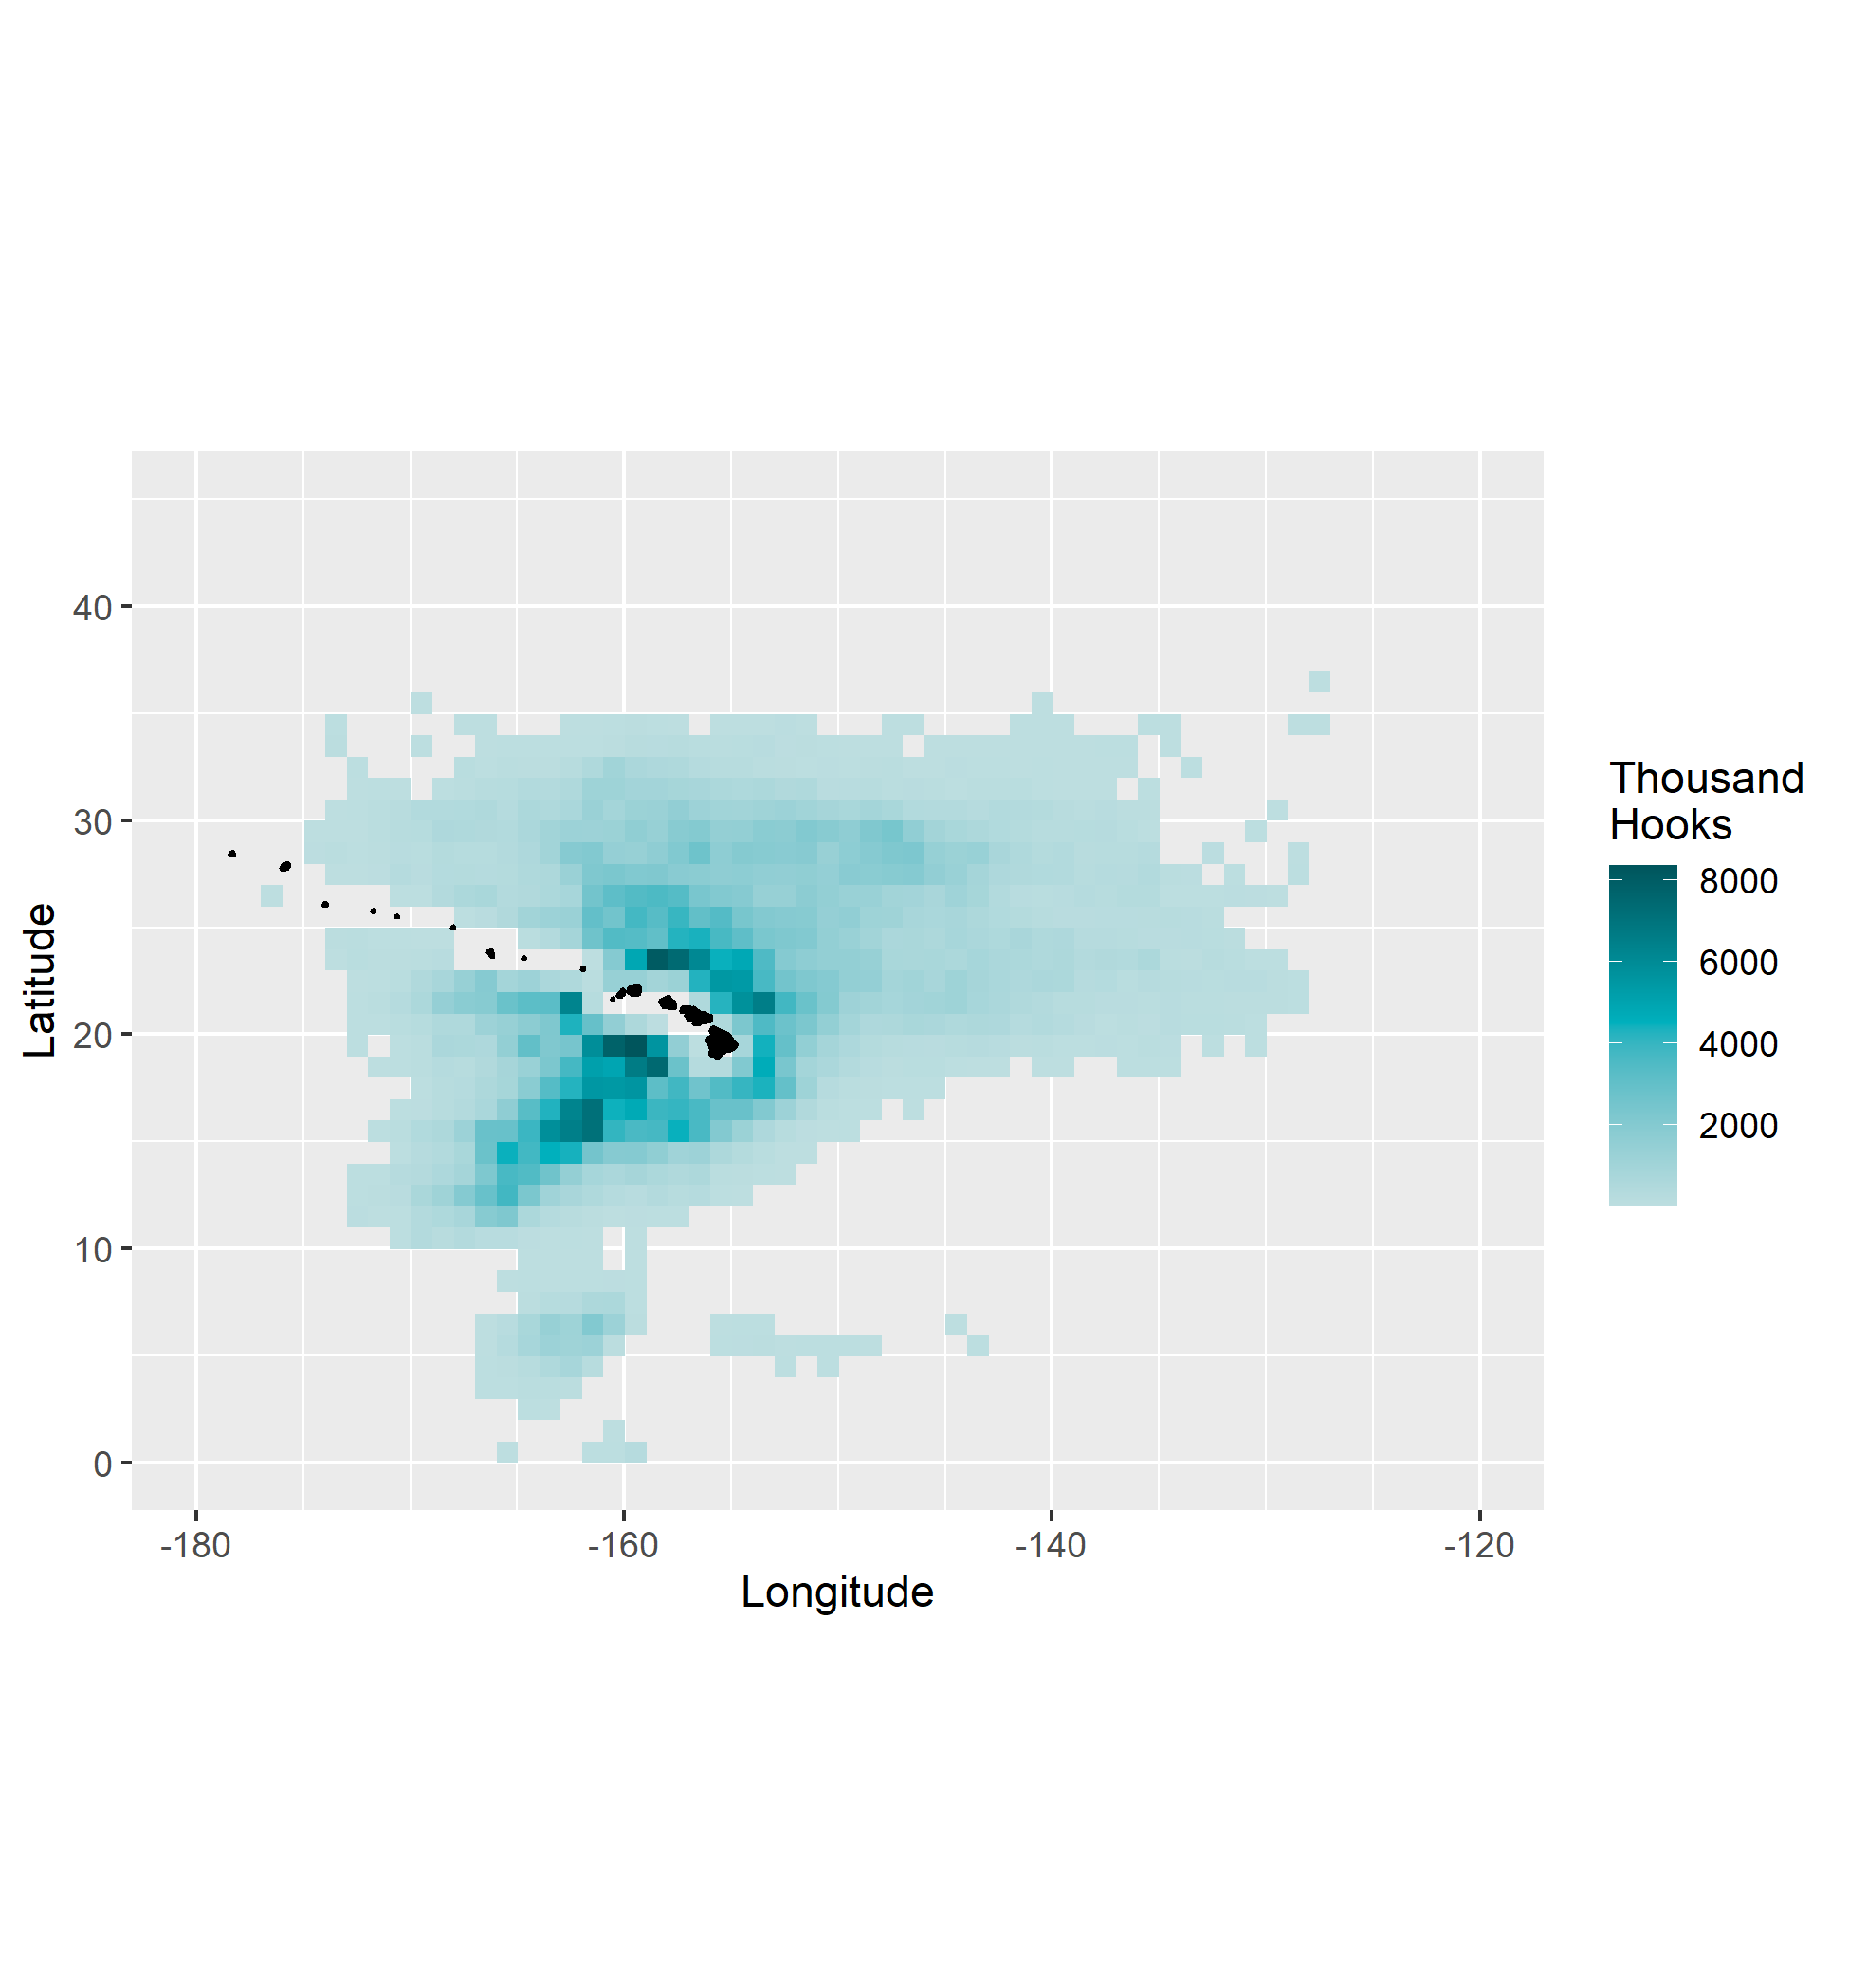
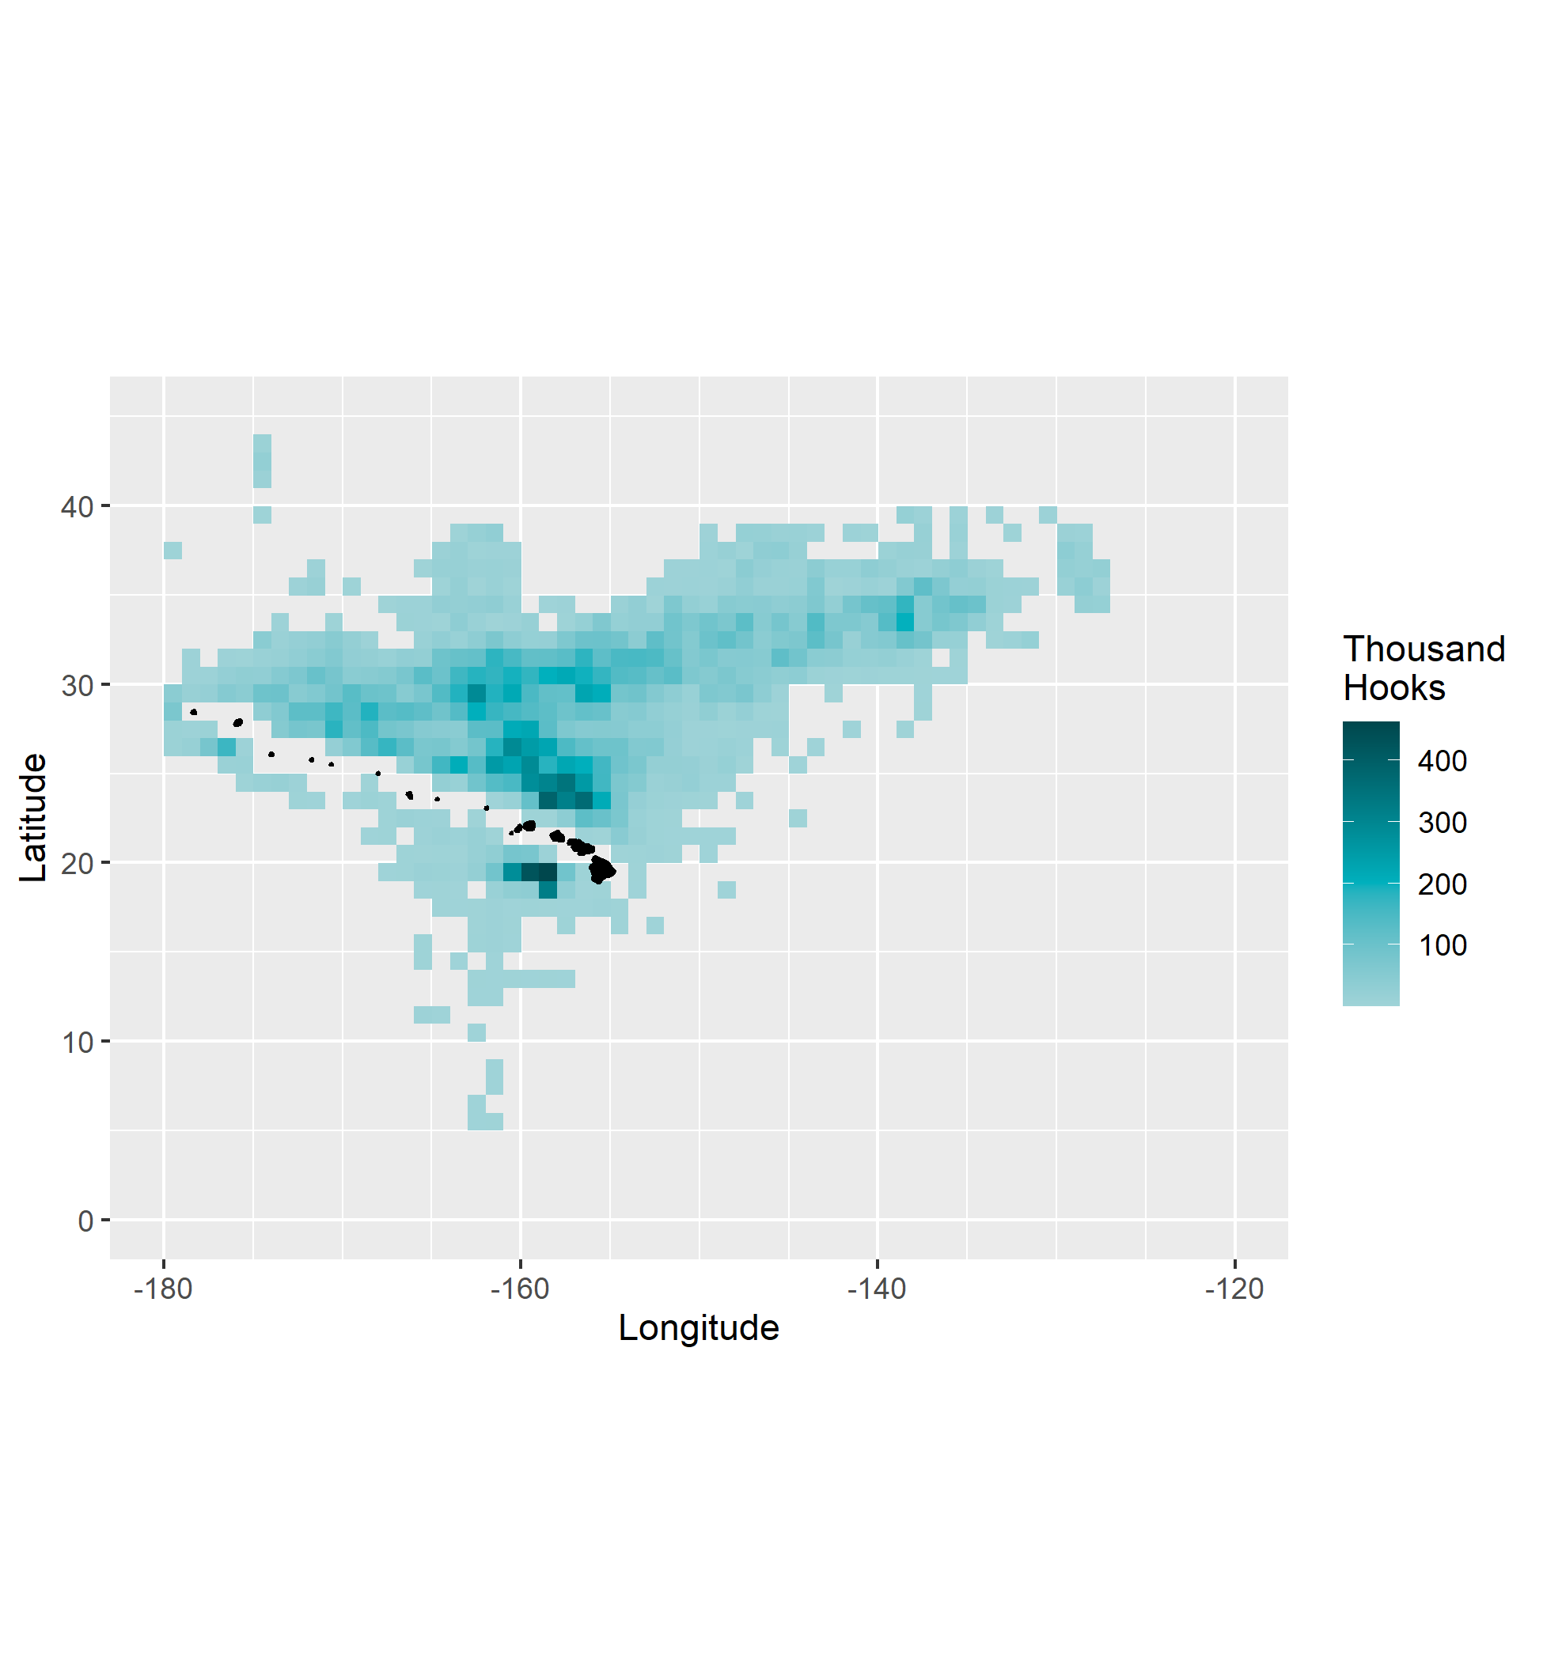
Shallow-Set / Swordfish-Targeting
Deep-Set / Tuna-Targeting
Total Effort (thousand hooks)
1995–2021
Total Effort (thousand hooks)
1995–2021

Slide 4
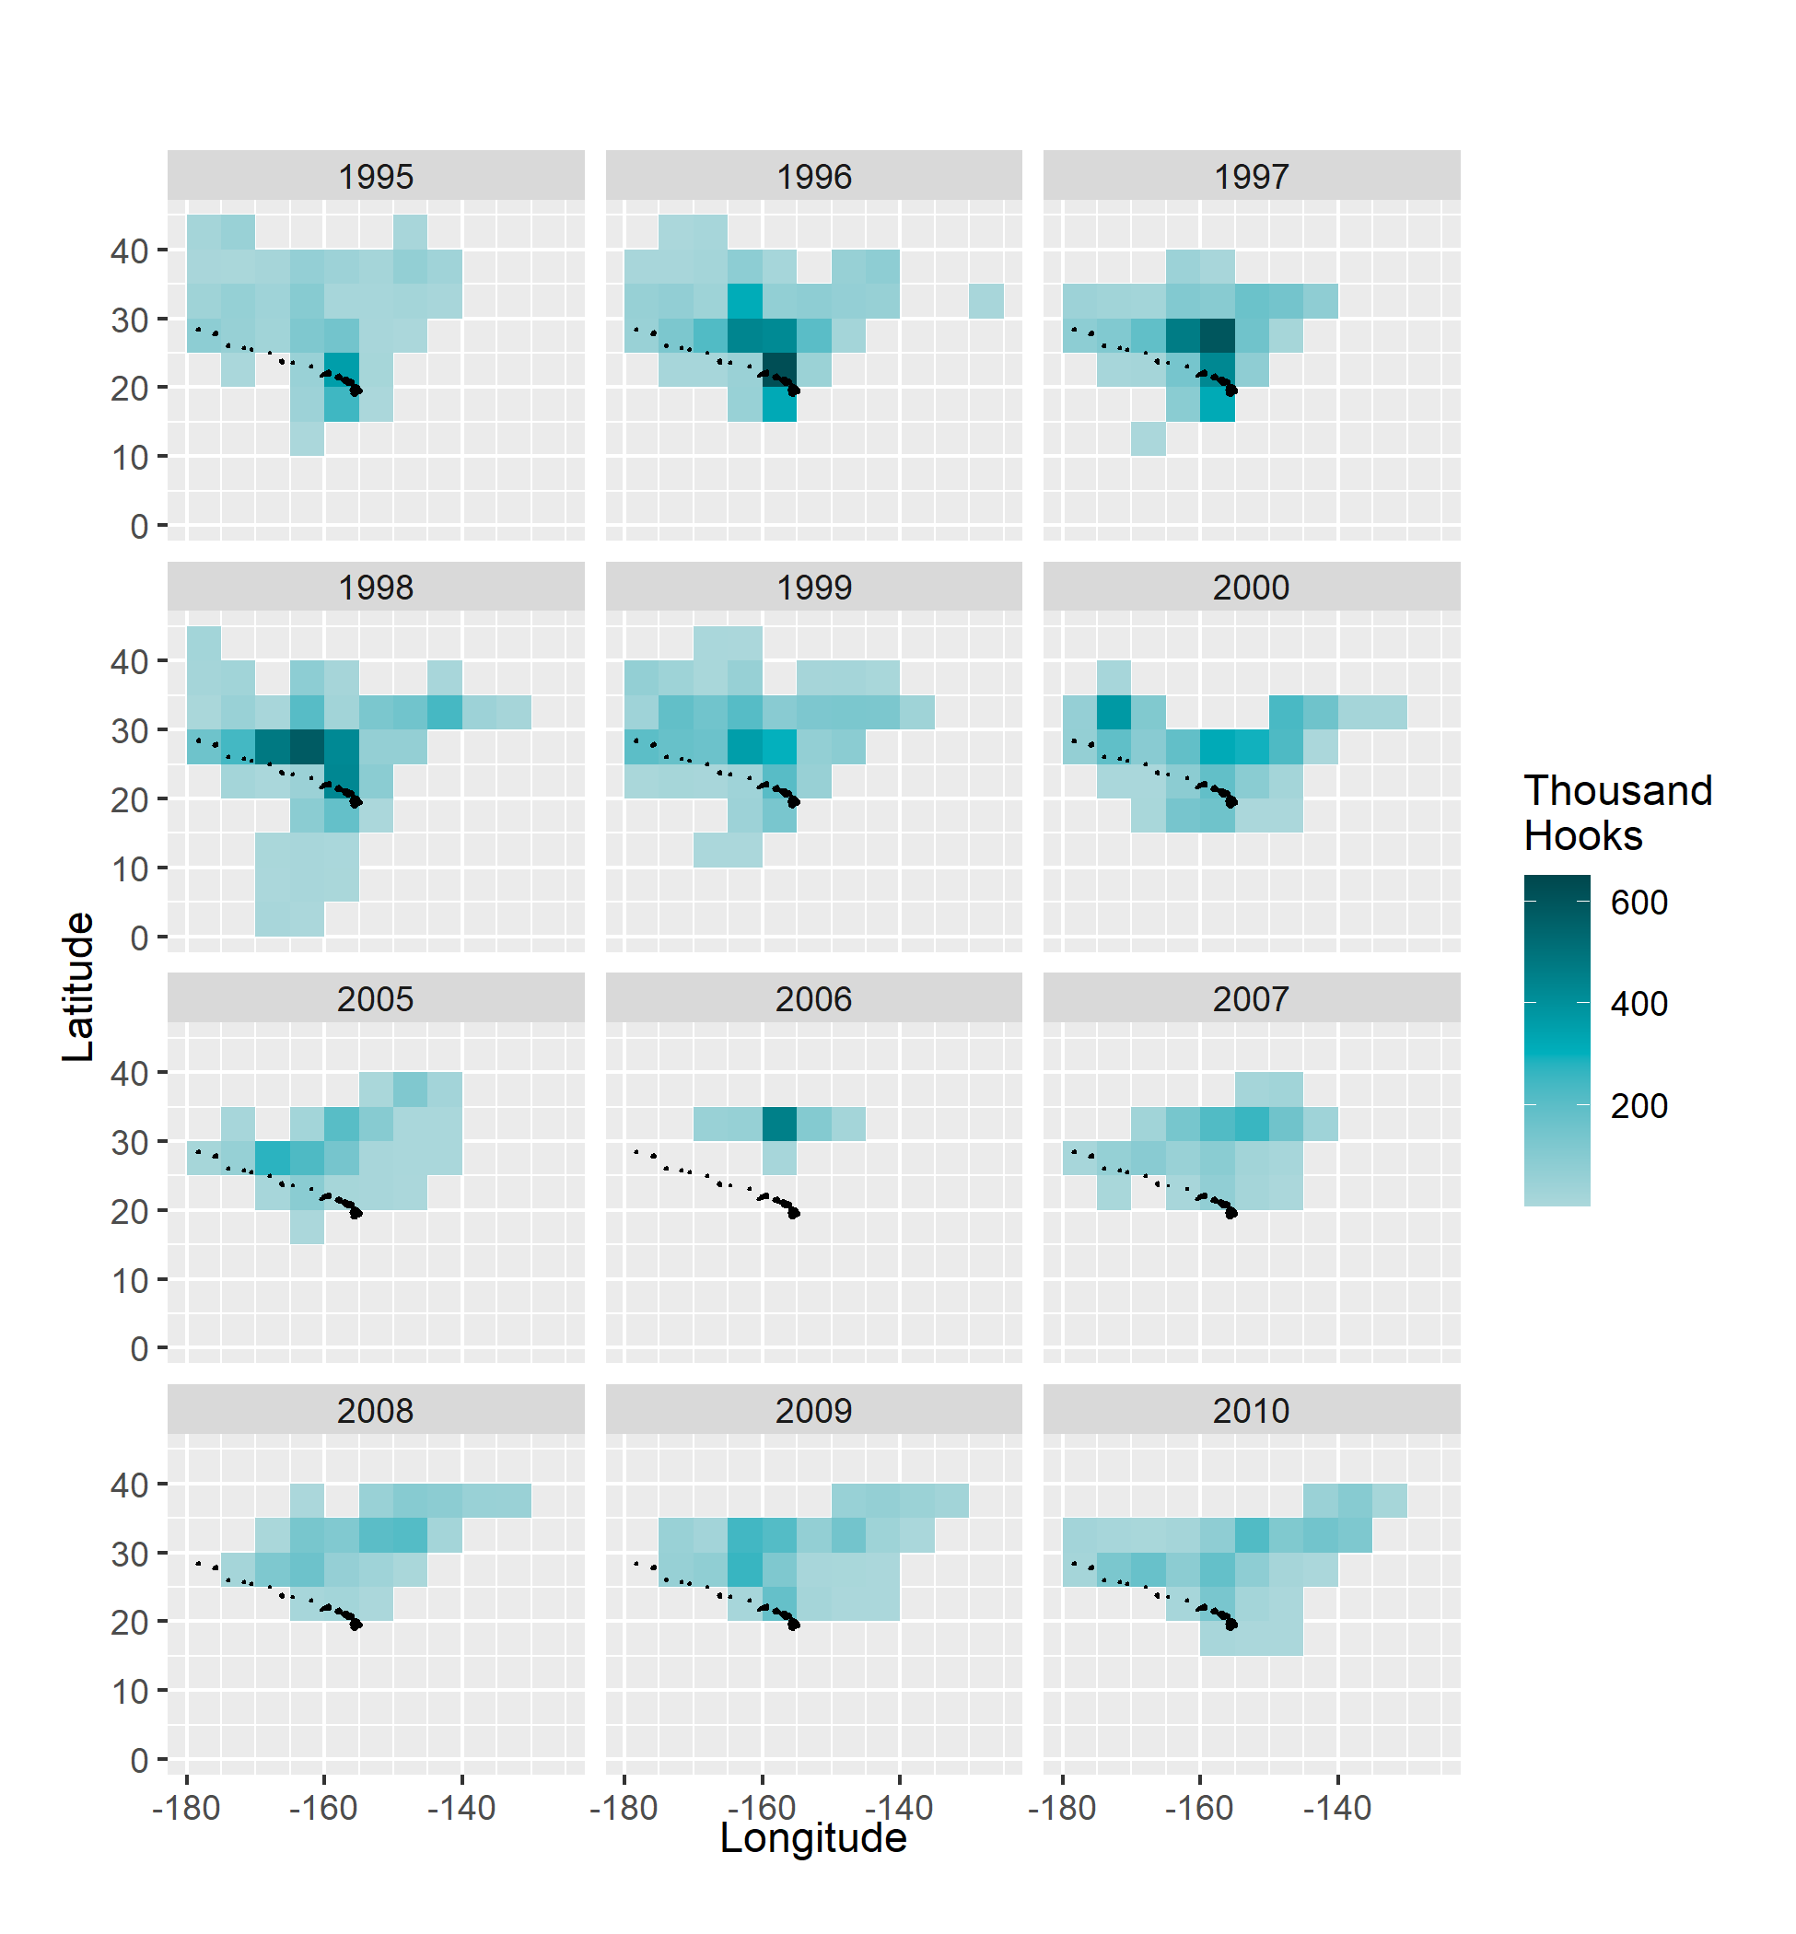
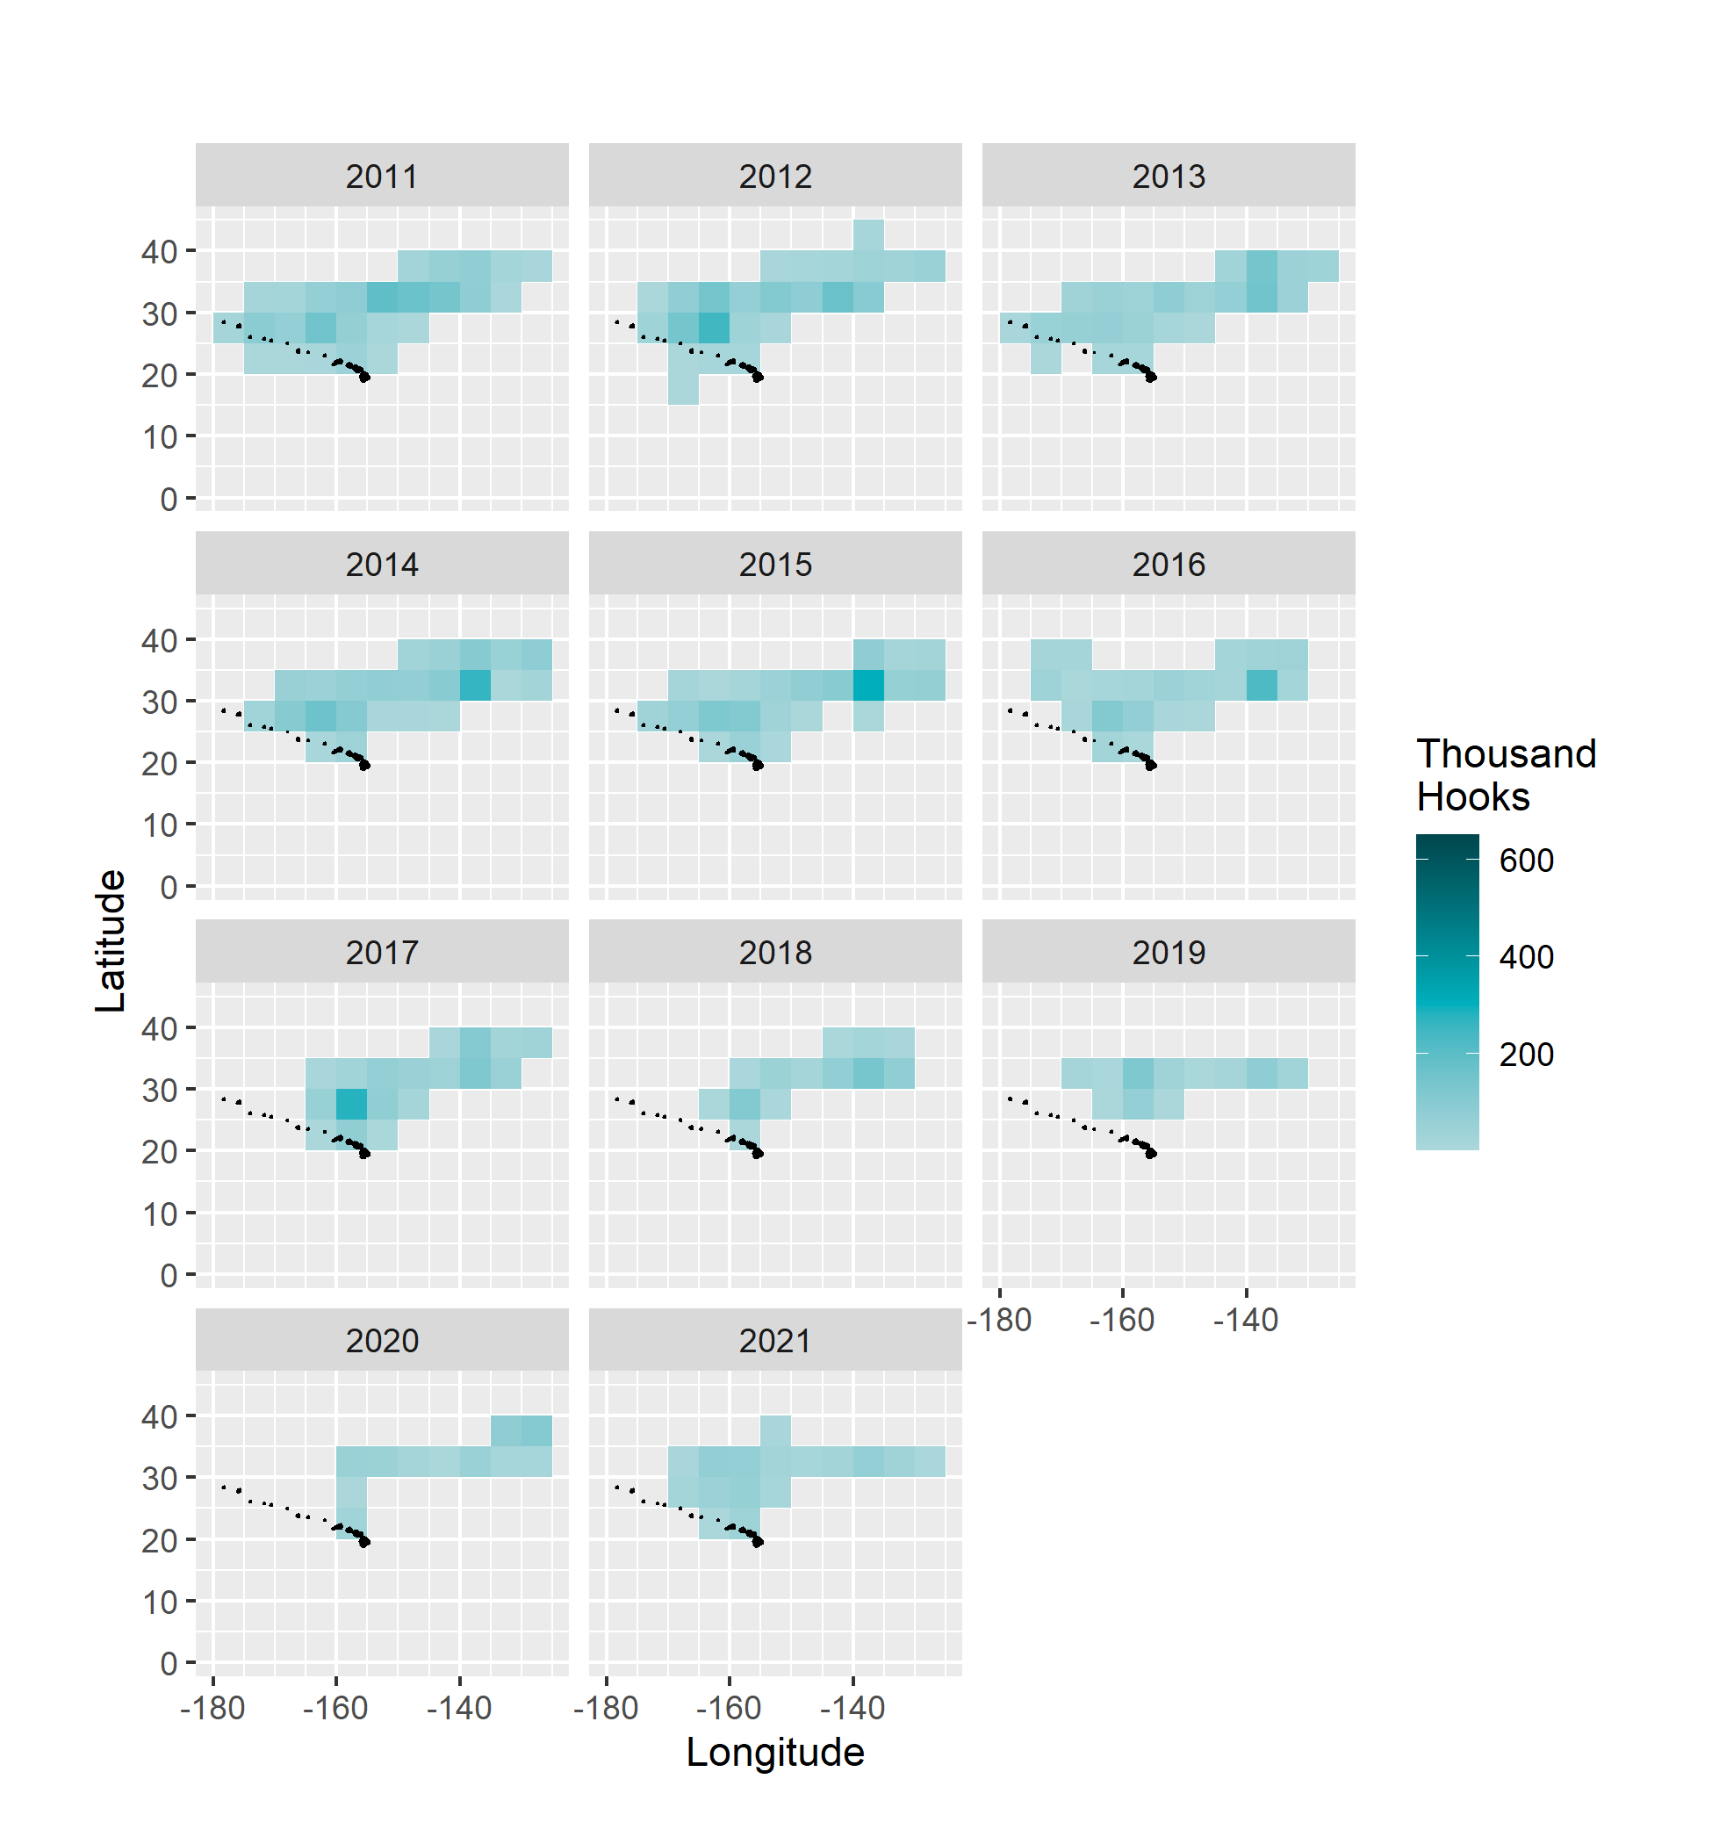
Shallow-Set / Swordfish-Targeting: Effort (thousands hooks) by Year

Slide 5
Model
Presence/absence (Binomial) × positive (Lognormal) processes
General Additive Mixed-Effects (R package 'gamm4')
Vessel Permit number = random effect
Forward stepwise model selection with covariates
Lowest AIC, significant likelihoods ratio test statistic, stop when deviance explained < 0.25%
Index prediction using marginal means (Walter's Large Table; year × month × operational)
Spatial / Temporal
Latitude
Longitude
Time of year (1–366)
Time of day (begin set, 0–23)
Environmental
Moon phase (0–1)
Sea surface temperature (SST)
Mixed-layer Depth (MLD)
Southern Oscillation Index (SOI)
Pacific Decadal Oscillation (PDO)
Operational
HPF
Bait type
Notes:
reminder: the working hypothesis in exploring environmental covariates in the CPUE standardization is that these are effecting catchability of the fishing fleet, not underlying abundance trends.

Slide 6
Selected Models
Process | Model Covariates | % Deviance Explained
Shallow-Set, 1995–2000 (14.7% zeros)
Presence / Absence | s(Hour) + s(Yday) + s(Lat) + HPF | 48.4
Positive | s(Lat) + s(Yday) + s(Moon) + s(Lon) + s(Hour) + HPF | 48.9
Shallow-Set 2005–2021 (1.1% zeros)
Positive | s(Moon) + s(Yday) + SST + s(Lon) + s(Lat) | 34.4
Deep-Set 1995–2021 (84.2% zeros)
Presence / Absence | s(Yday) + SST + s(Lat) | 8.8
Positive | s(Hour) + s(Yday) + Bait + s(Lat) + SST + HPF | 30.9
Notes:
All models included Year and random intercept for Permit ##
A few comments on the selected covariates:
Time of year selected in all models as first or second term
Time of day in all models except deep-set presence/absence
Latitude or Latitude+Longitude in all models: I did consider the tensor product Lat*Lon, it was marginal for inclusion and not very informative
Moon phase was selected early in shallow-set positive process (more important than time of year for later series).
Environmental variables (MLD, large-scale indices PDO and SOI) never selected. SST selected in deep-set but was only slightly influential

Slide 7
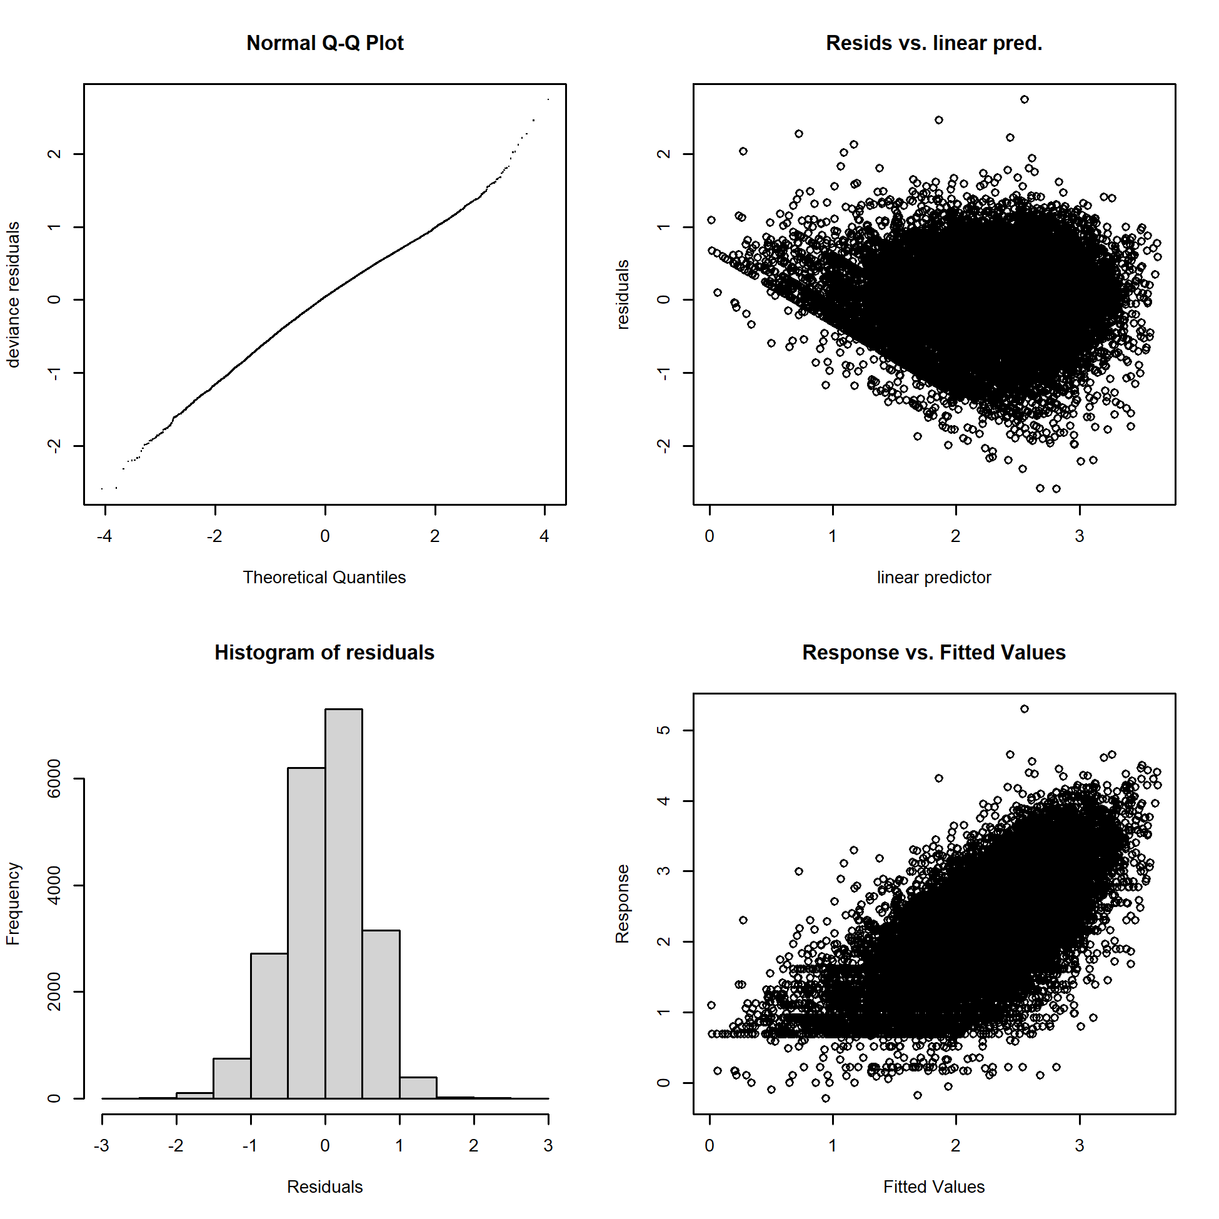
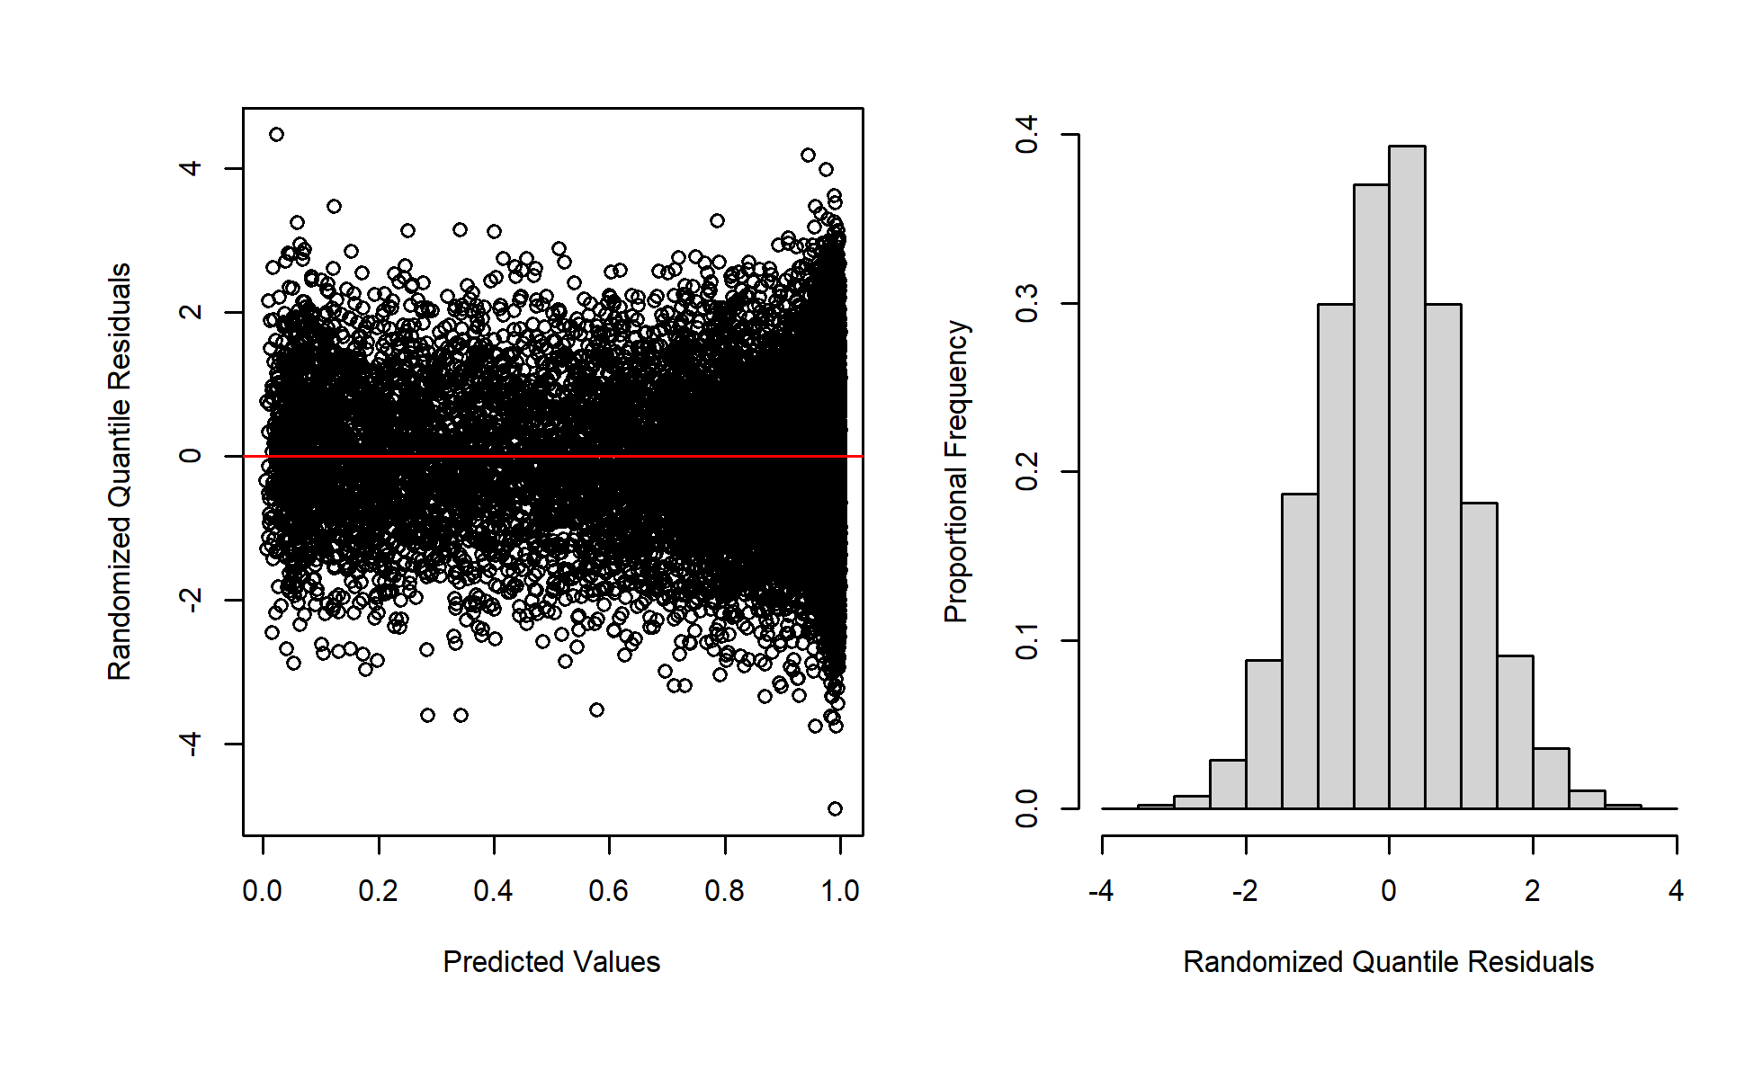
Diagnostics: Shallow-Set 1995–2000
Positive (Lognormal)
Presence/Absence (Binomial)

Slide 8
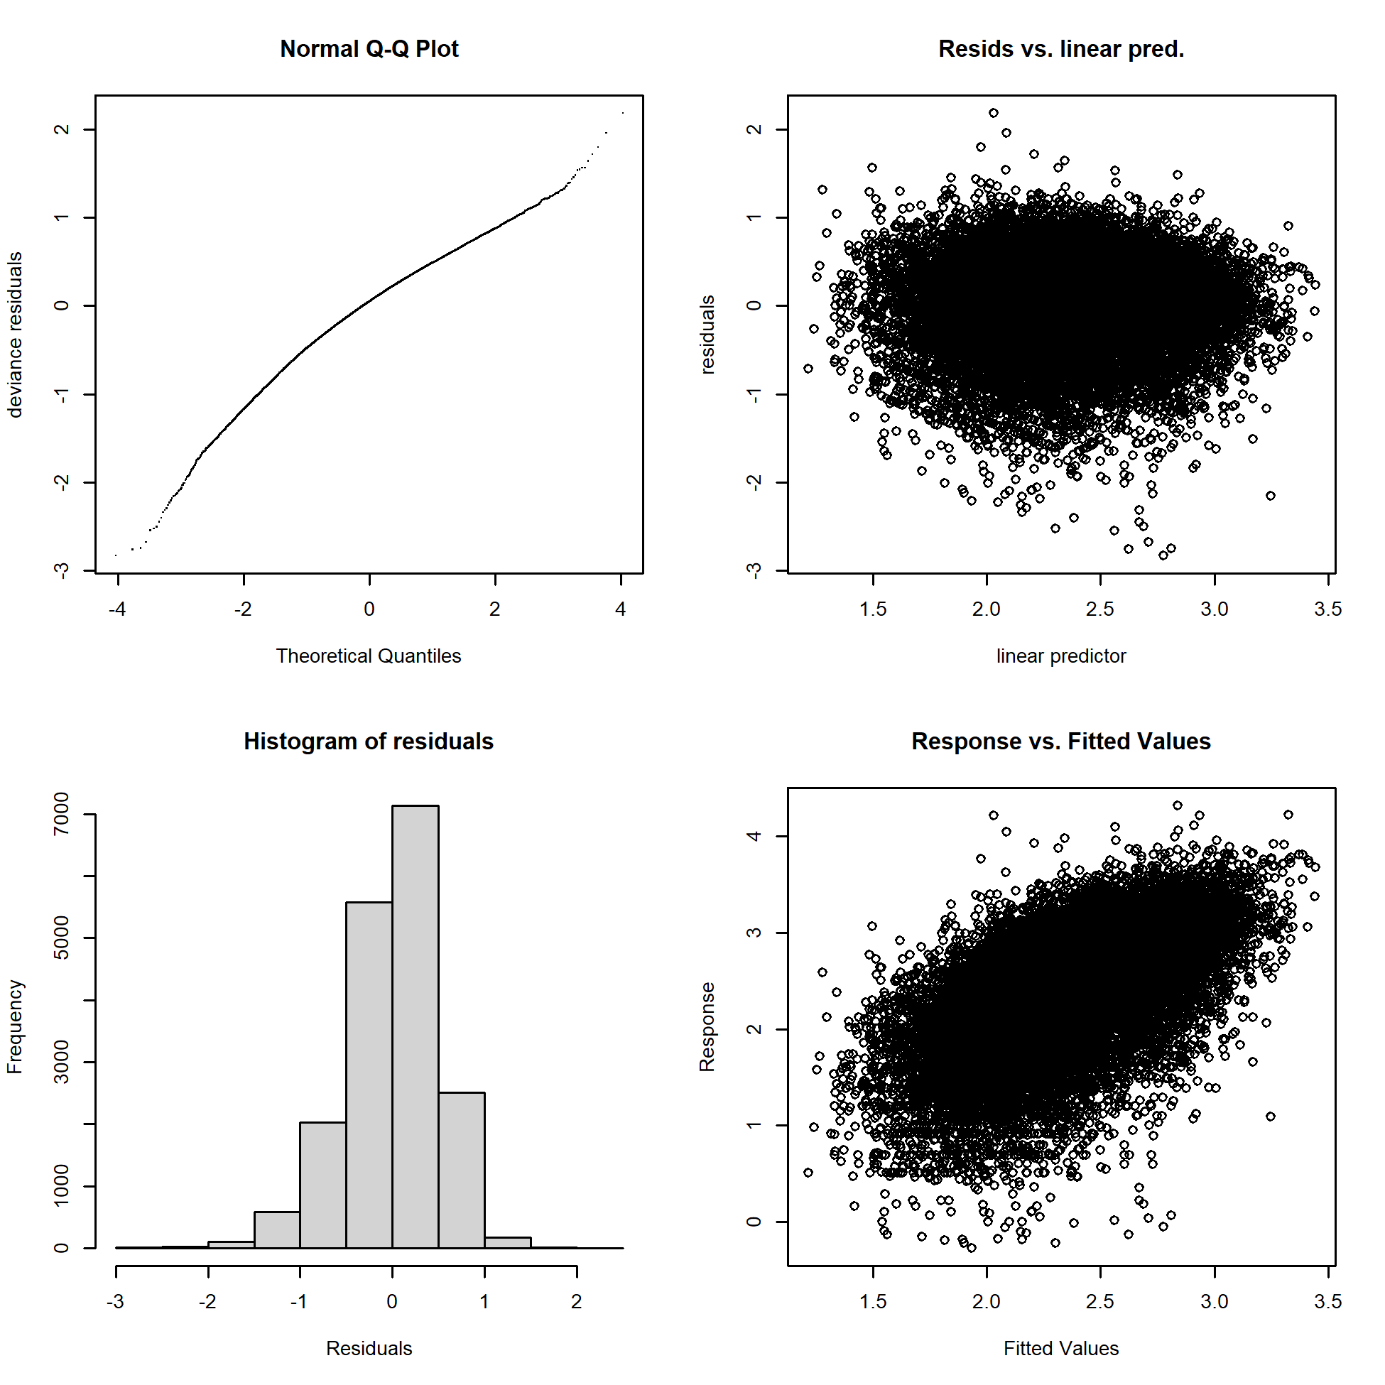
Diagnostics: Shallow-Set 2005–2021
Positive (Lognormal)
No Presence/Absence Model

Slide 9
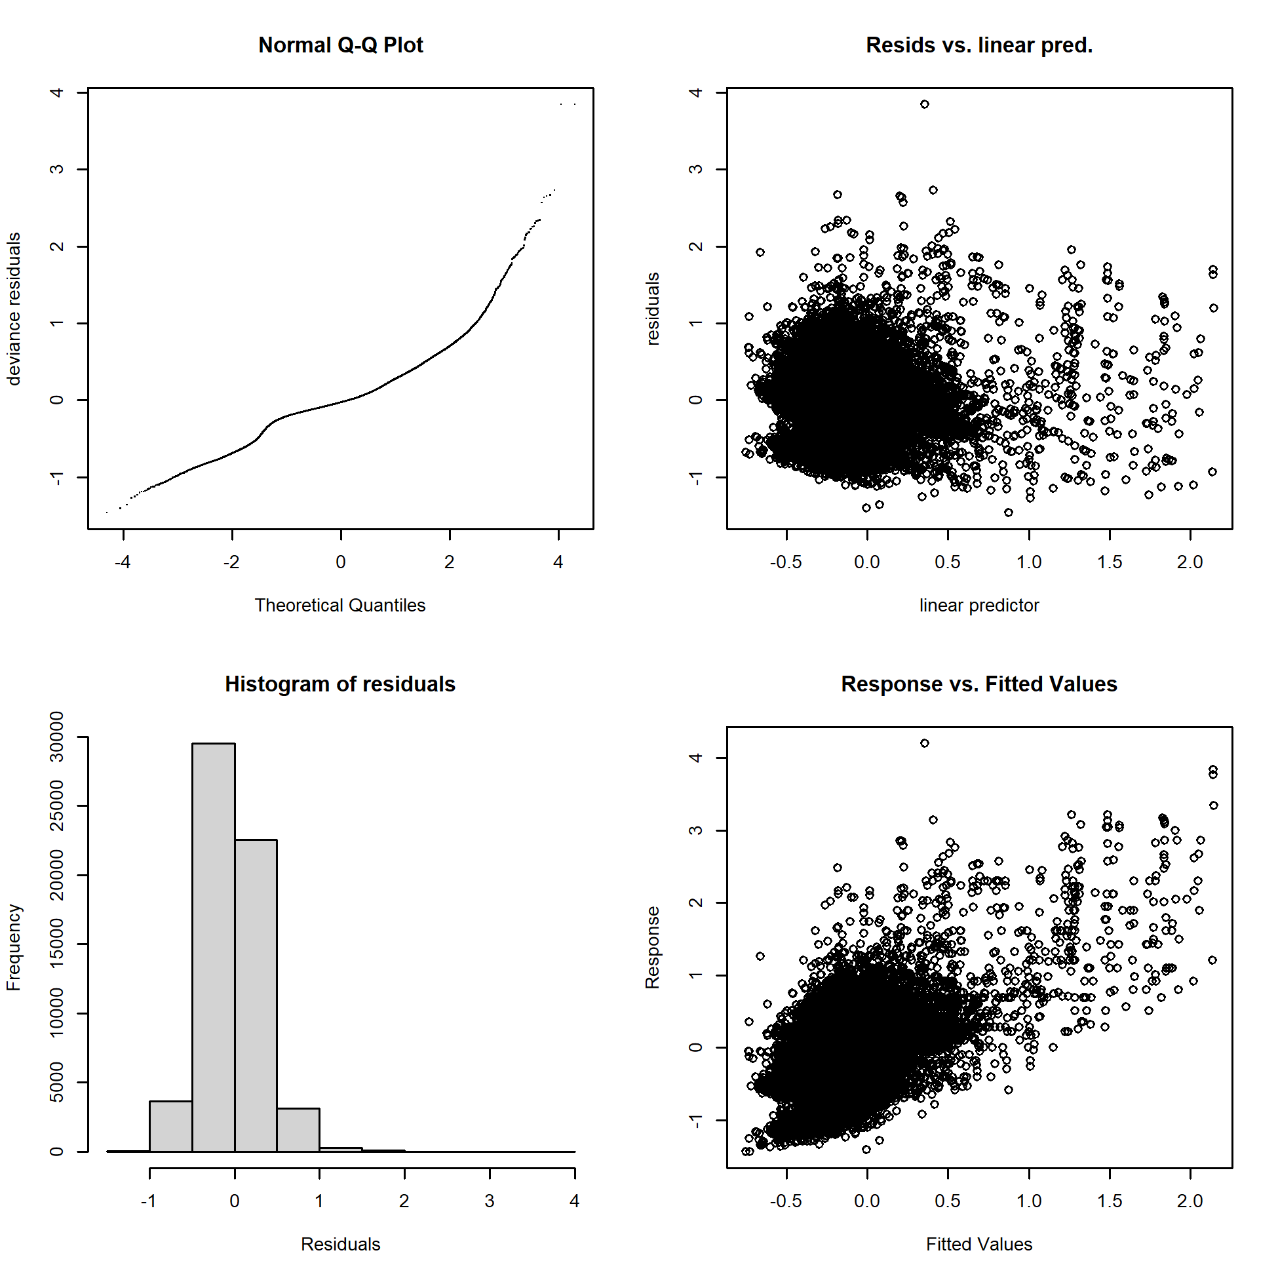
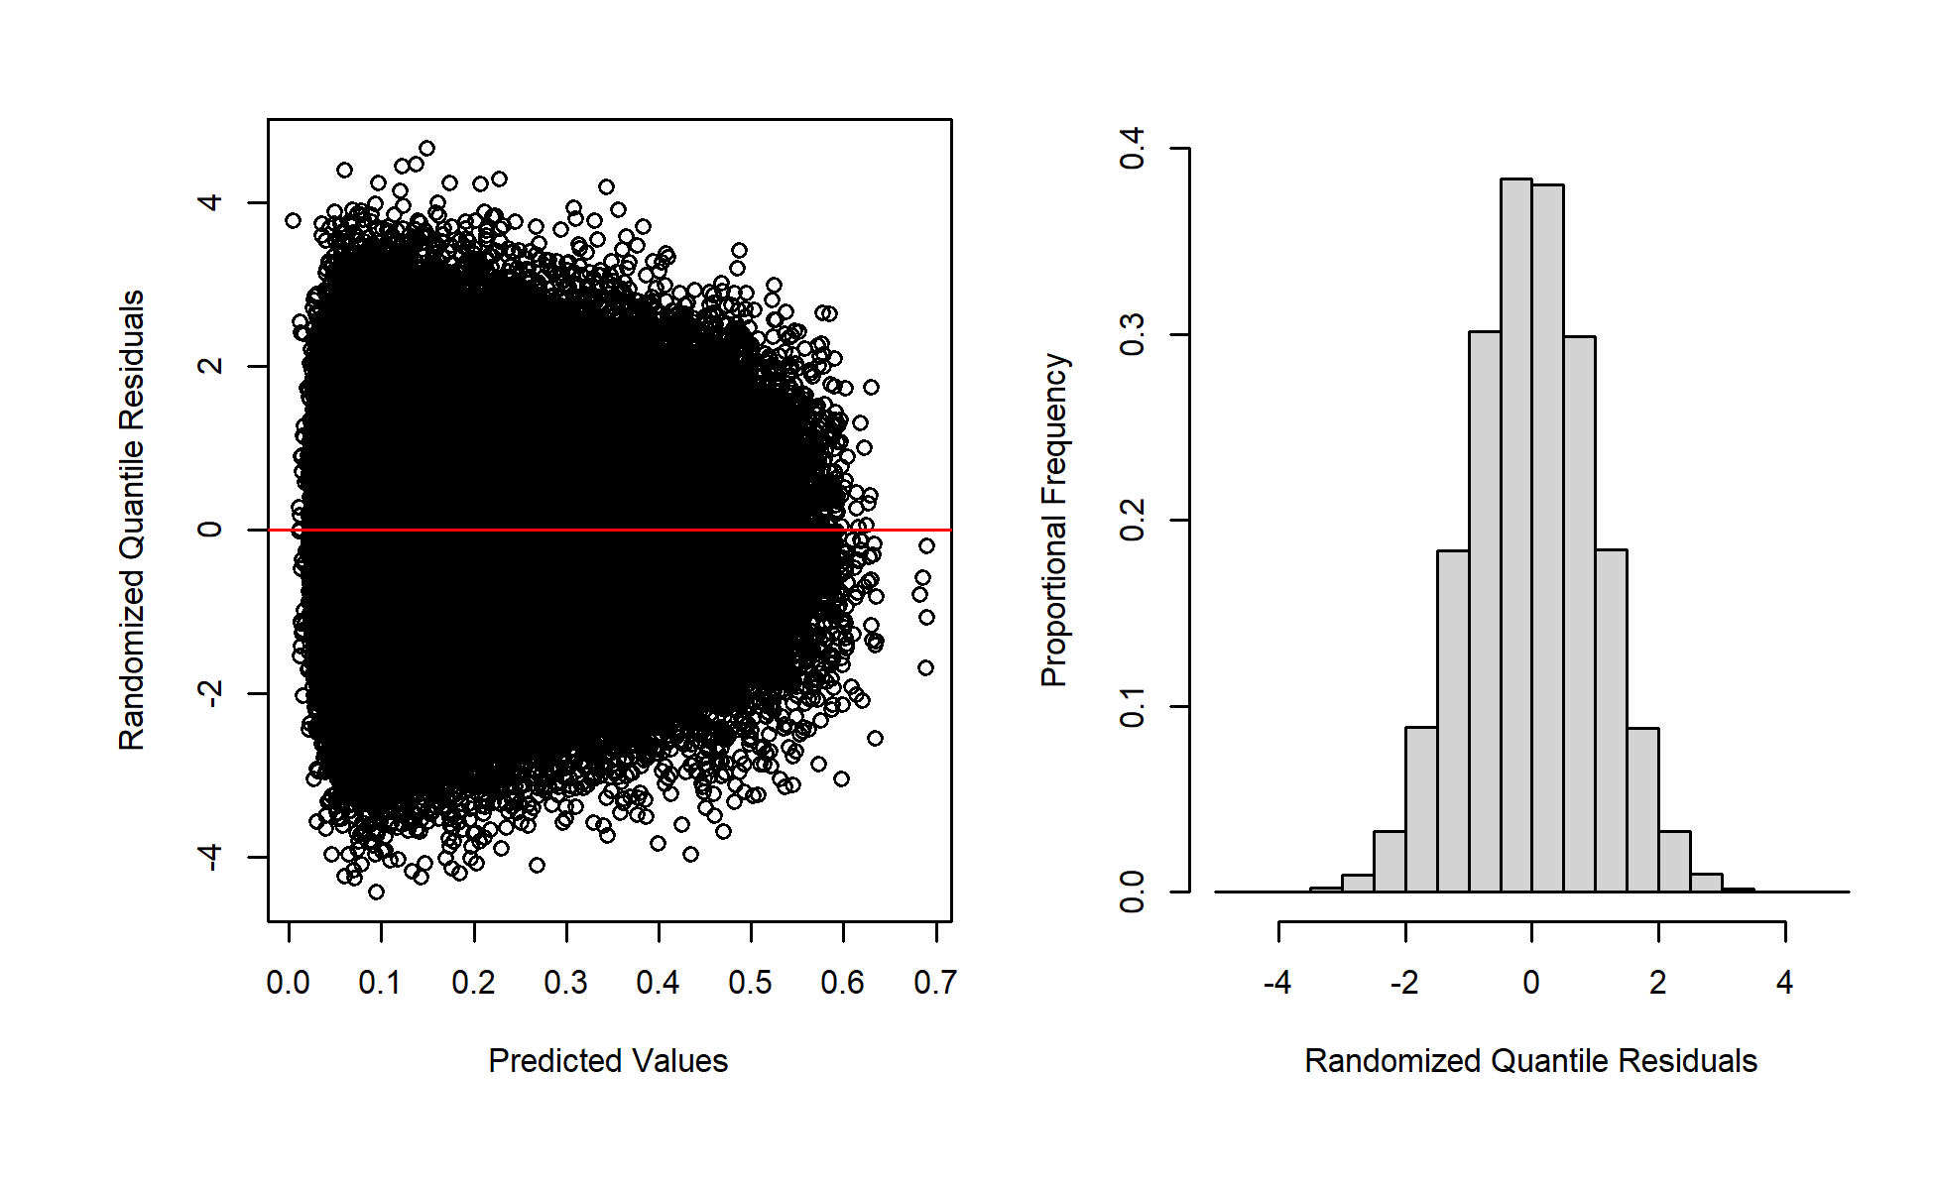
Diagnostics: Deep-Set 1995–2021
Positive (Lognormal)
Presence/Absence (Binomial)

Slide 10
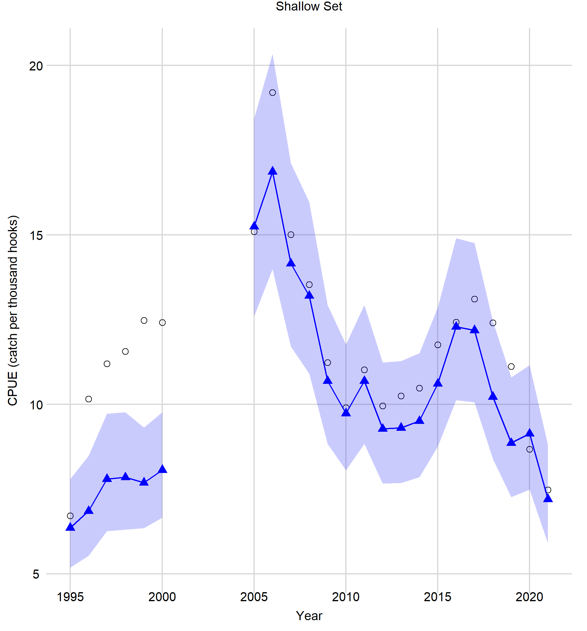
Standardized Index: Shallow-Set
Nominal
Standardized
95% CI

Slide 11
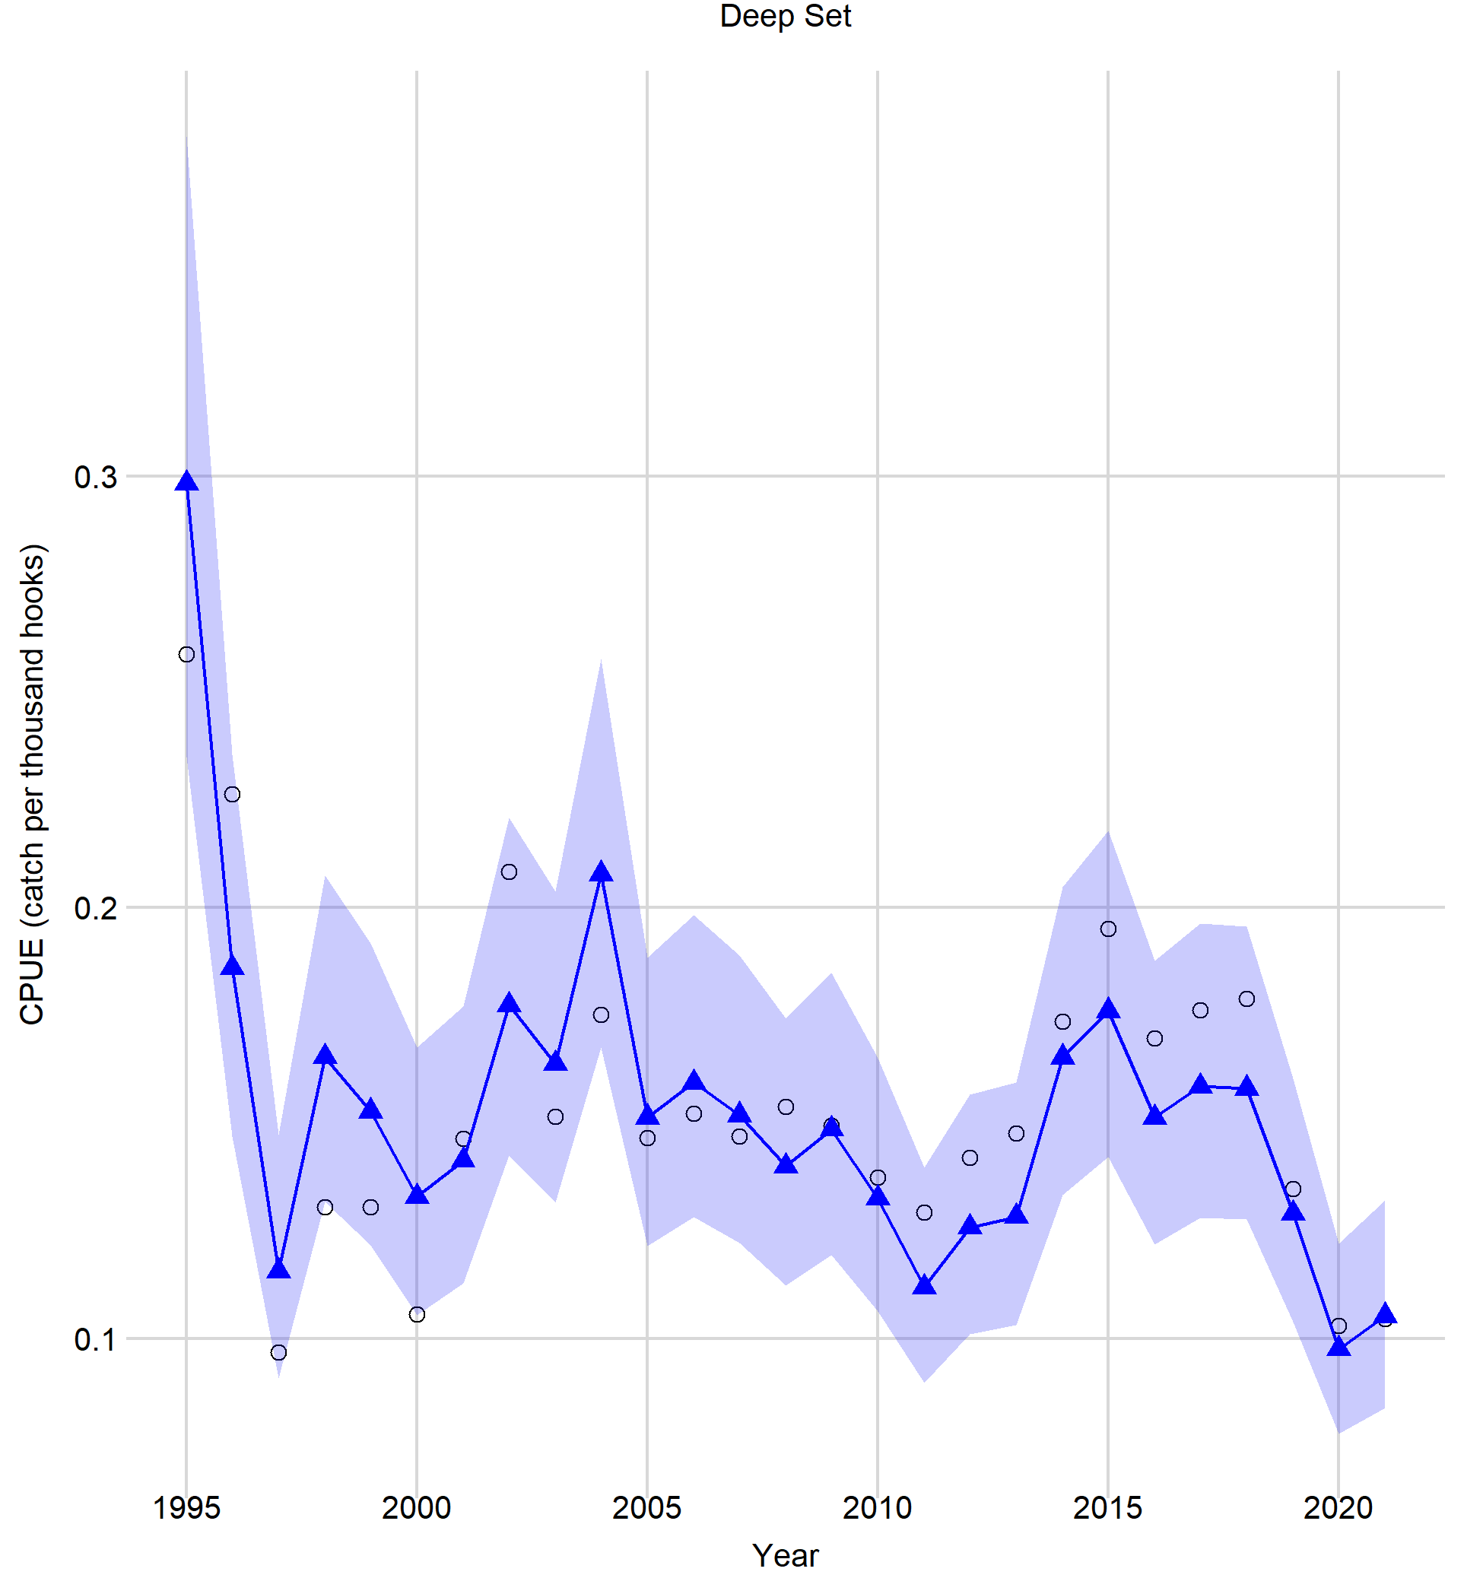
Standardized Index: Deep-Set
Nominal
Standardized
95% CI

Slide 12
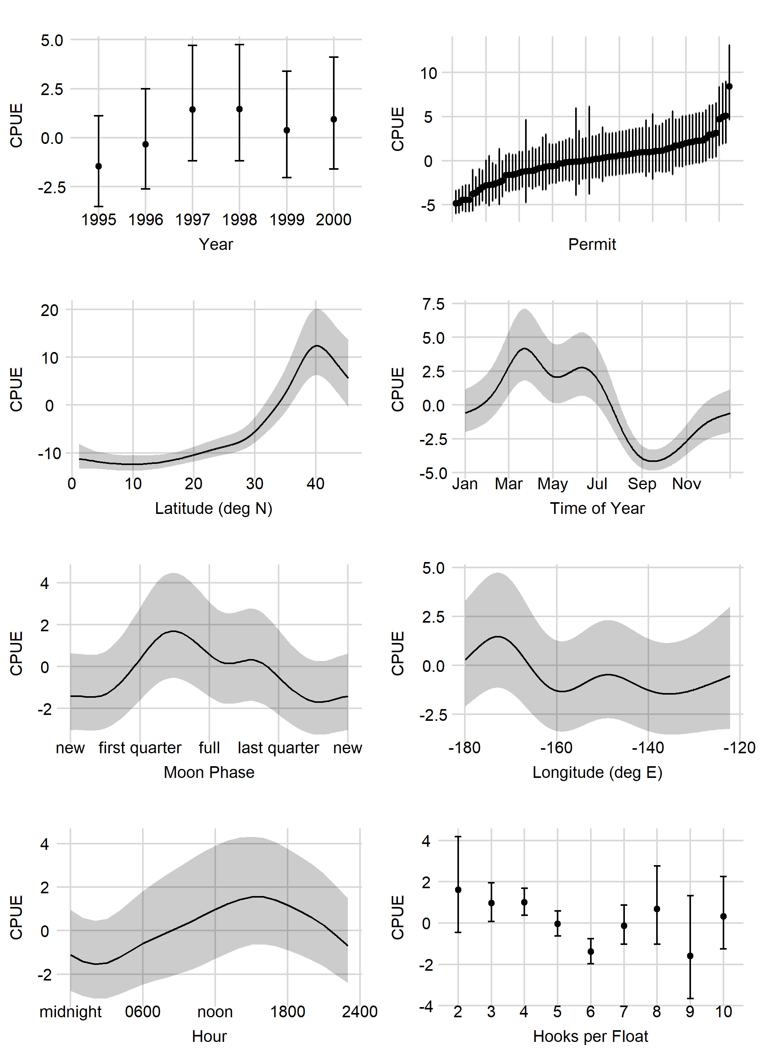
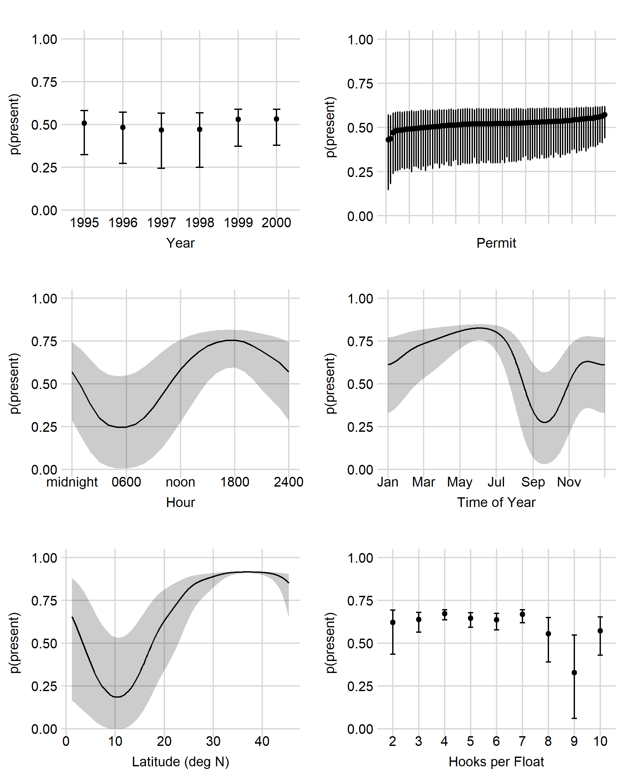
Shallow-Set 1995–2000
Presence/Absence (Binomial)
Positive (Lognormal)

Slide 13
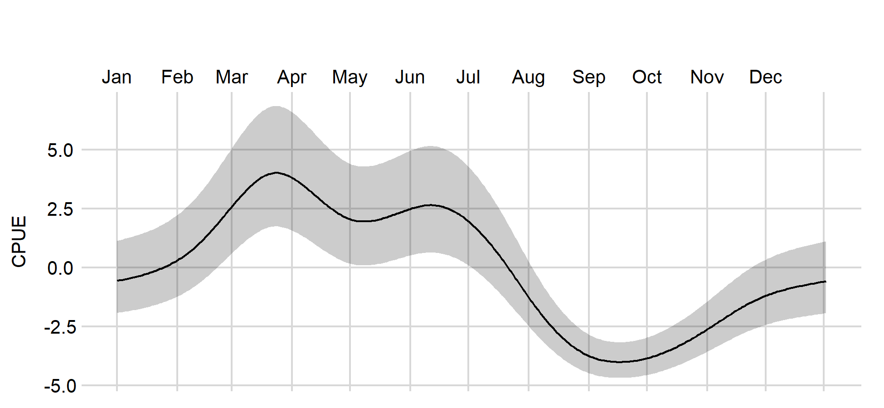

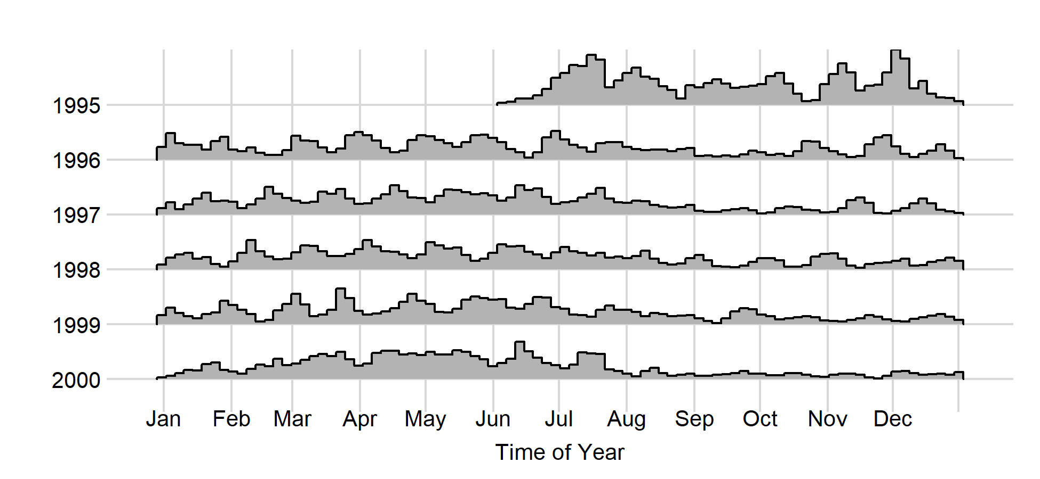
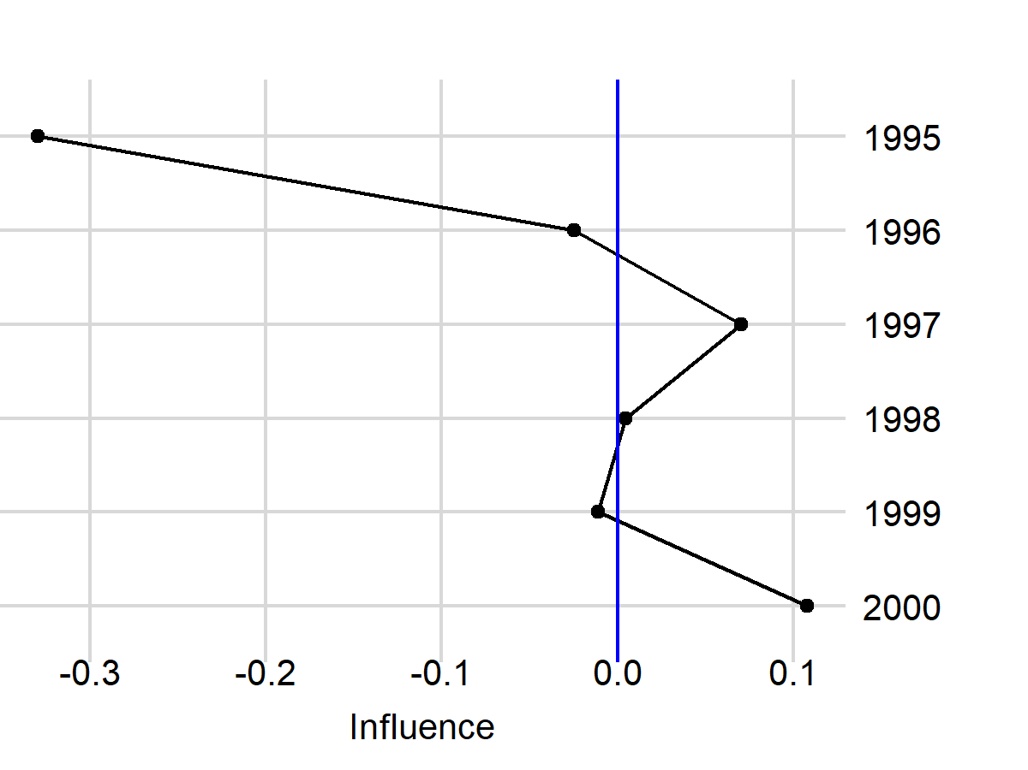
Shallow-Set 1995–2000, Positive Process, Time of Year
Marginal Effects
Year
Number of Sets
Influence of Time of Year

Slide 14
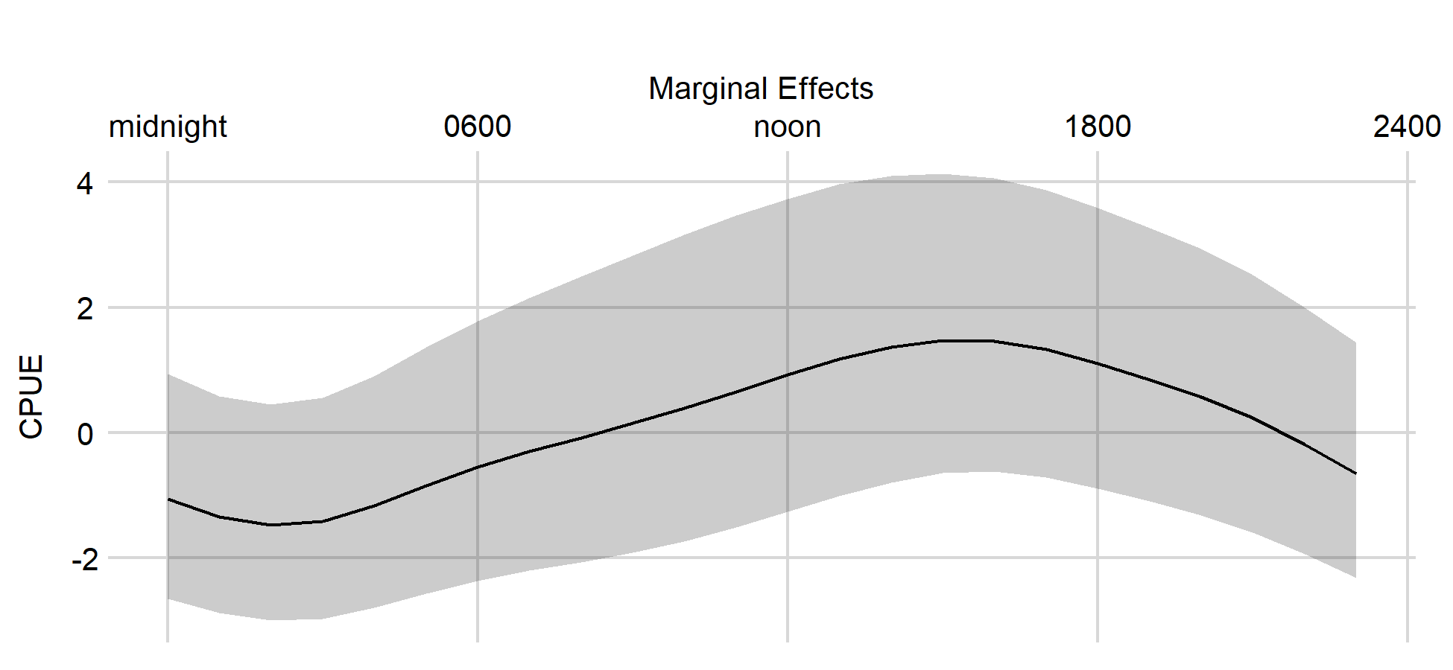
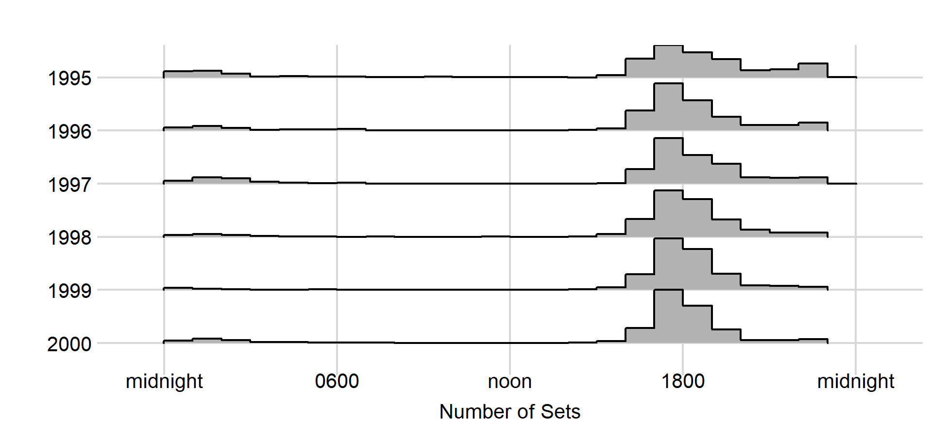
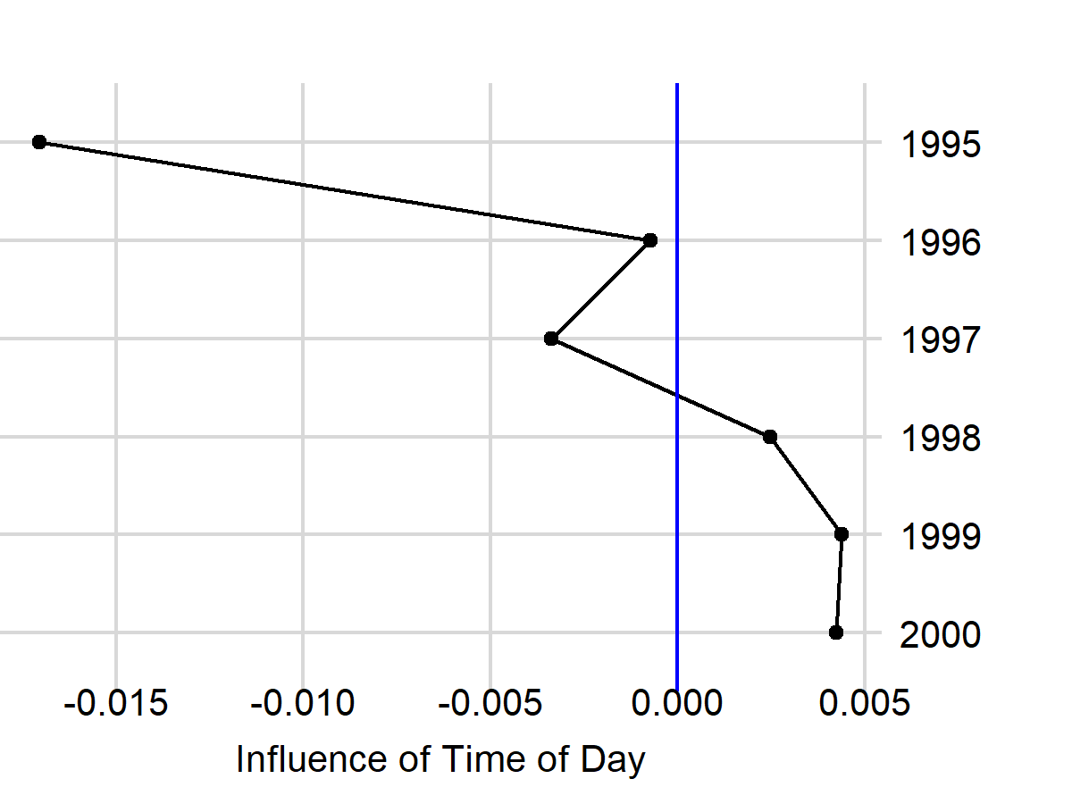
Shallow-Set 1995–2000, Positive Process, Time of Day

Slide 15
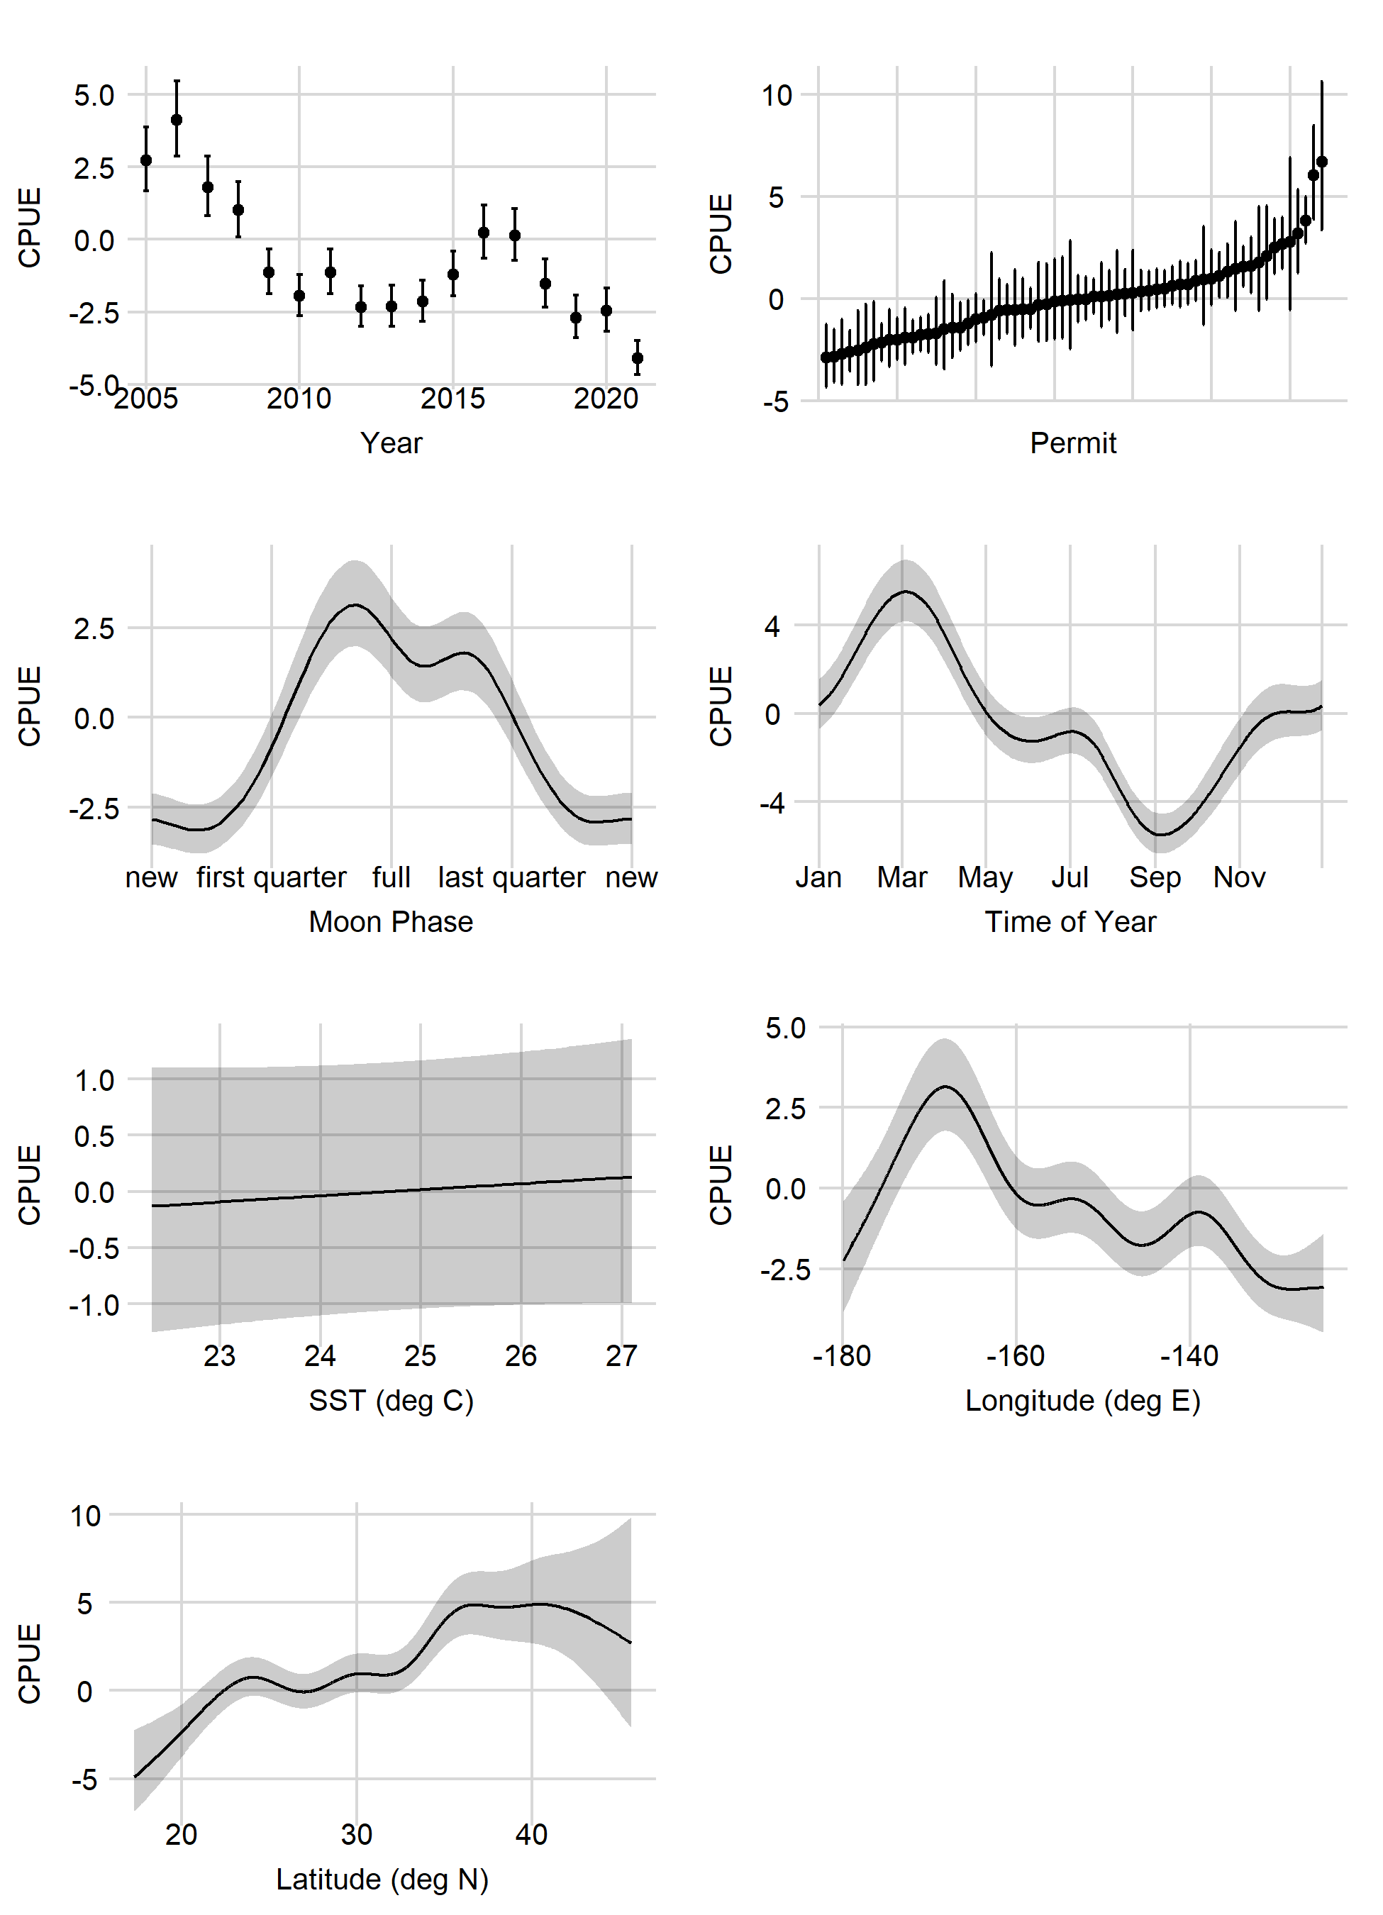
Shallow-Set 2005–2021
No Presence/Absence Model
Positive (Lognormal)

Slide 16
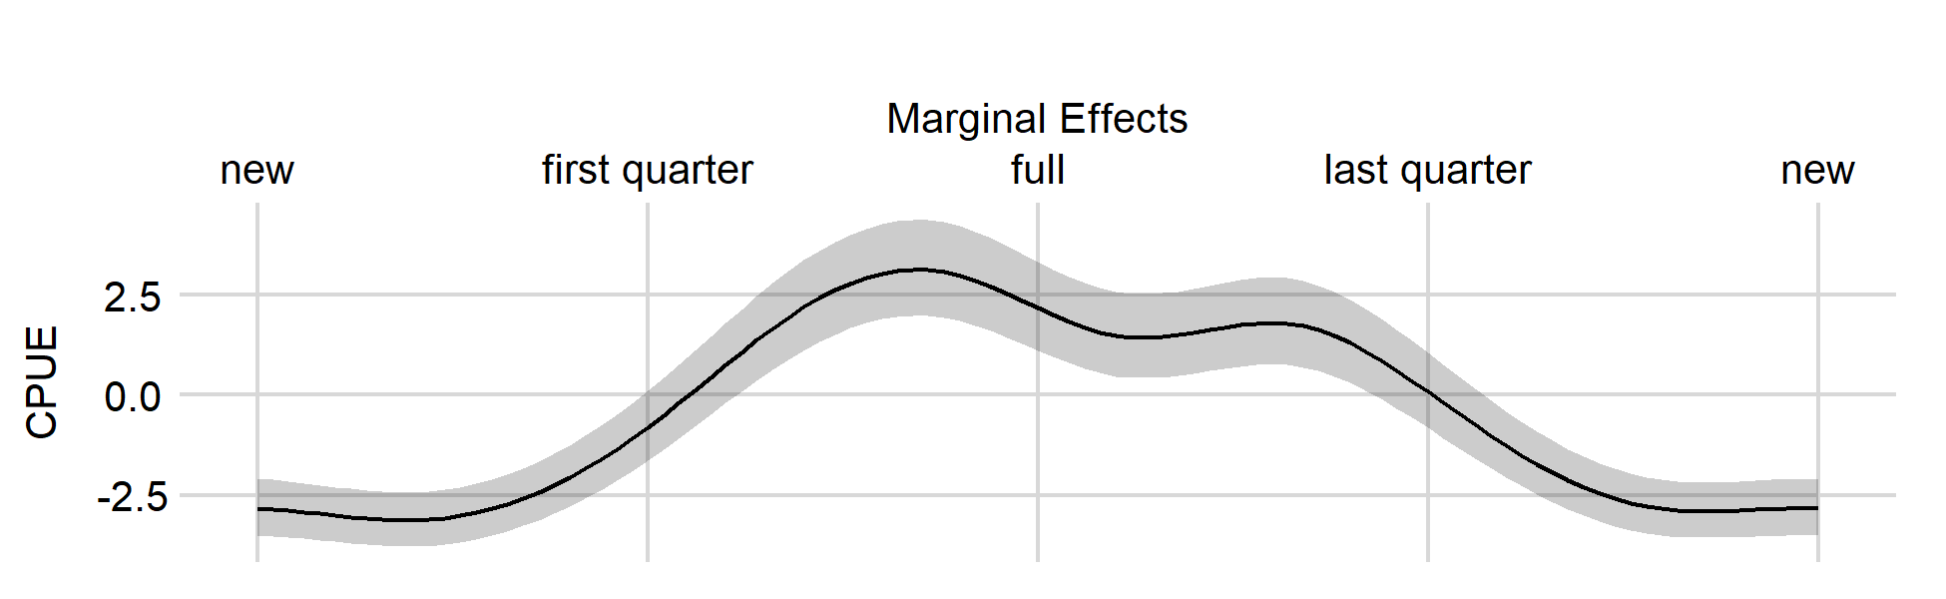
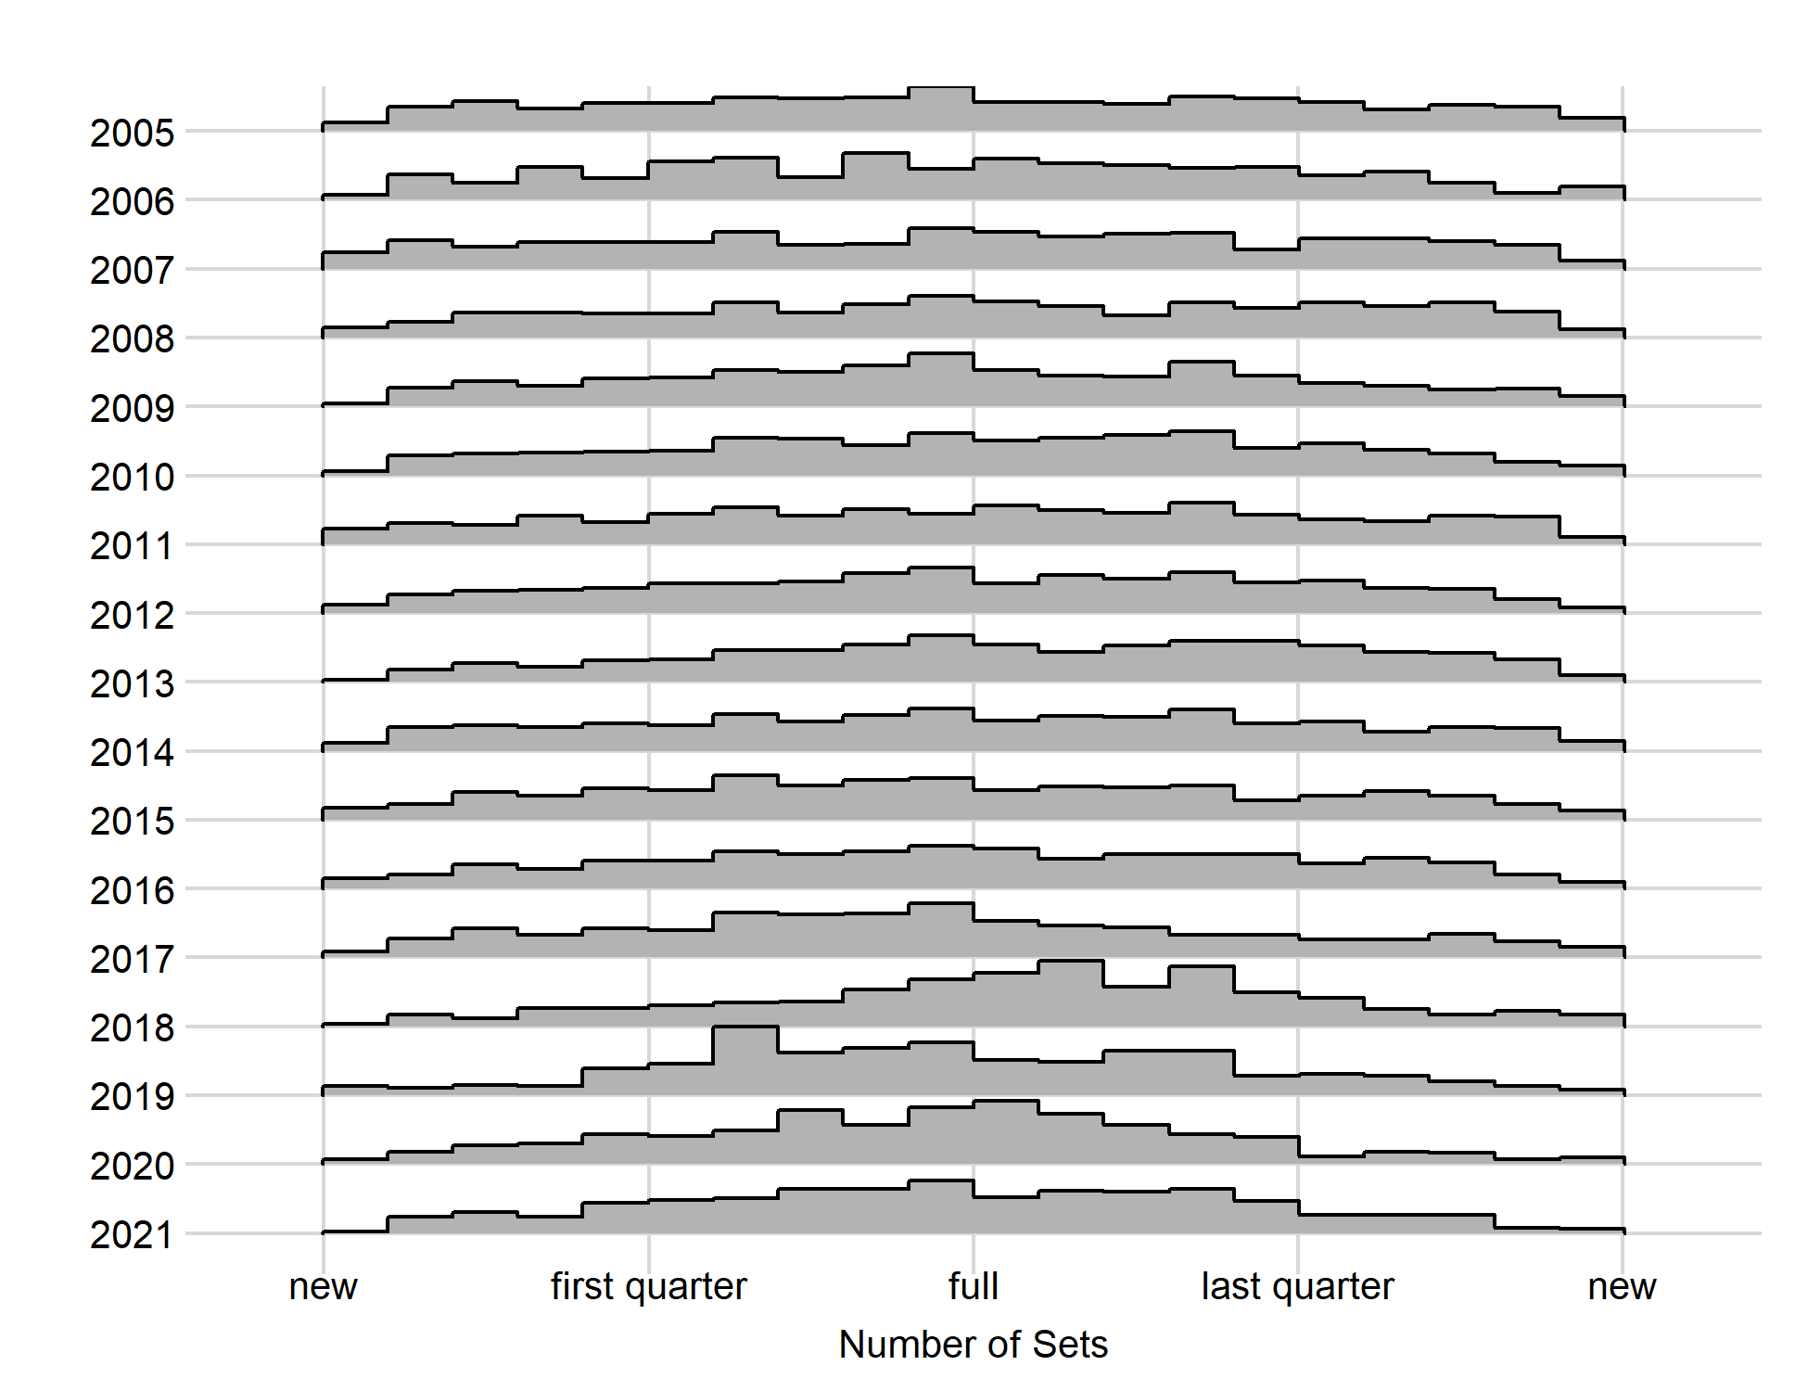
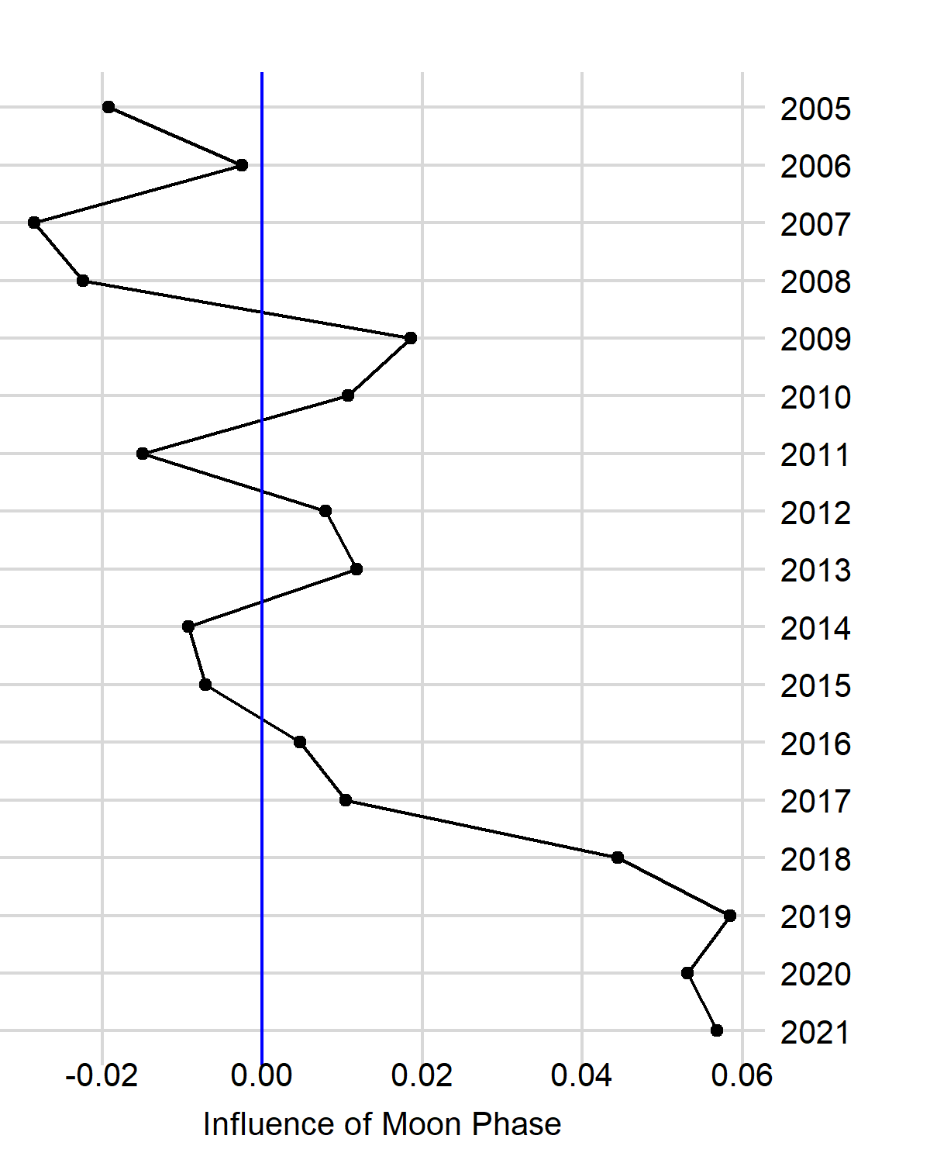
Shallow-Set 2005–2021, Positive Process, Moon Phase

Slide 17
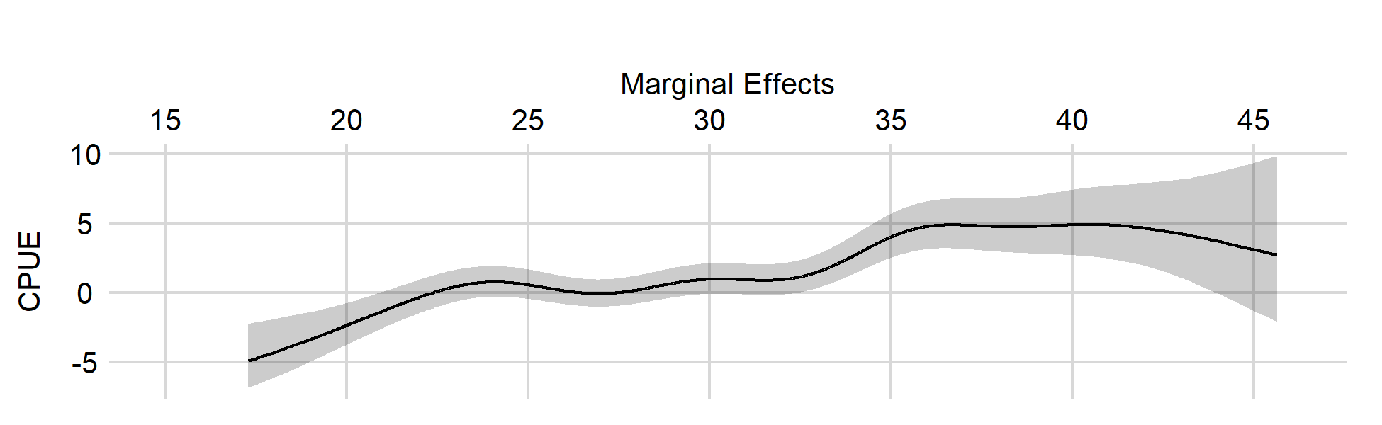
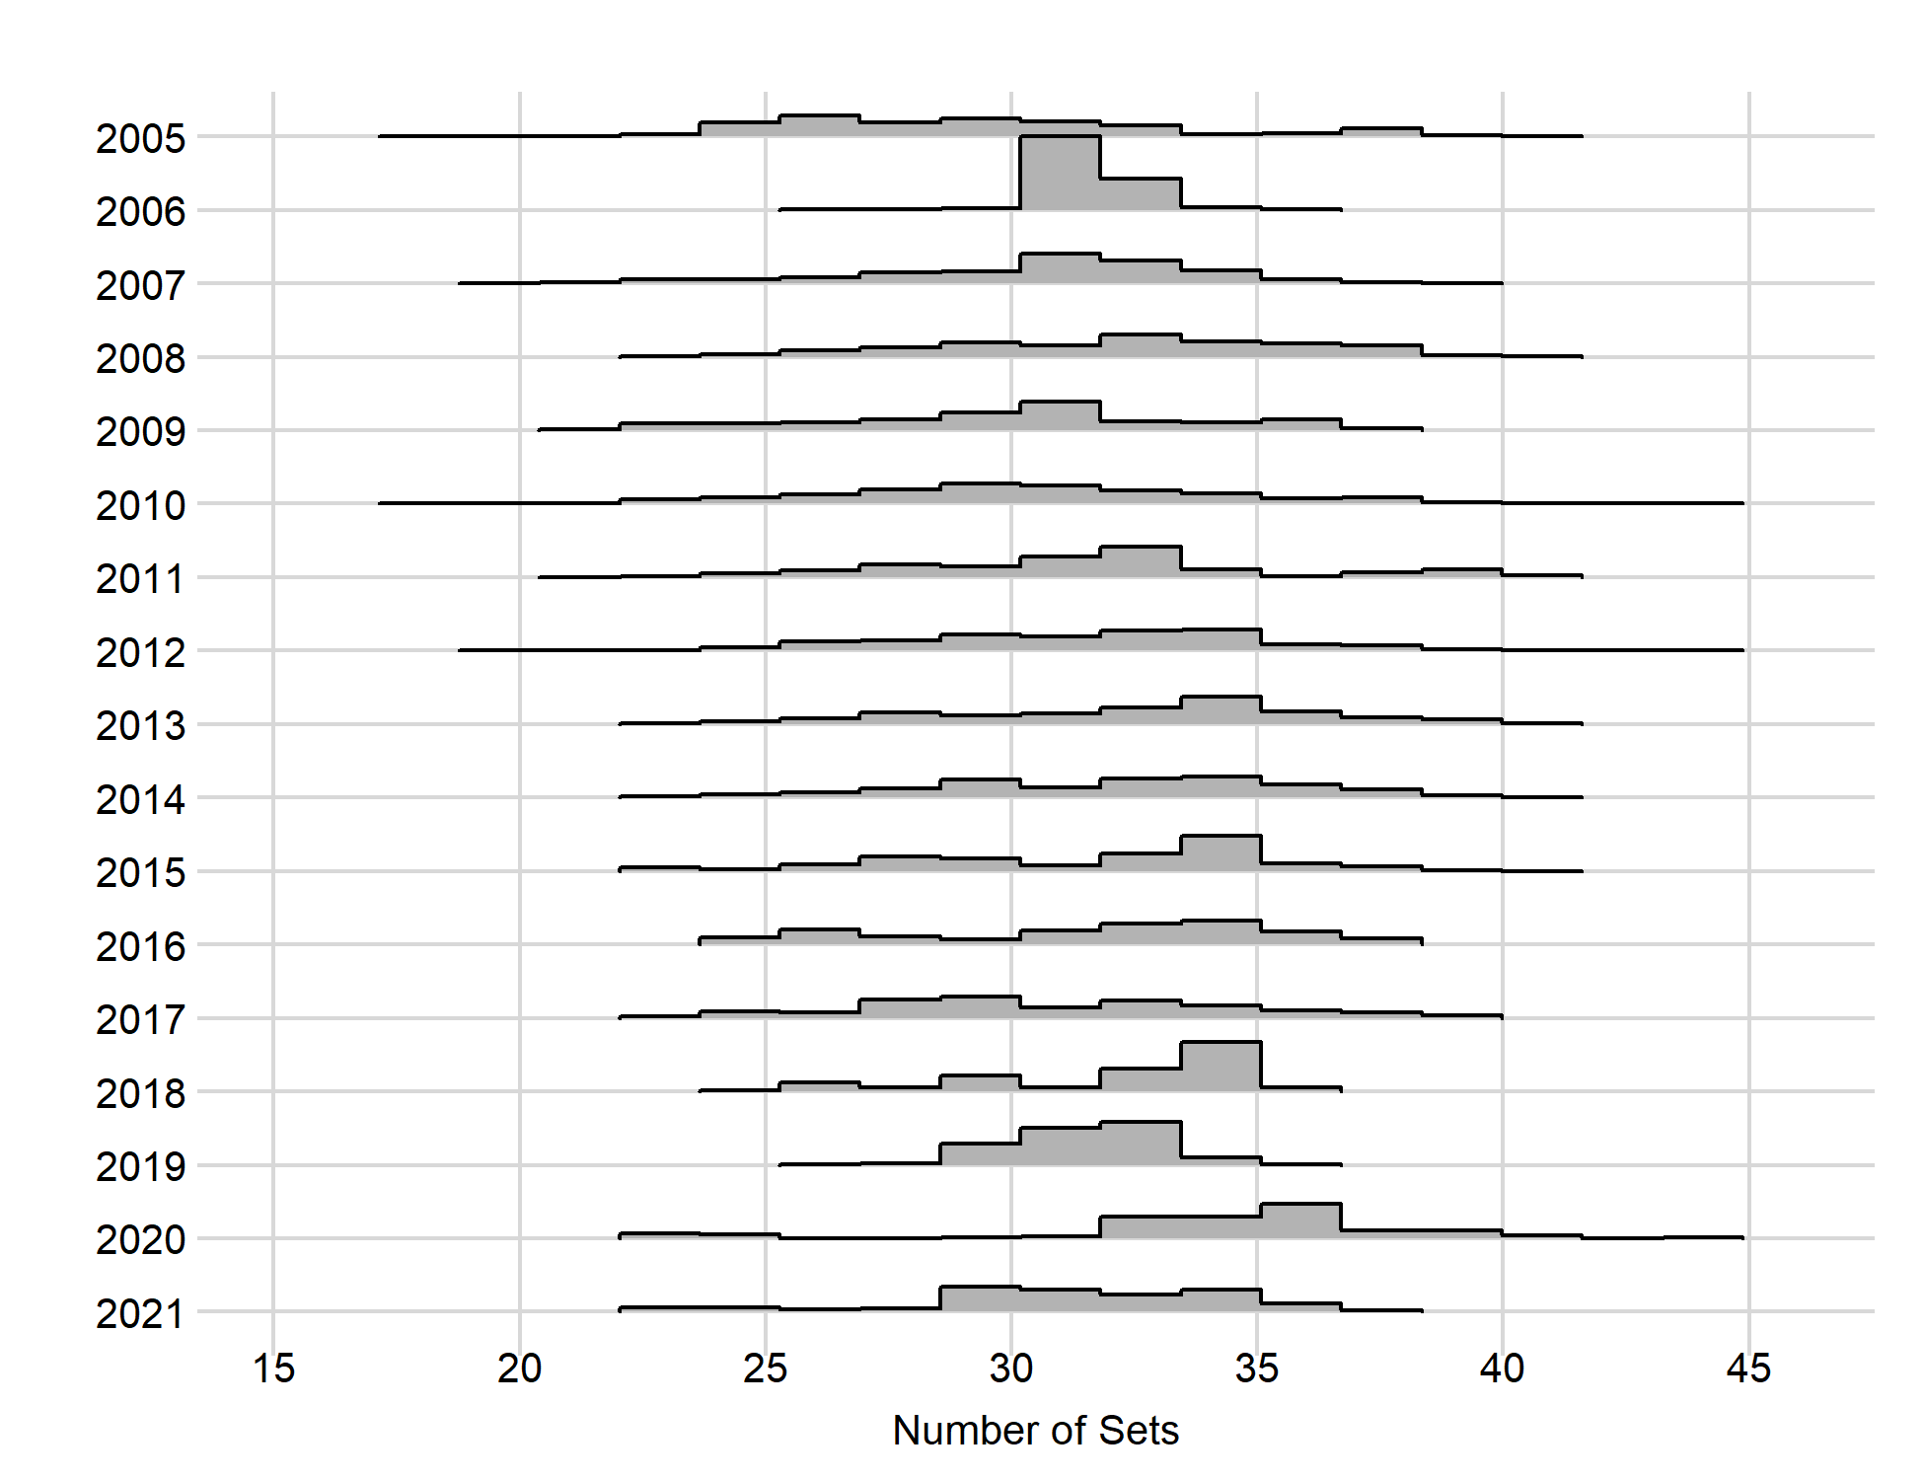
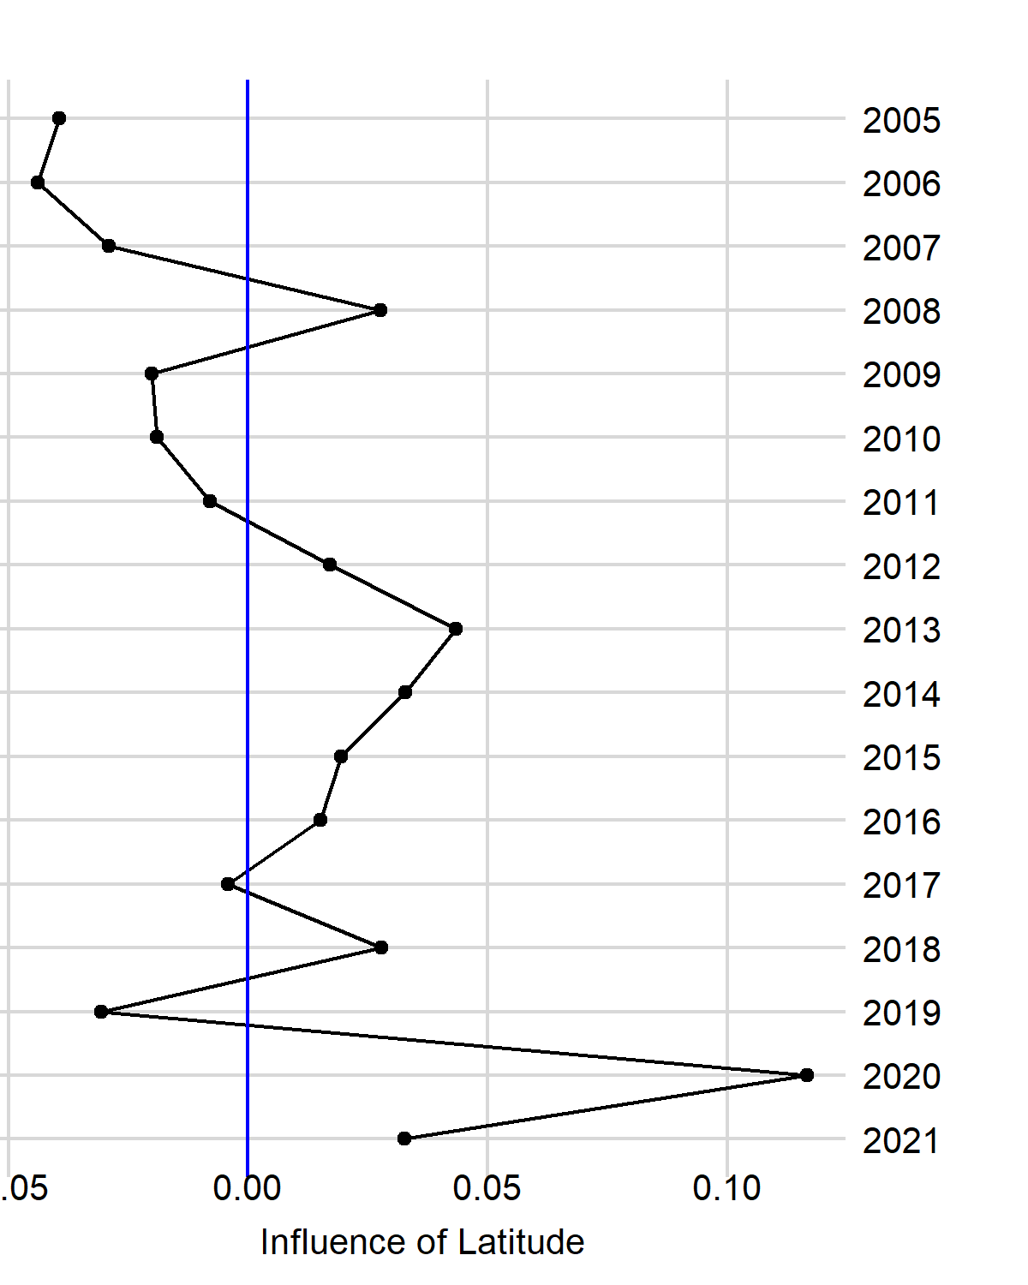
Shallow-Set 2005–2021, Positive Process, Latitude

Slide 18
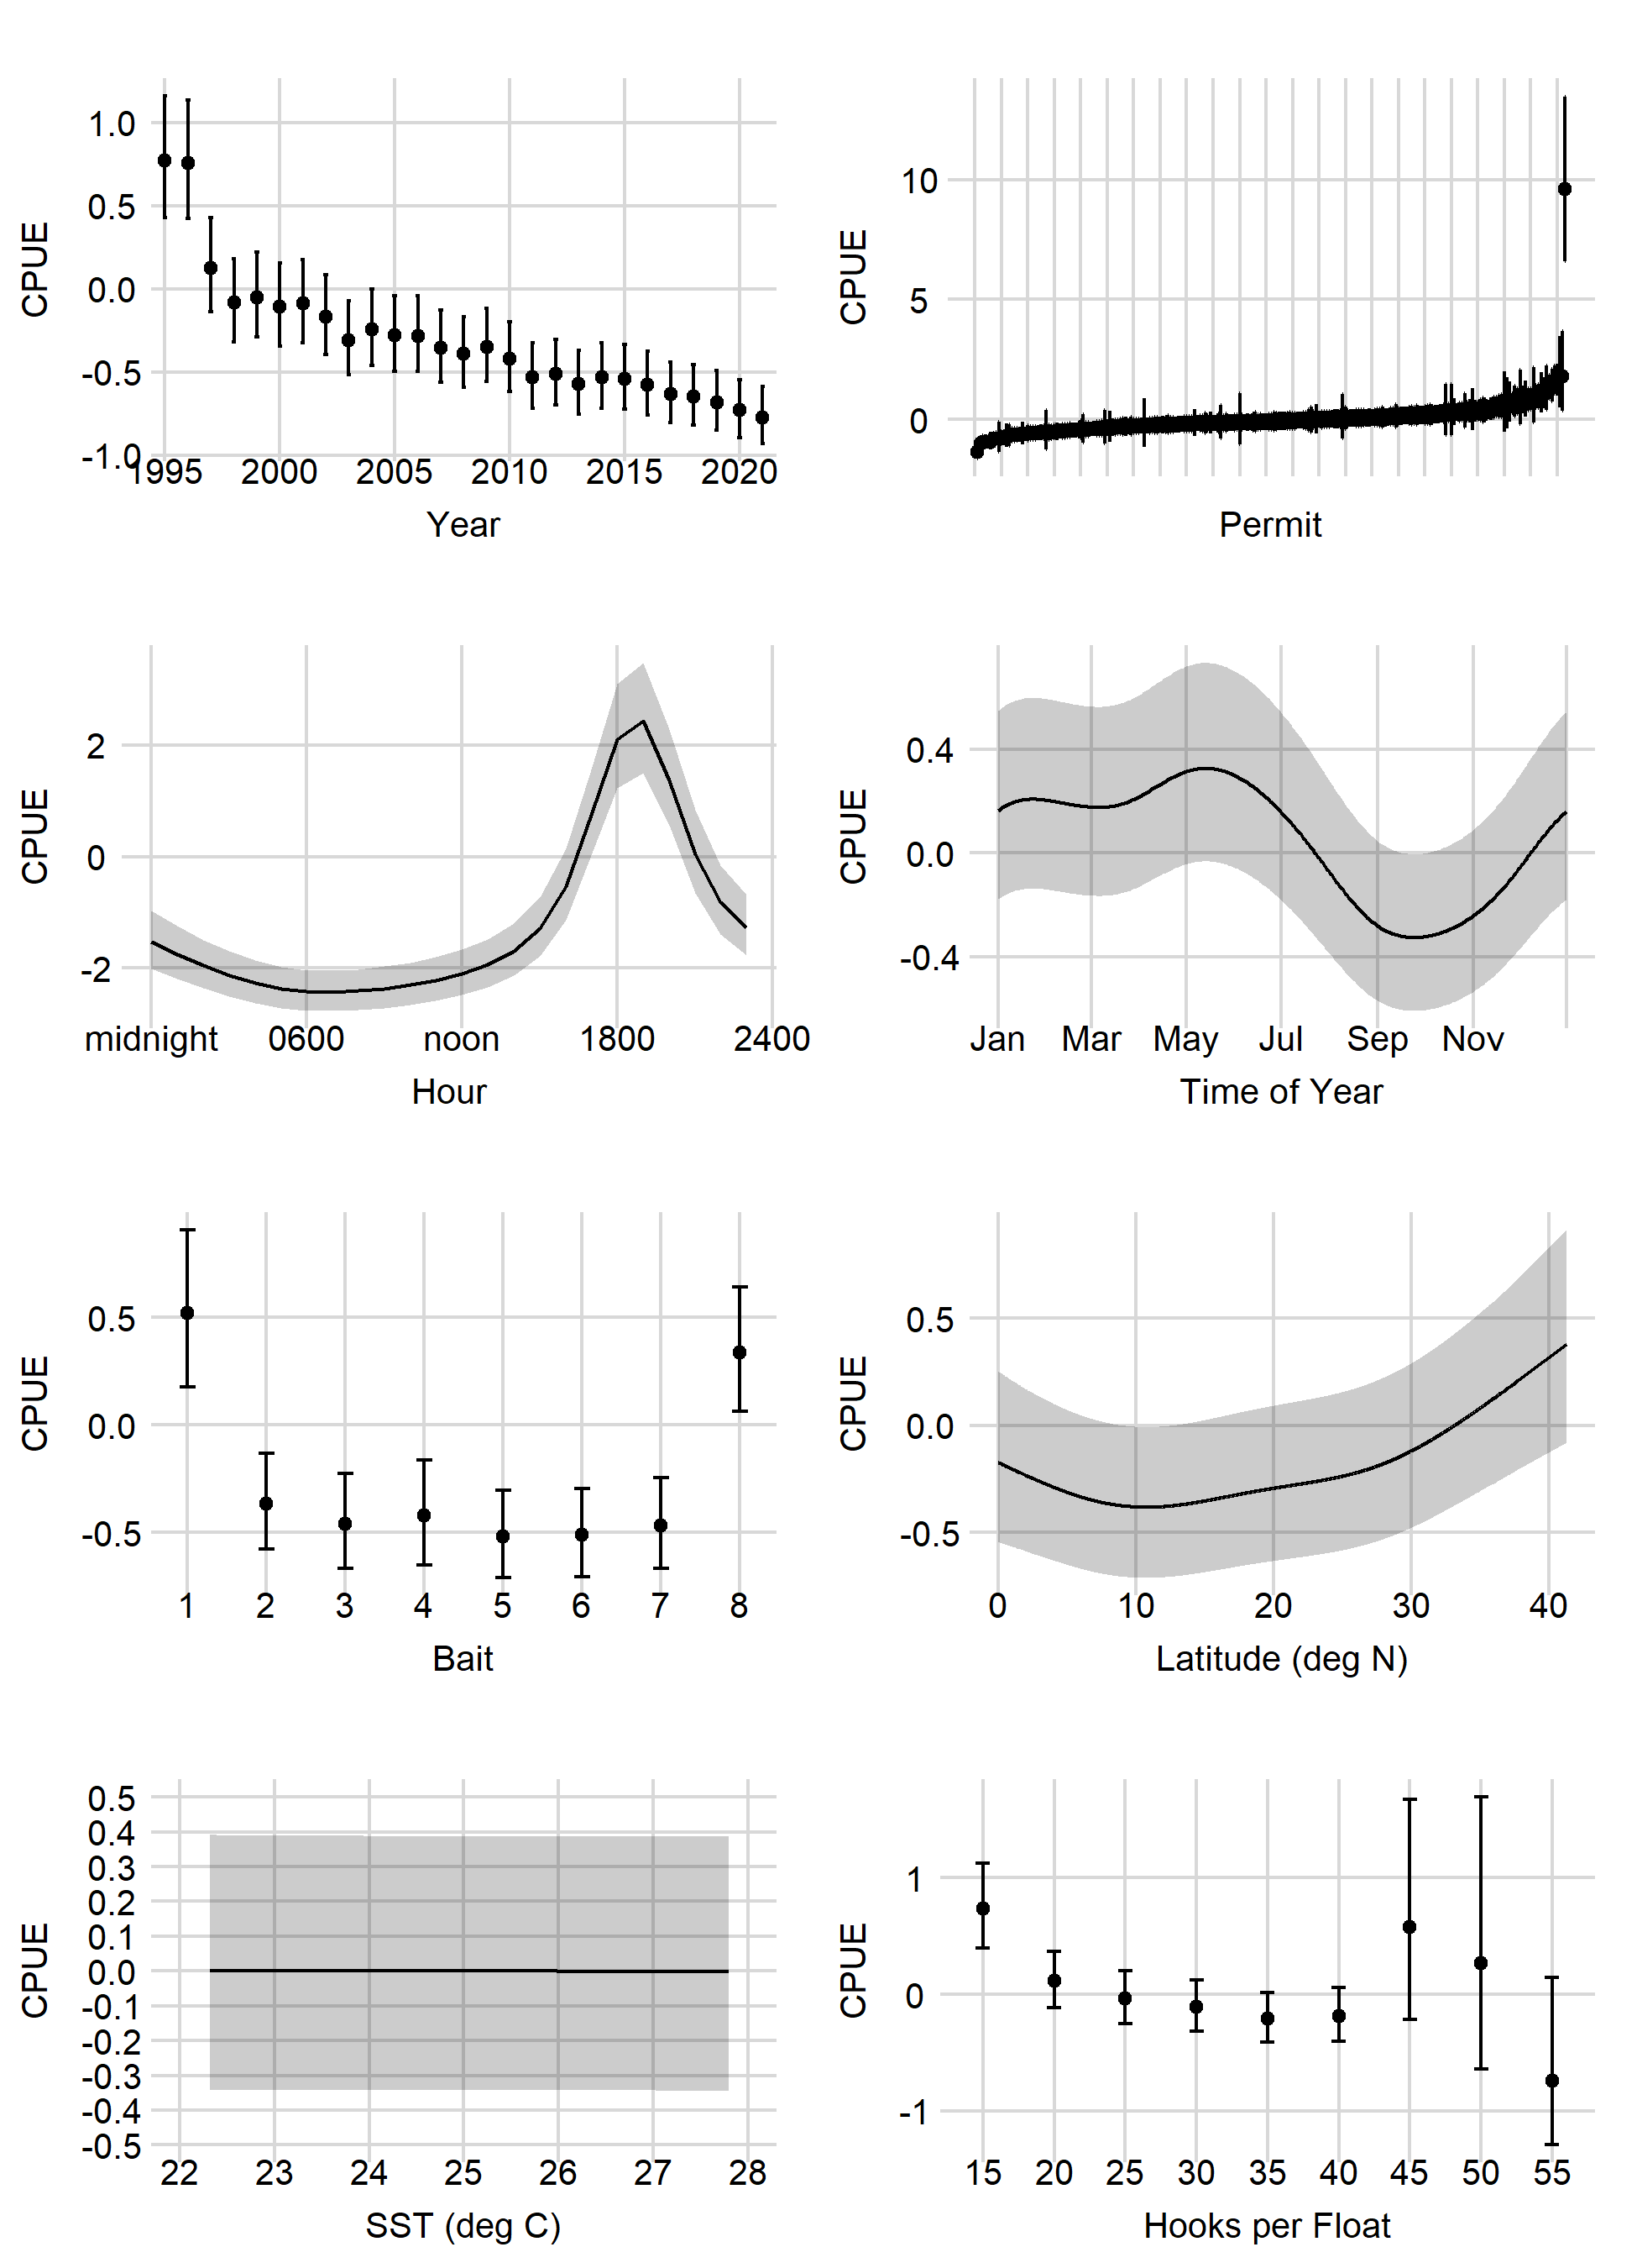
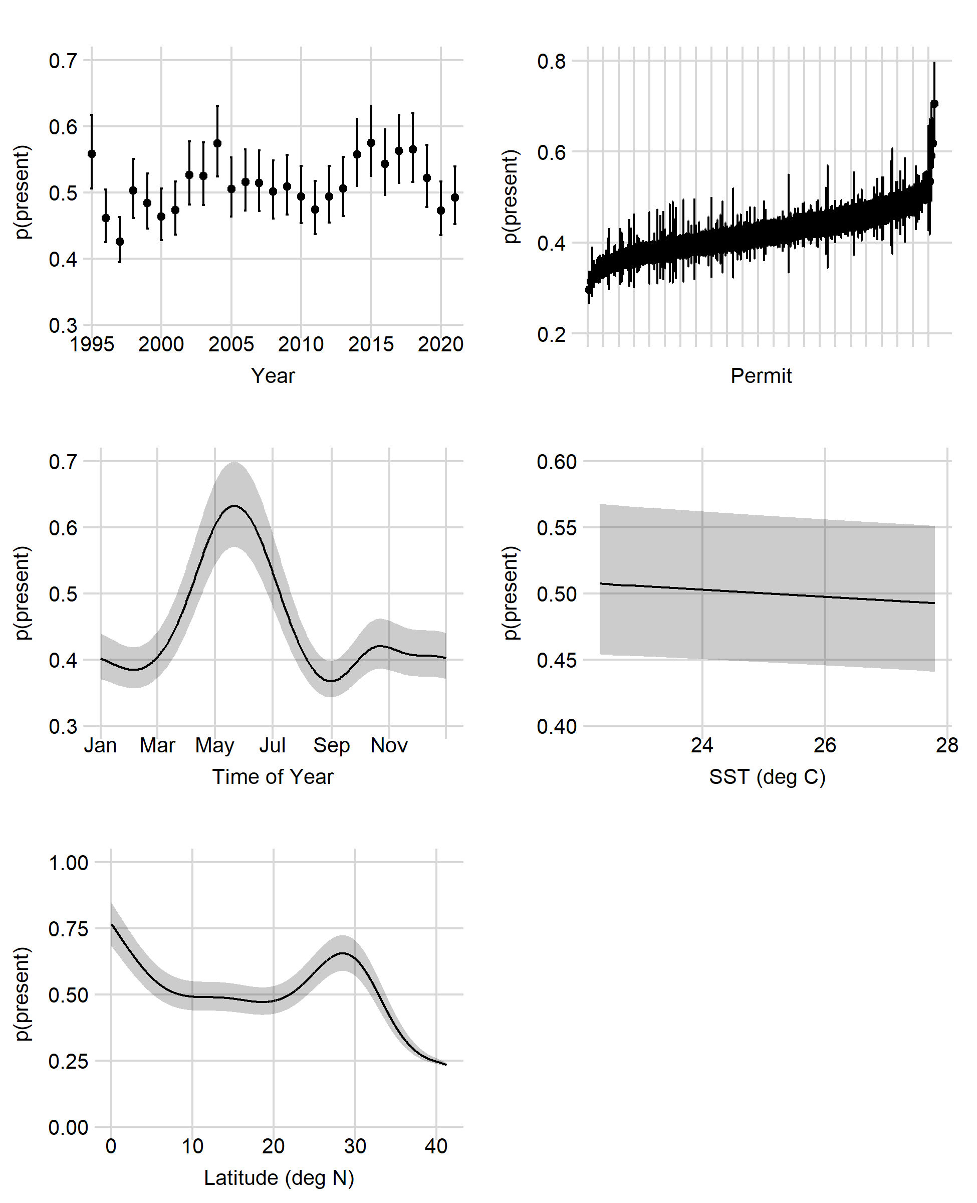
Deep-Set 1995–2021
Presence/Absence (Binomial)
Positive (Lognormal)

Slide 19
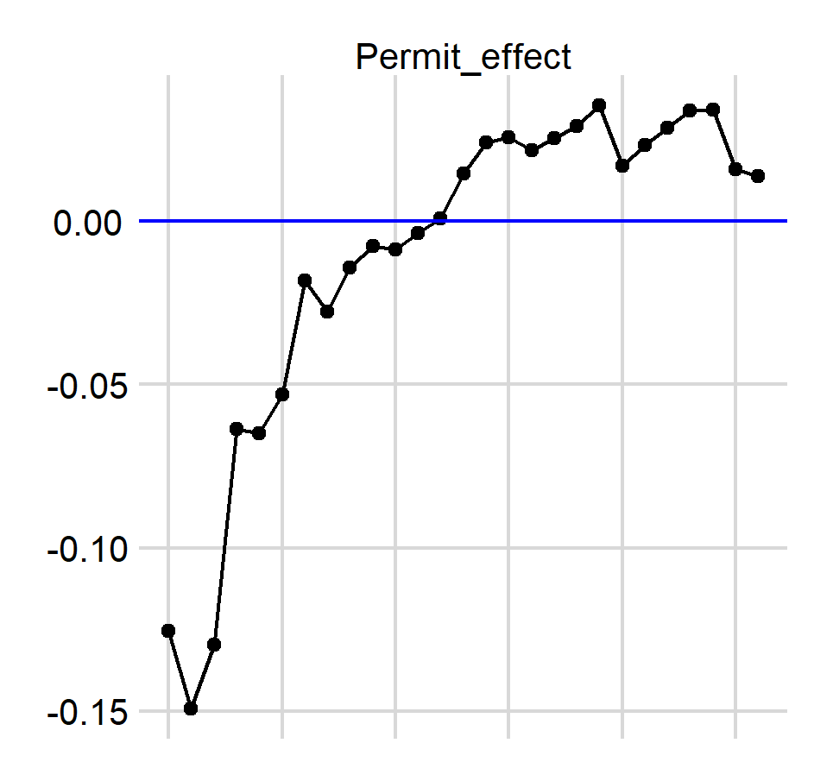
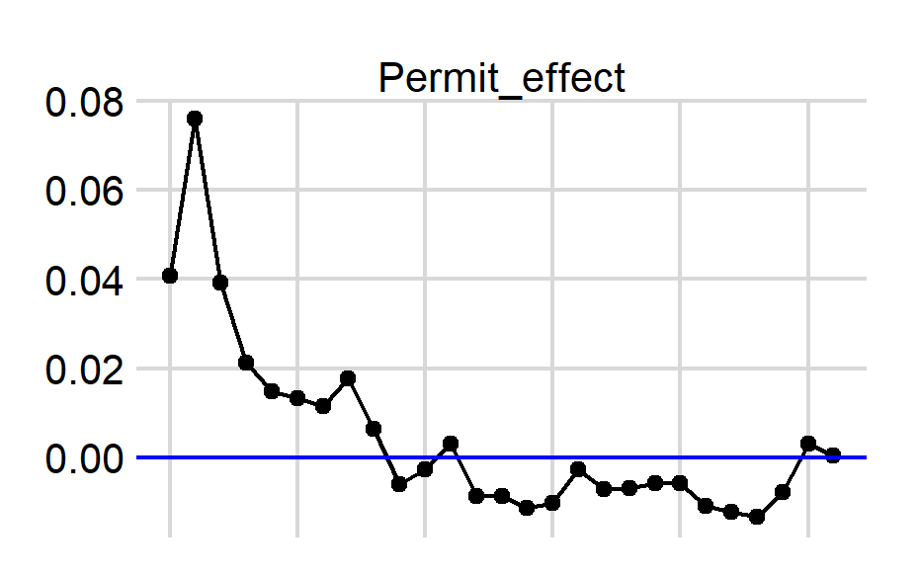
Influence of Permit Over Time: Deep-Set
Presence/Absence
Positive Process
1995 2000 2005 2010 2015 2020
1995 2000 2005 2010 2015 2020

Slide 20
Standardized Index: Summary

Slide 21
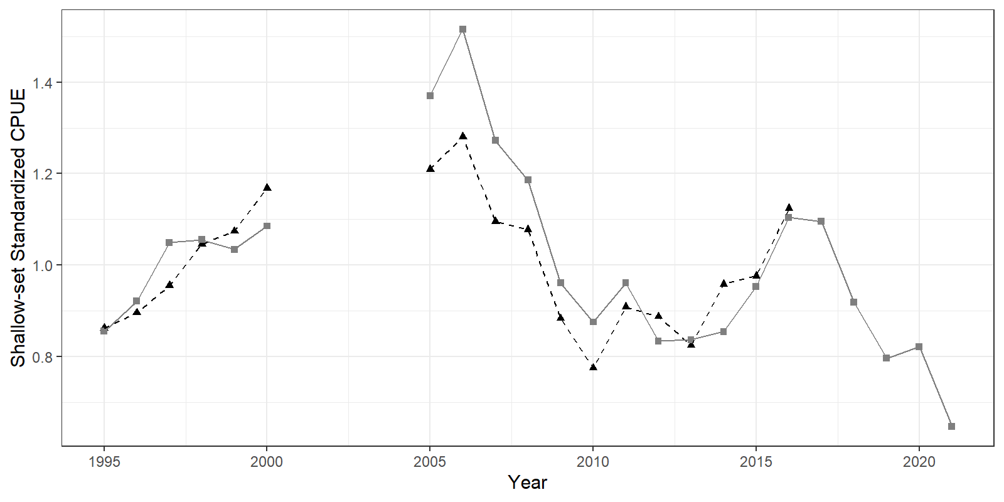
Standardized Index: Summary

Slide 22
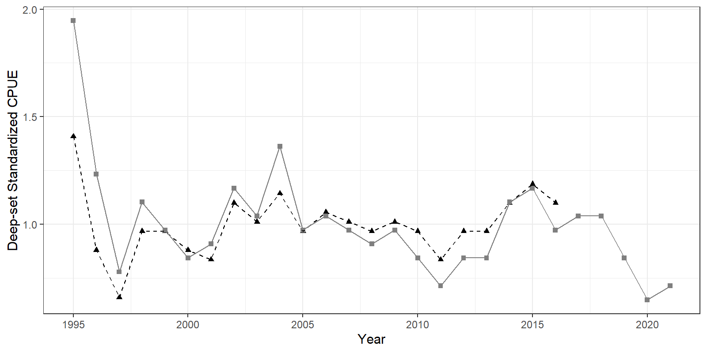
Standardized Index: Summary

Slide 23
Additional Slides

Slide 24
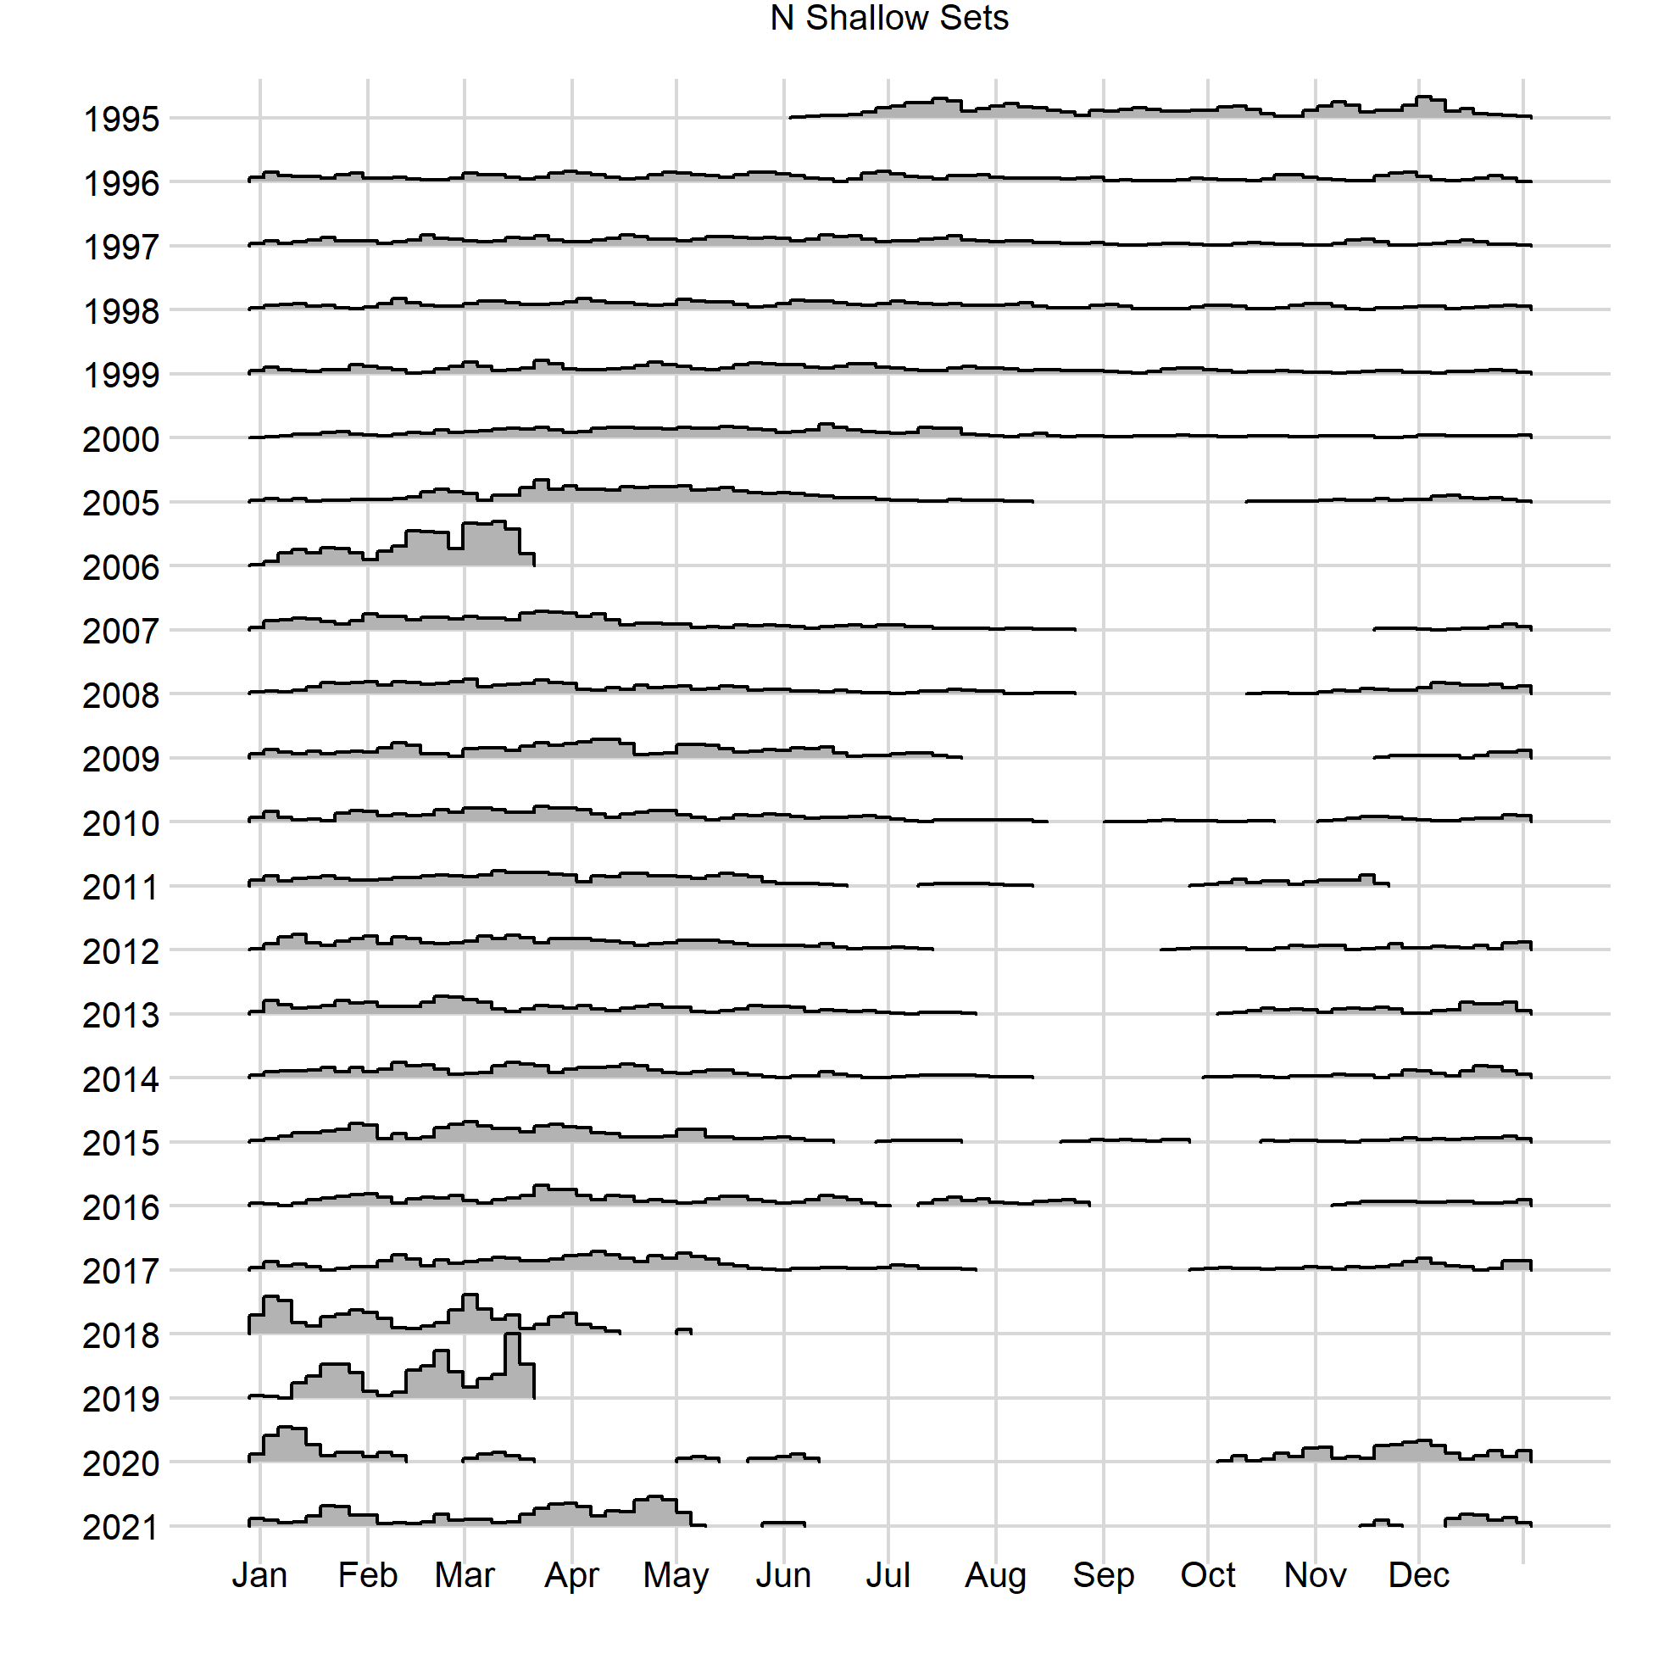
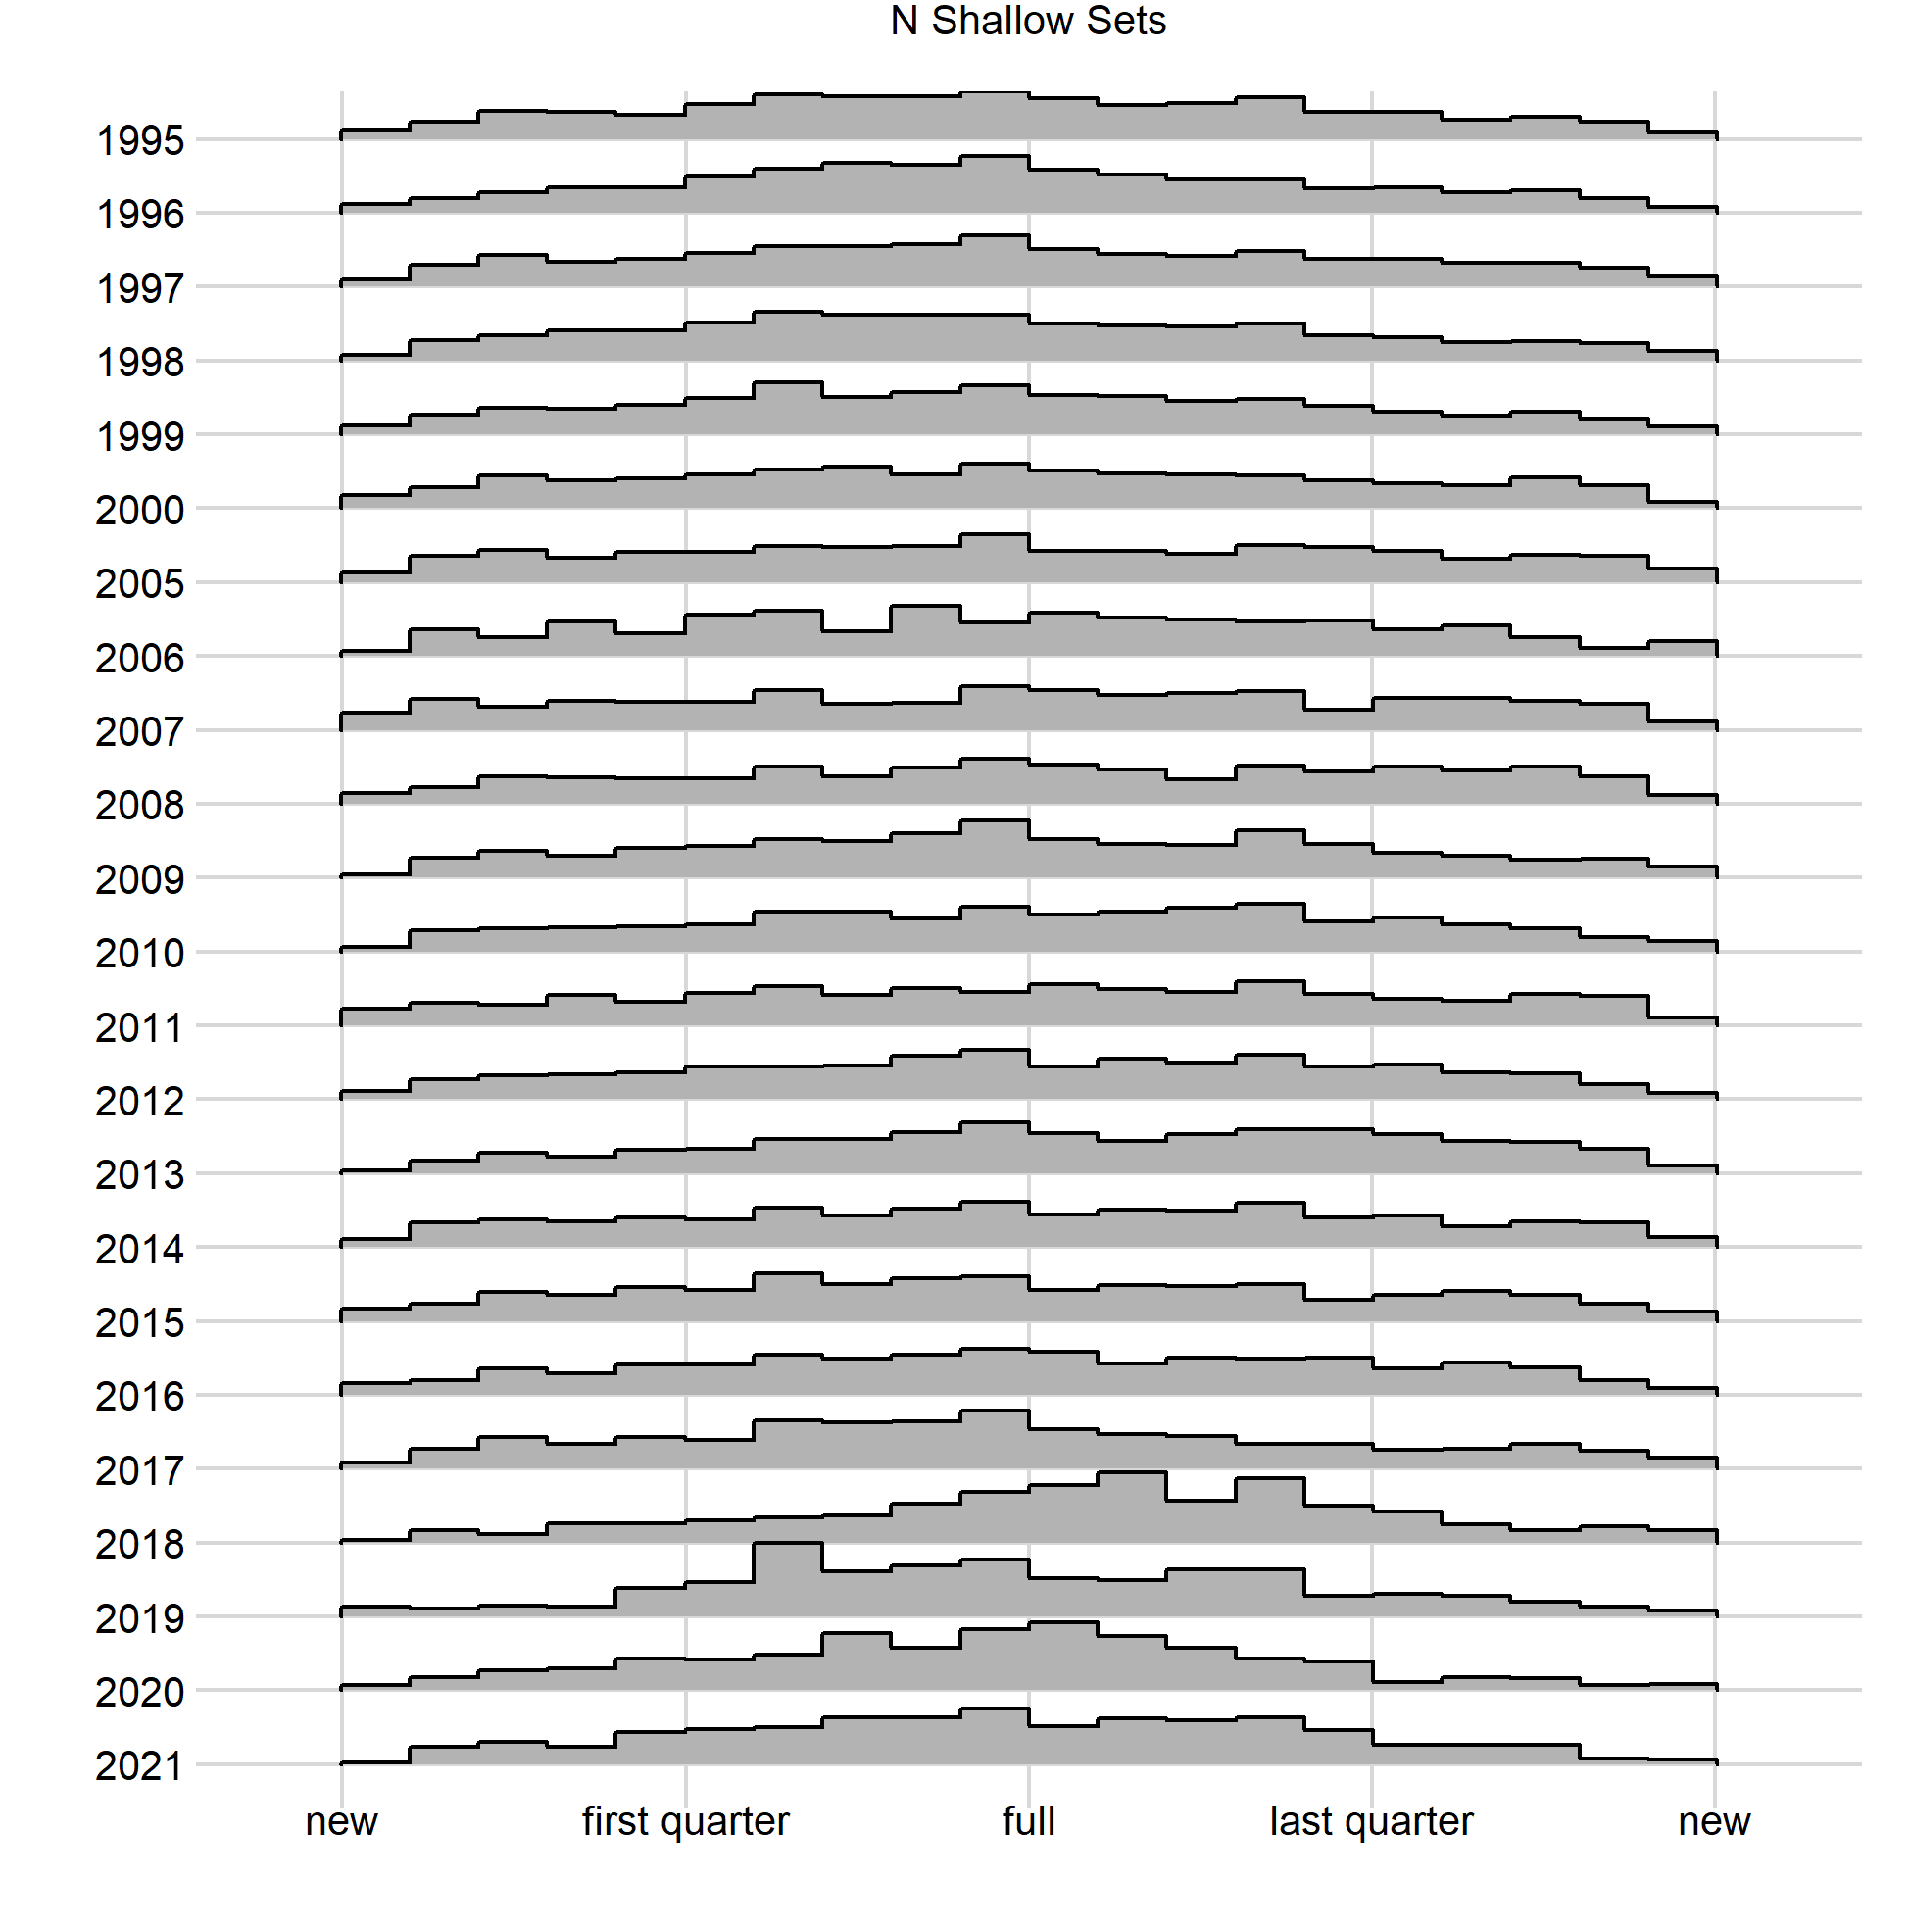
Shallow-Set, Number of Sets By Year, All Covariates

Slide 25
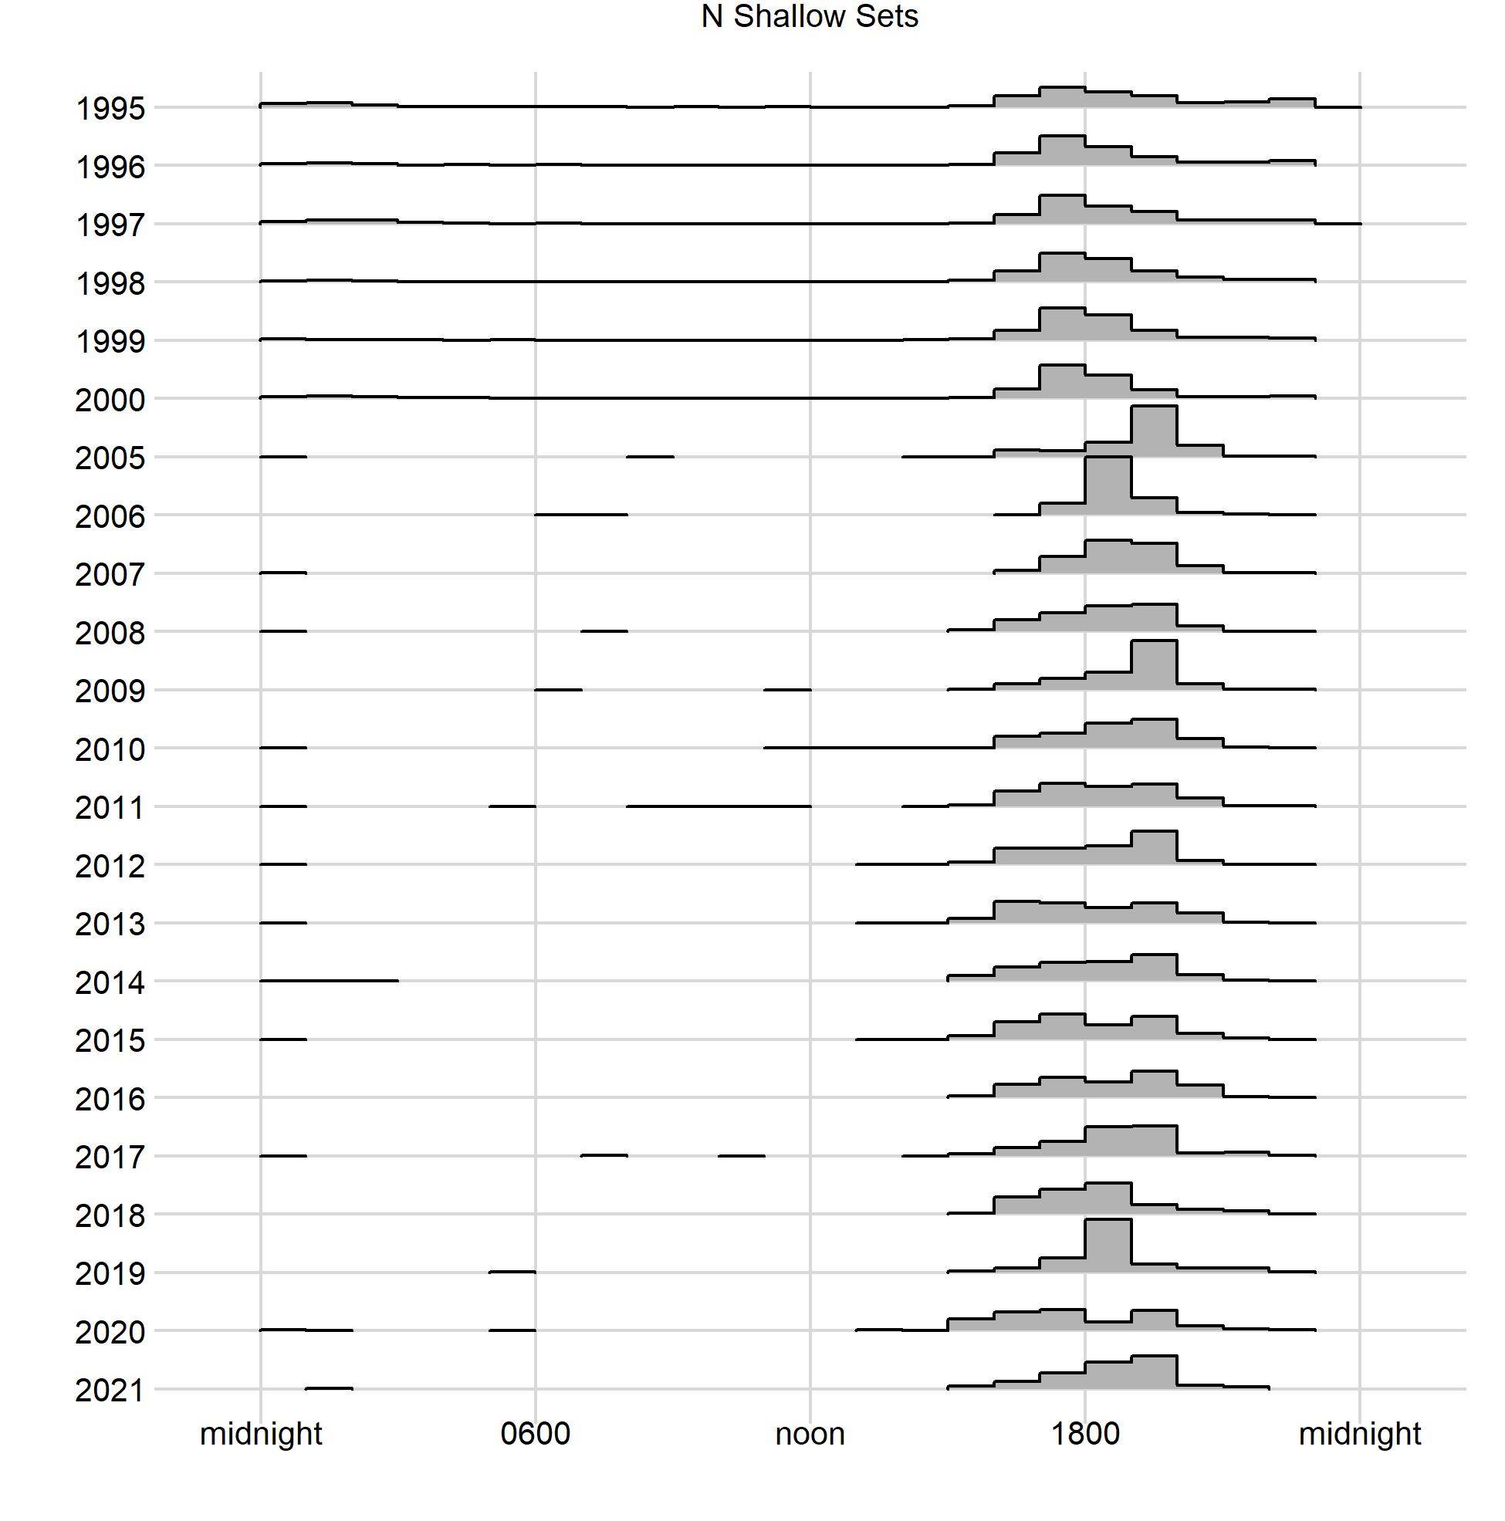
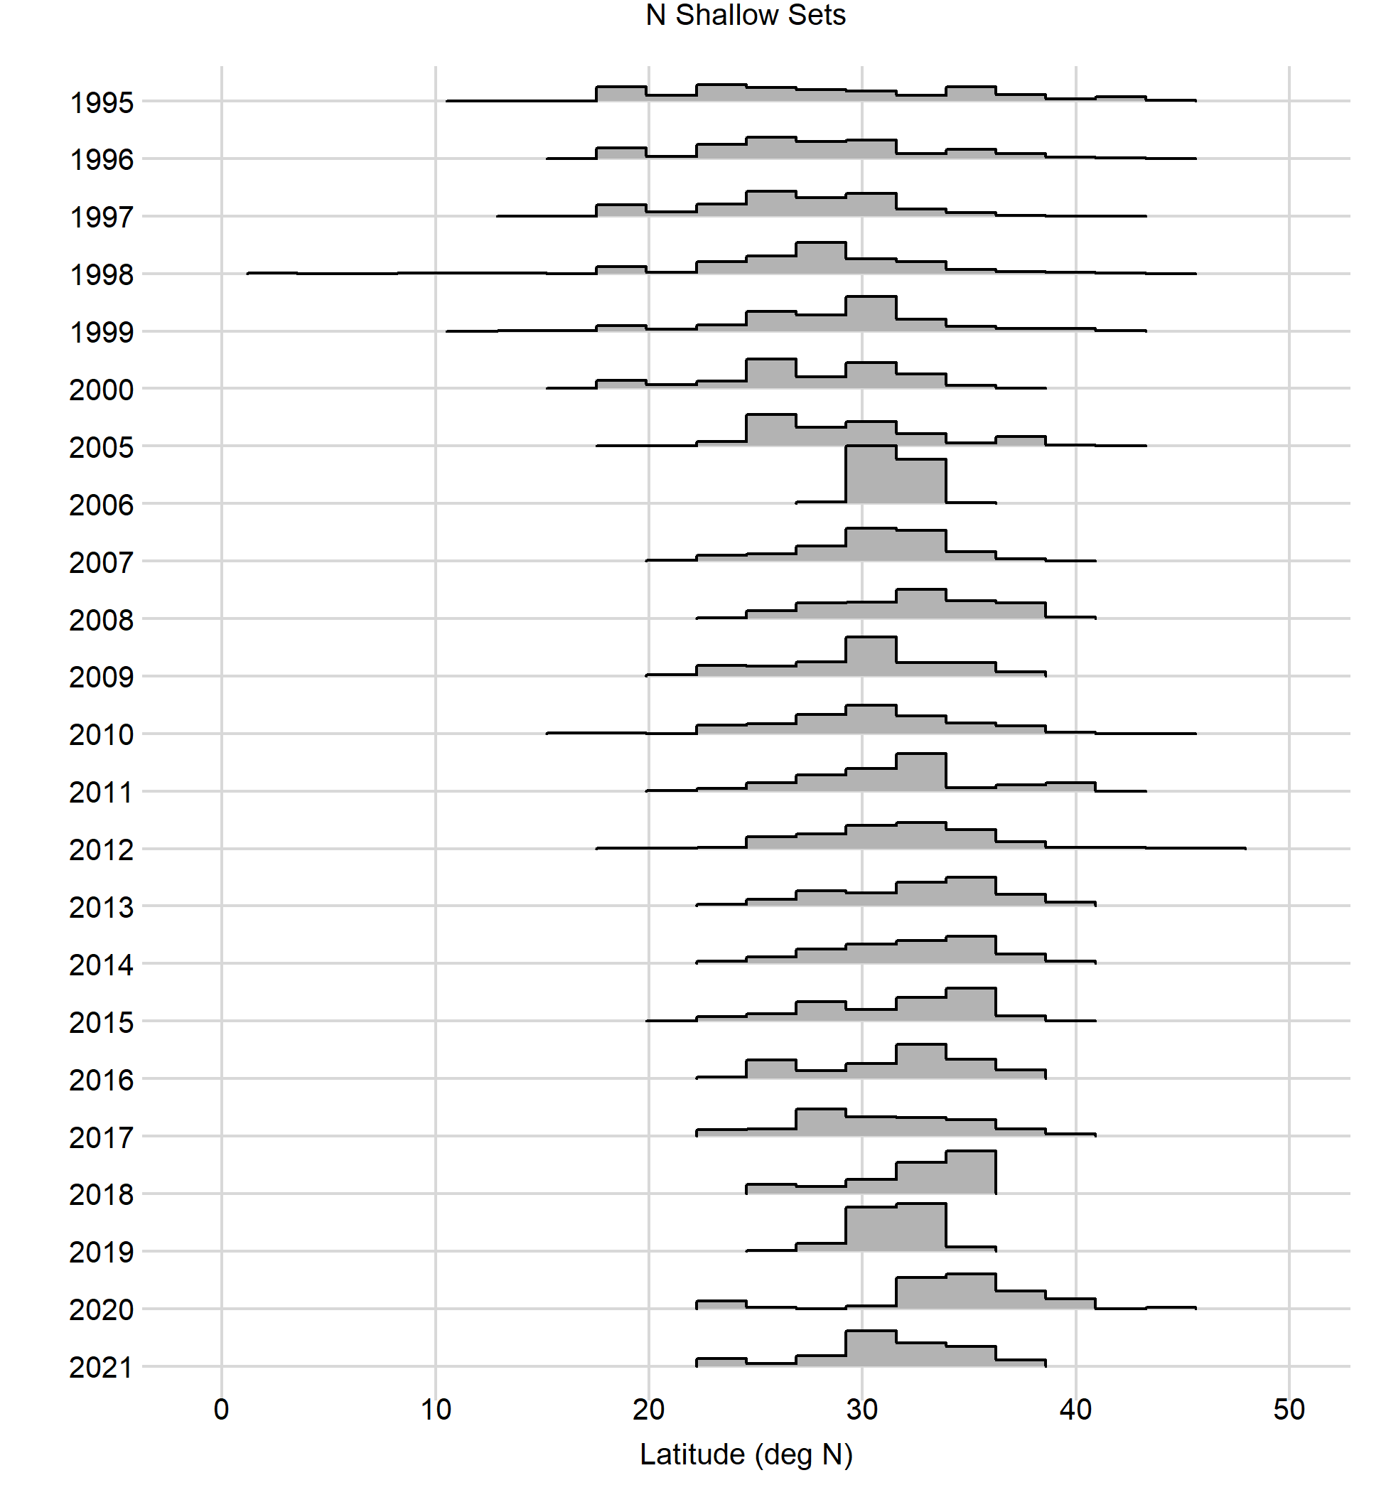
Shallow-Set, Number of Sets By Year, All Covariates

Slide 26
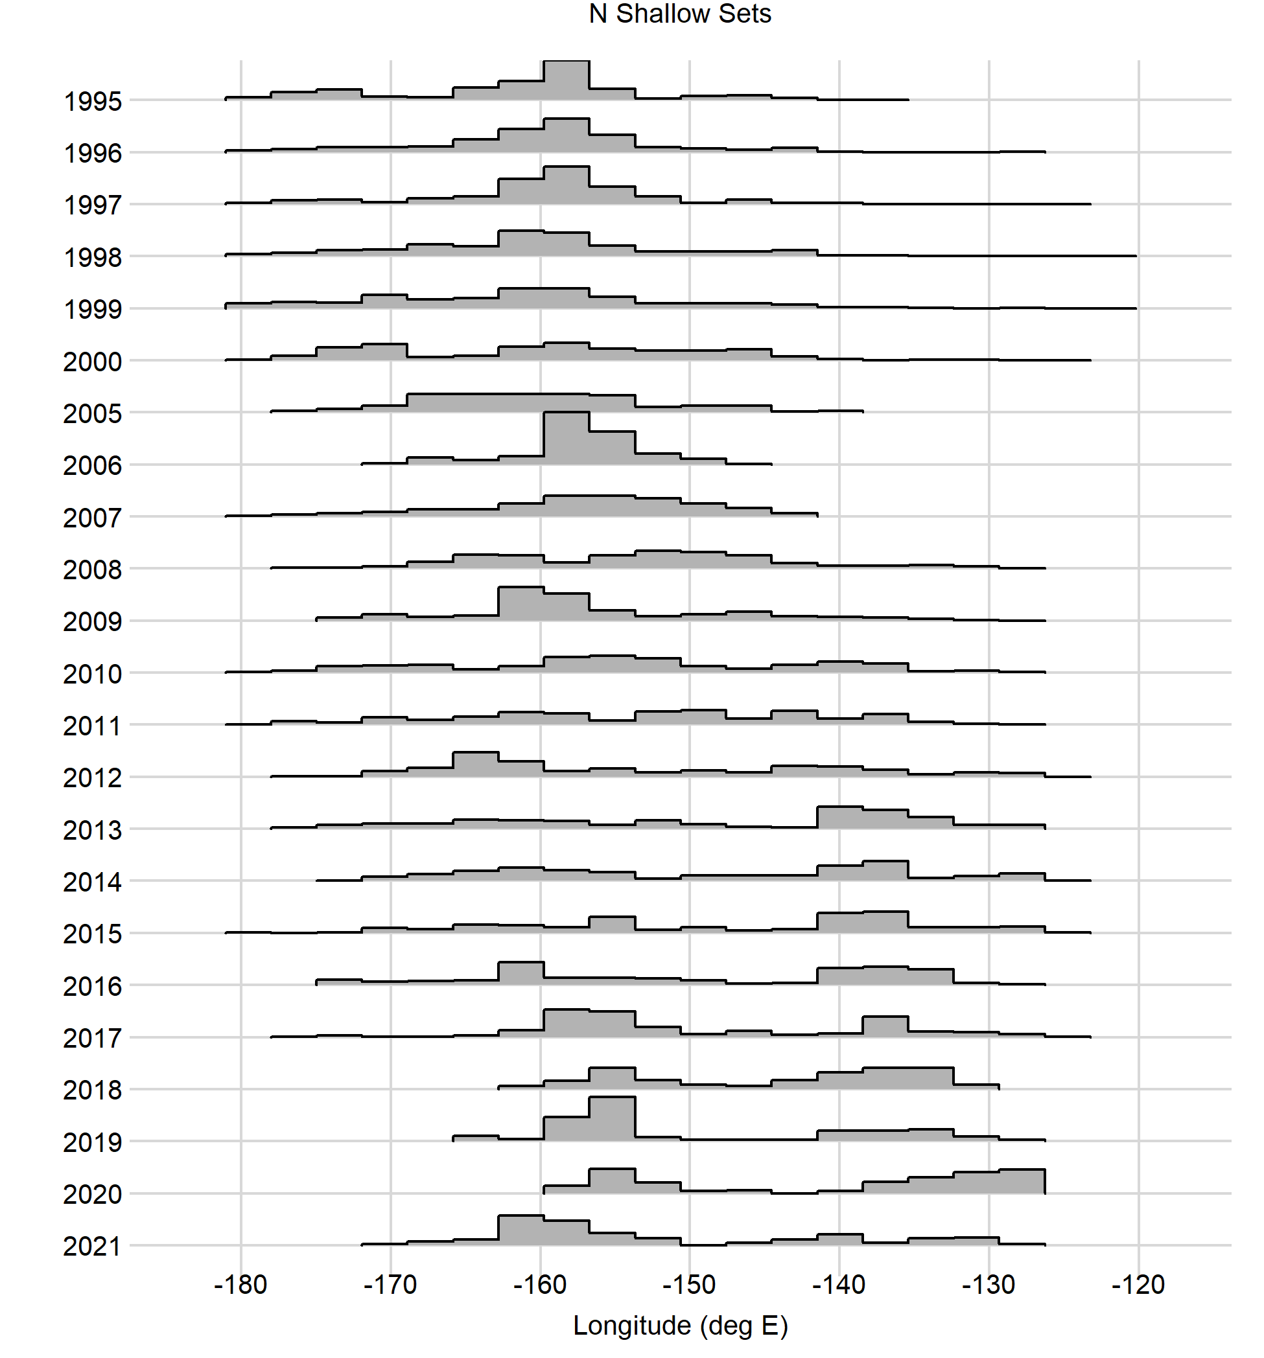
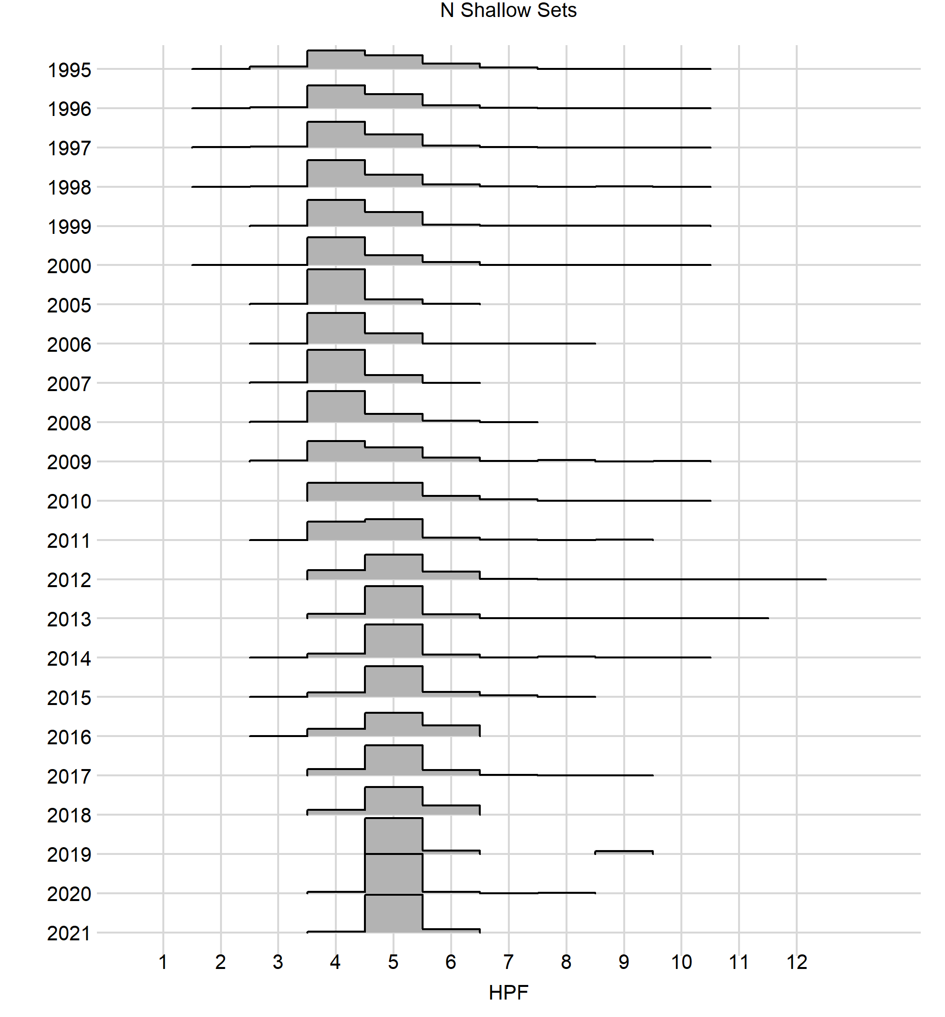
Shallow-Set, Number of Sets By Year, All Covariates

Slide 27
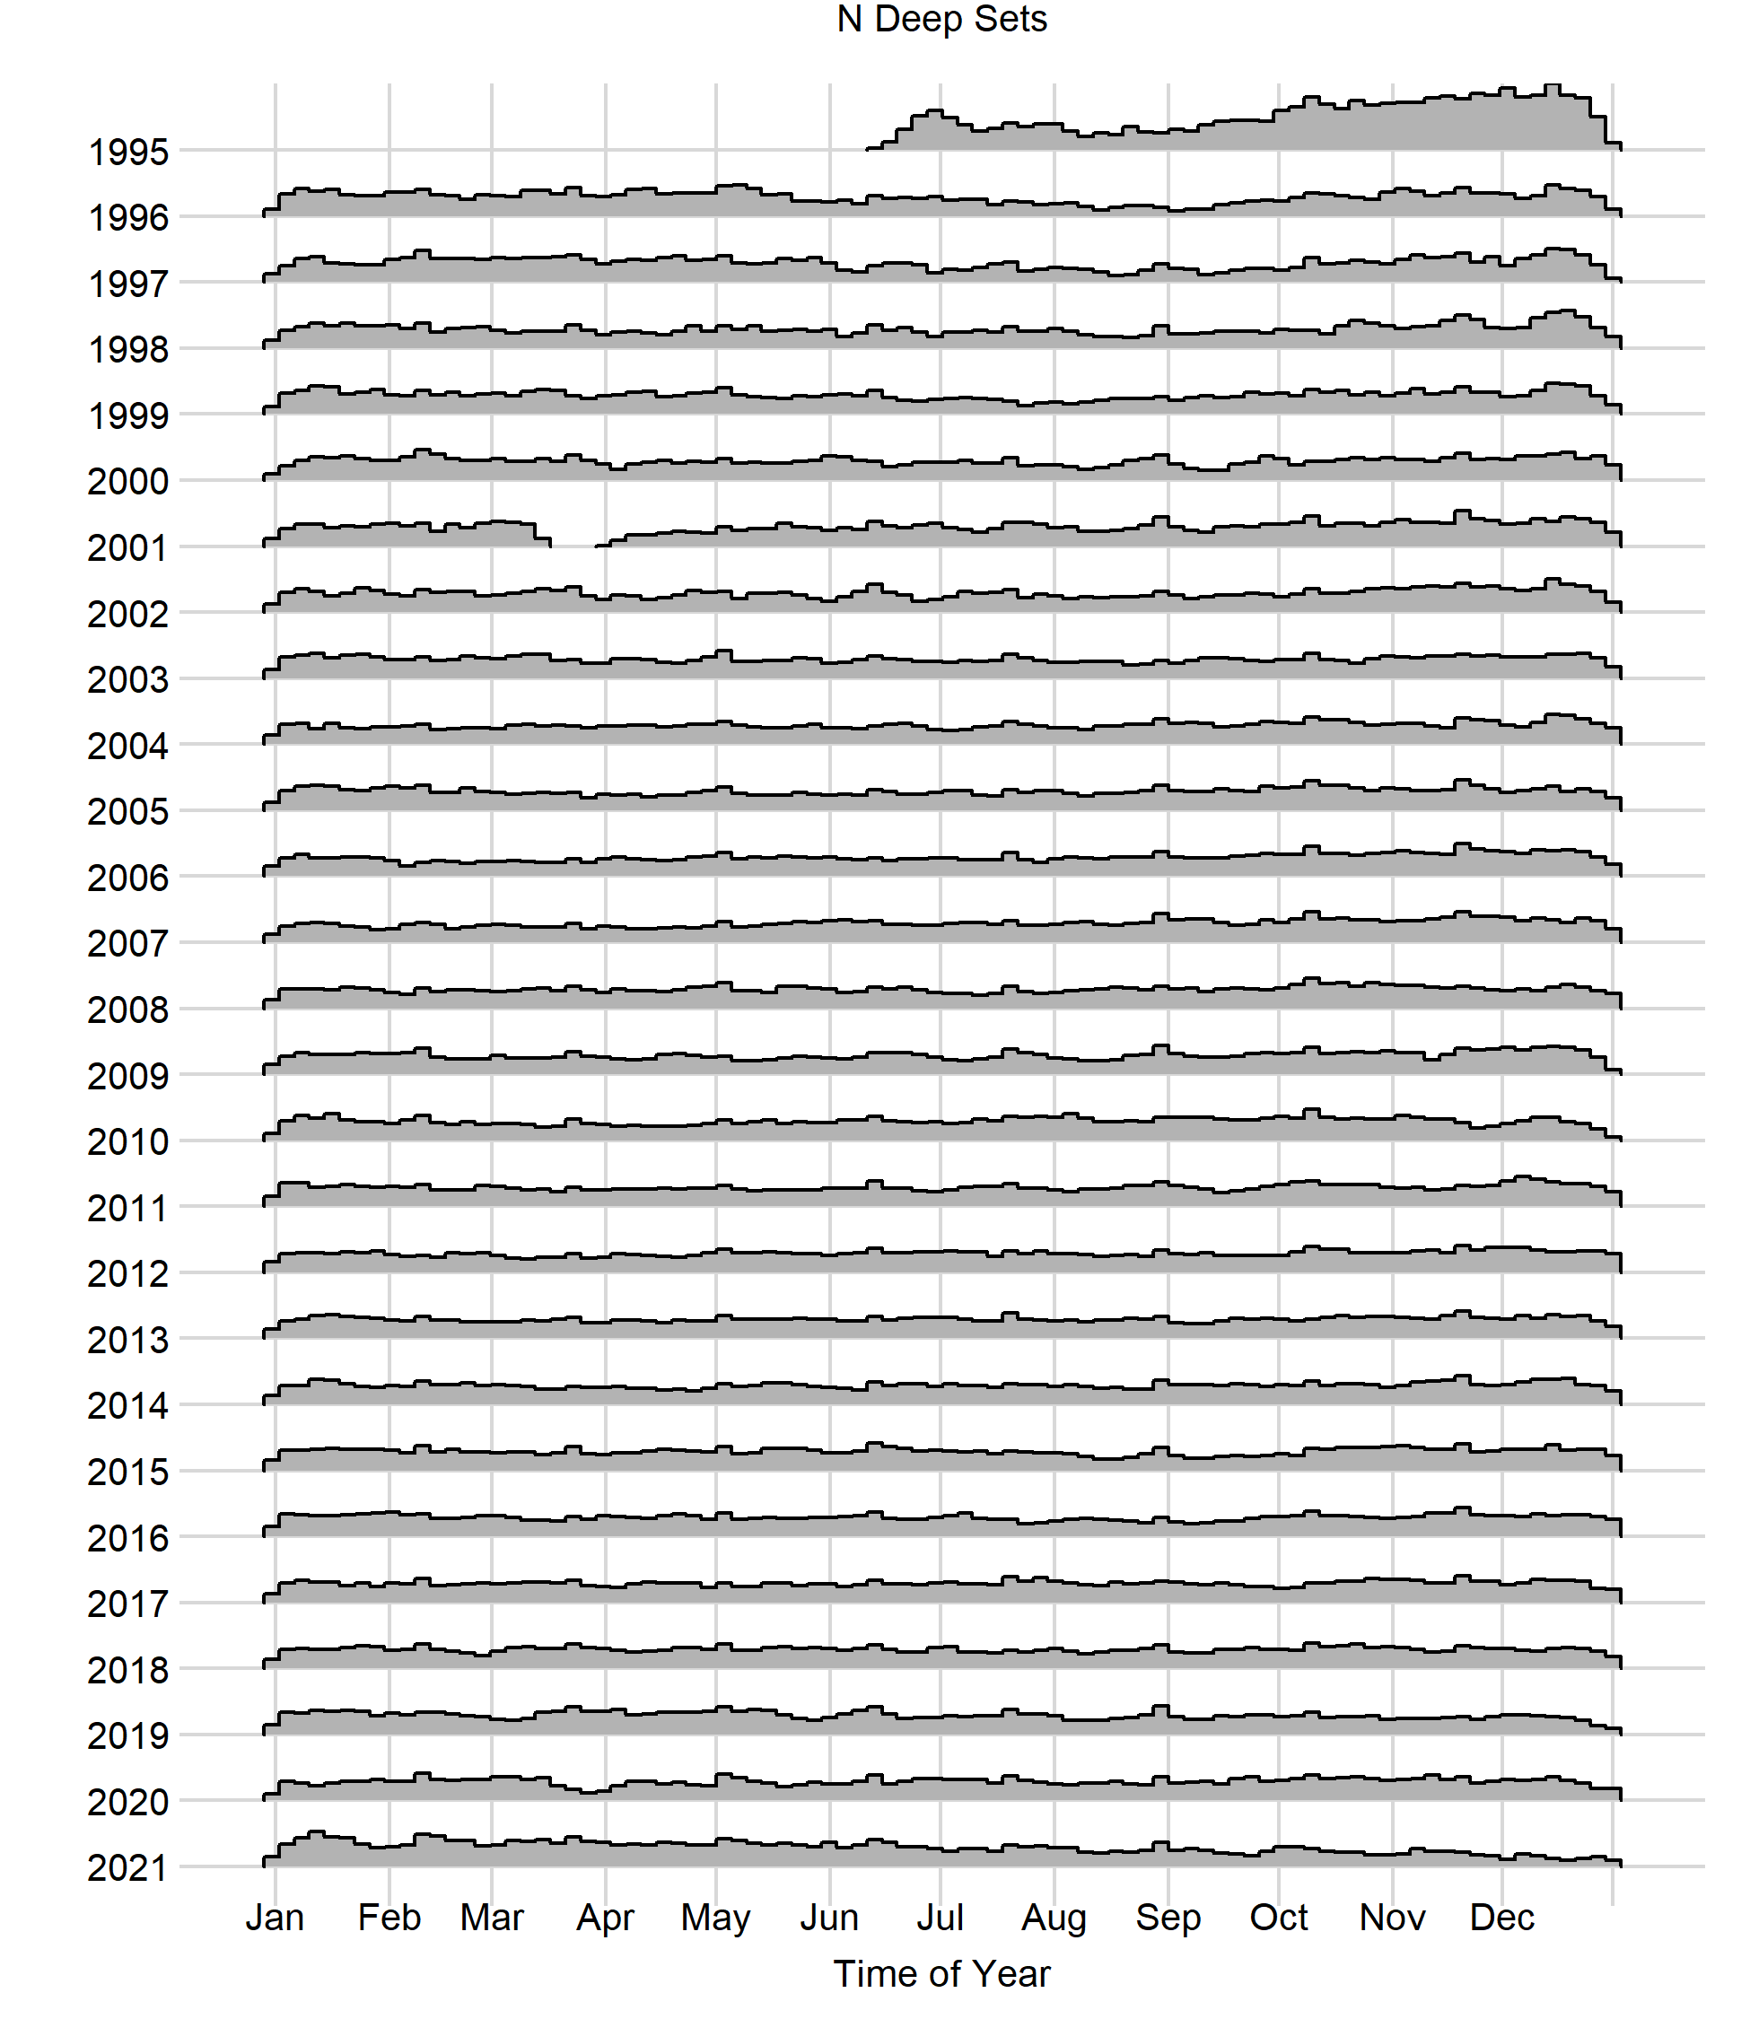
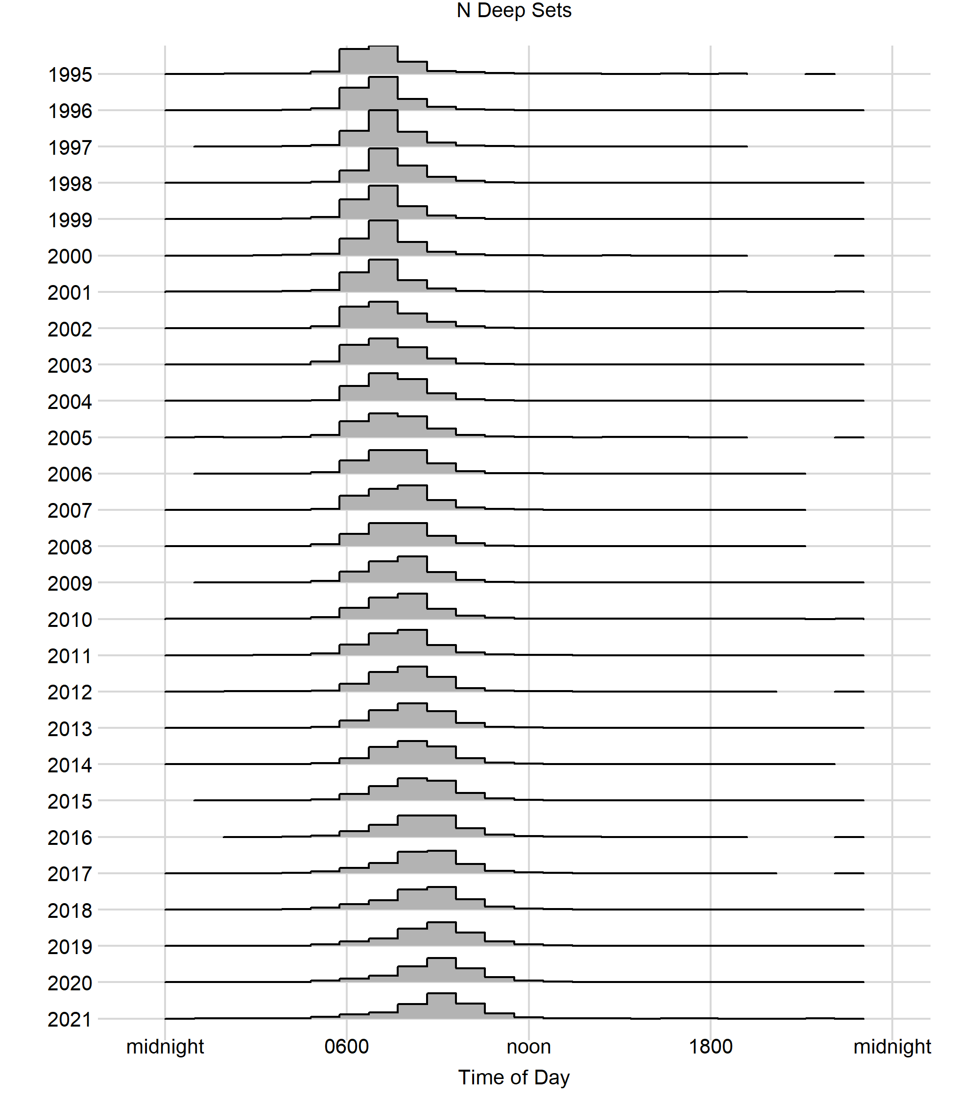
Deep-Set, Number of Sets By Year, All Covariates

Slide 28
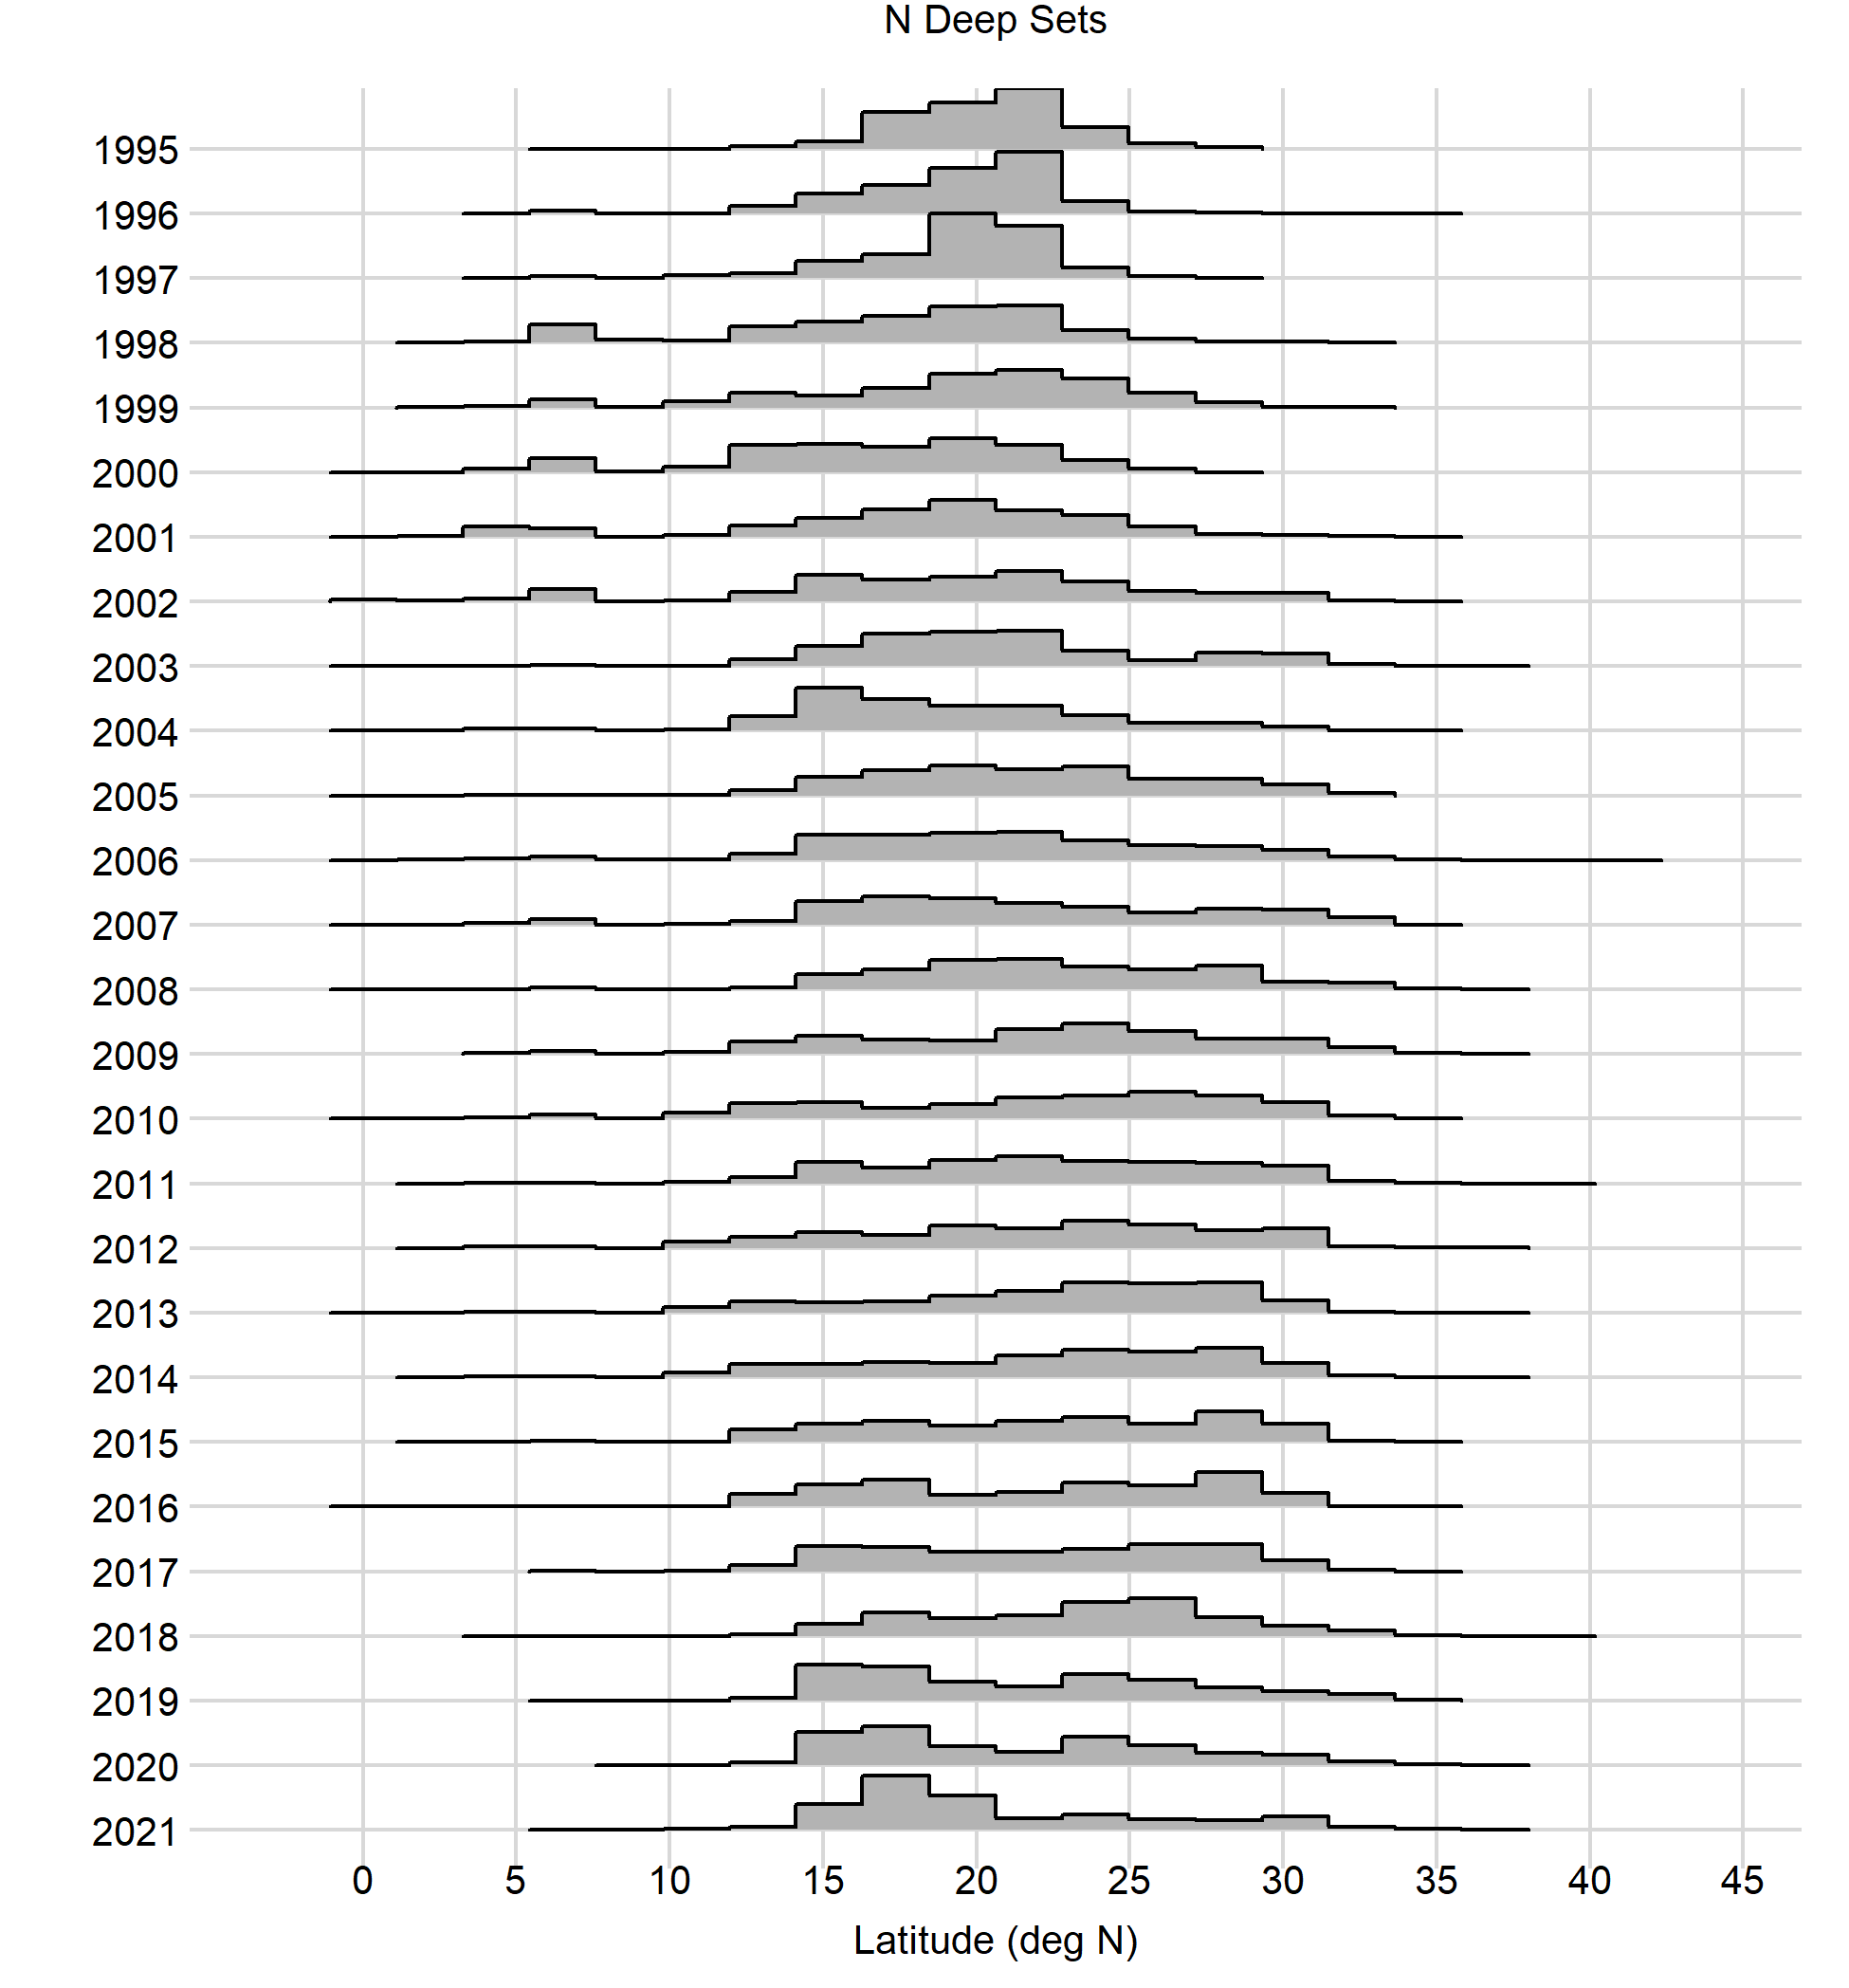
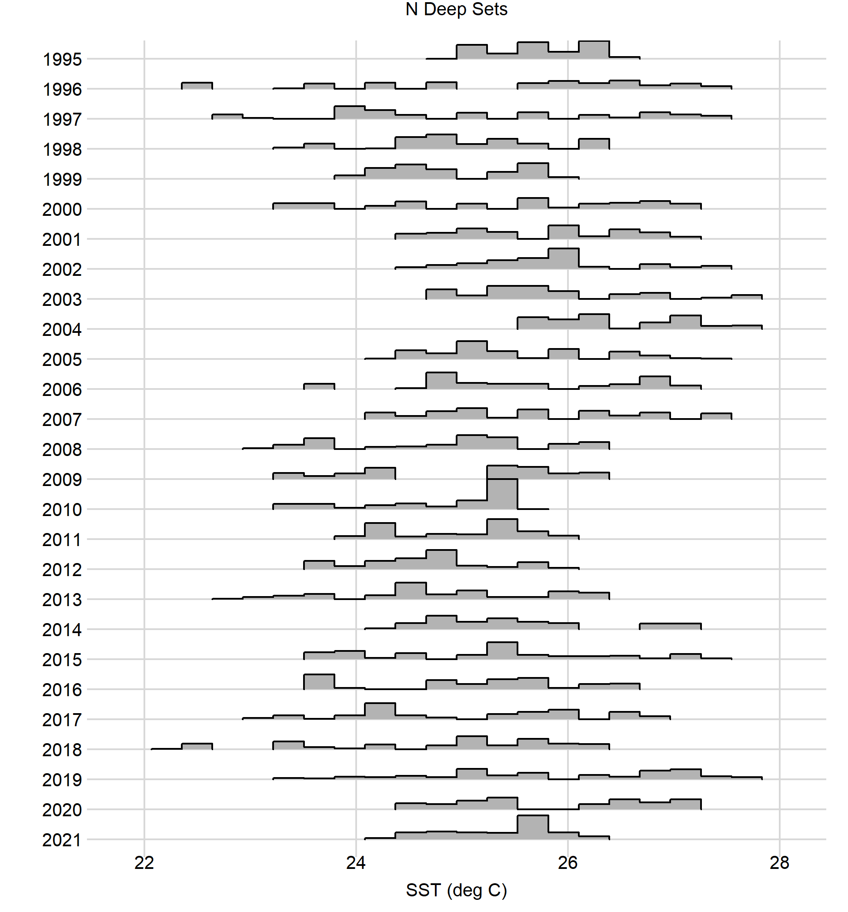
Deep-Set, Number of Sets By Year, All Covariates

Slide 29
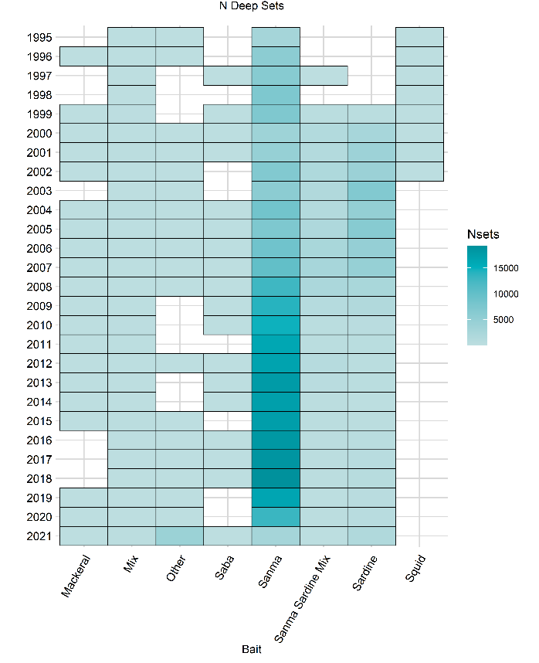
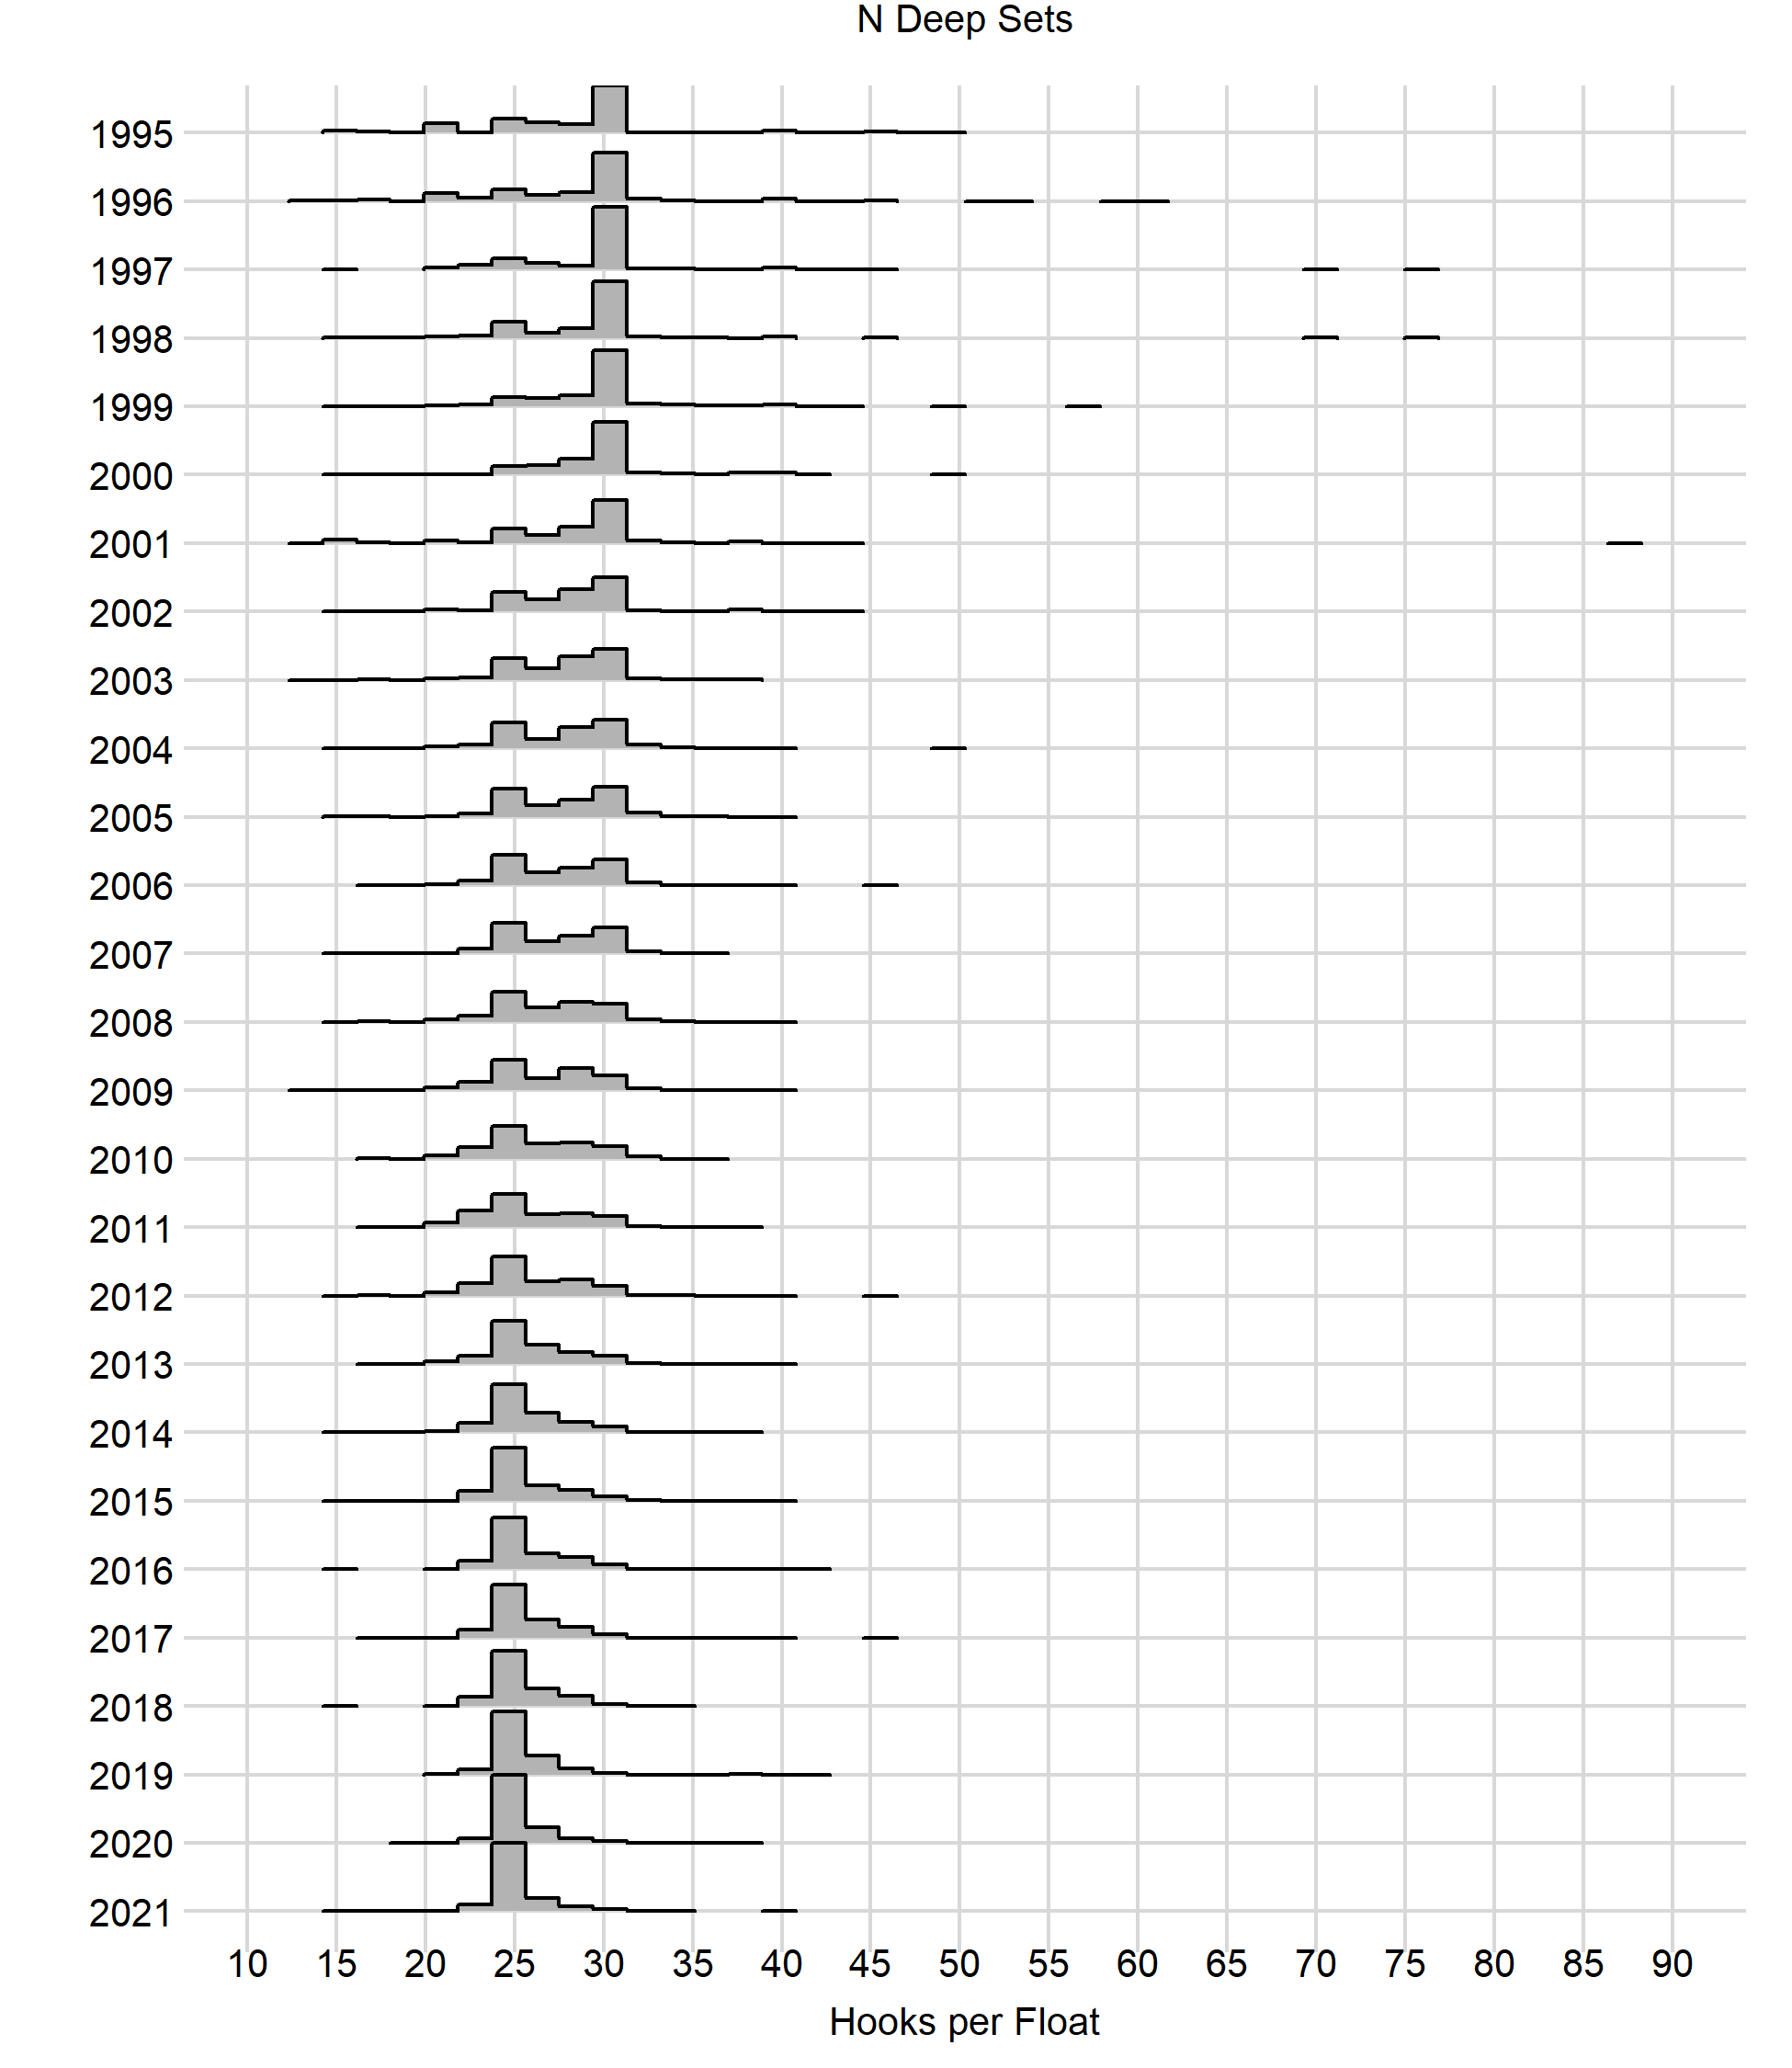
Deep-Set, Number of Sets By Year, All Covariates

Slide 30
Title

Slide 31
Title

Slide 32
Title

